Slide 1
JAG Applicants: 2018 JAG RFP Budget Attachment

Slide 2
What we will Cover…
Purpose of New Budget Attachment
Goal of New Attachment
Why the Change?
Using the New Attachment
RFP Budget Funding Thresholds
Requirements
New Budget Tables
Narrative

Slide 3
What we will Cover…
Where to Find Budget Attachment on BSCC Website
Contact Information

Slide 4
Purpose
Streamline the proposal process and simplify the budget section
Budget section was the source of the most issues during the technical review process last cycle
New Budget Attachment new to all applicants

Slide 5
RFP Funding Thresholds
Apply for amount that can be reasonable expended each year
Apply for same amount of funding for each year
Carrying over of unspent funds will require prior approval from BSCC

Slide 6
Requirements
All 3 budget years and PPA allocations tabs must be completed
Funds must be requested in whole dollars only
Budget line items are limited to those contained in Budget Attachment
If no money is requested for a particular line item, enter $0 in the budget table and “N/A” in the corresponding narrative

Slide 7
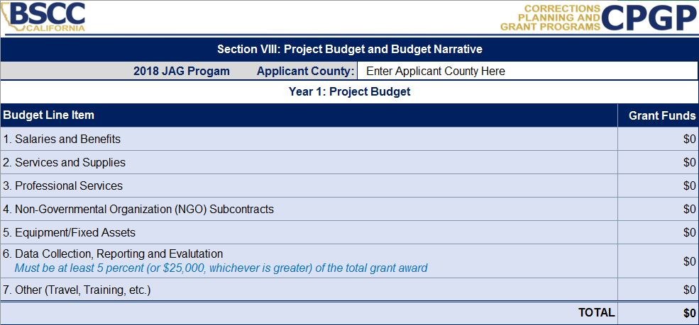
Using The Budget Tables
Project budget located at top of each budget year tab
Applicants must enter their county information
Dollars will automatically populate from line item budget tables on corresponding tab

Slide 8
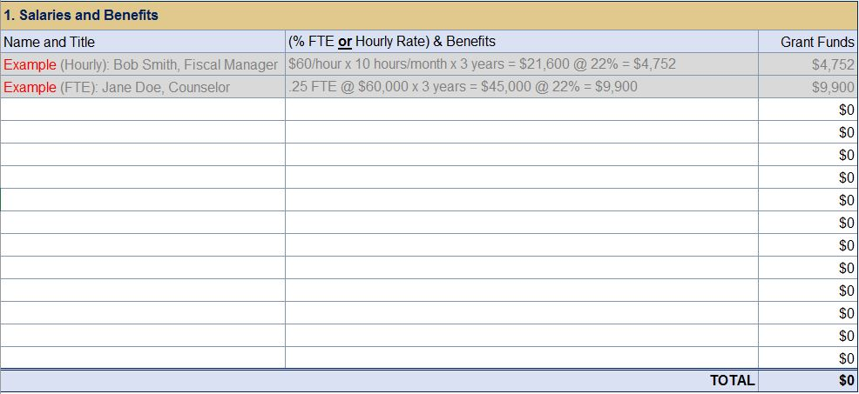
Using The Budget Tables
List the classification/title, percentage of time, salary or hourly rates, and the benefits (if applicable) for every staff person that will be funded from the grant
In the corresponding narrative, briefly describe their roles and responsibilities

Slide 9
Using The Budget Tables
Include grant funds associated with services and supplies purchased or donated by the applicant
Services and supplies purchased by partner agencies, subgrantees, or subcontractors should be included in the applicable budget section (e.g. Professional Services, NGO Contracts, etc.)

Slide 10
Using The Budget Tables
Include grant funds associated with public agency subcontracts or professional consultant subcontracts

Slide 11
Using The Budget Tables
Include grant funds associated with
Non-Governmental Organization (NGO)
subcontracts

Slide 12
Using The Budget Tables
Include grant funds associated with equipment and fixed assets purchased by the applicant
Equipment and fixed assets are nonexpendable property having a useful life of more than one year and acquisition costs of $5,000 or more per unit.
Equipment and fixed assets included in proposed budget does not guarantee approval, separate and prior approval from the BSCC will be required

Slide 13
Using The Budget Tables
Include grant funds associated with the project’s data collection, reporting and evaluation efforts and/or necessary enhancements to an existing data collection mechanism that will be used to capture grant-program required data as defined within the RFP

Slide 14
Using The Budget Tables
Include only training, travel, or other costs set aside for such purposes for use by the applicant agency
Similar costs allocated by partner agencies, subgrantees, or subcontractors should be included in the applicable budget section
Out-of-State travel using grant funding is permissible in rare cases. Prior and Separate BSCC approval will be required, even if proposed out-of-state travel is outlined proposed budget

Slide 15
Using The Budget Tables
Applicants must allocate JAG grant funds to one or more Program Purpose Areas (PPA) as described in the RFP
No JAG Funds may be expended outside of the JAG priority PPAs
The totals for each year in the Program Purpose Areas (PPA) Funding Table must equal the total grant funds requested for that year

Slide 16
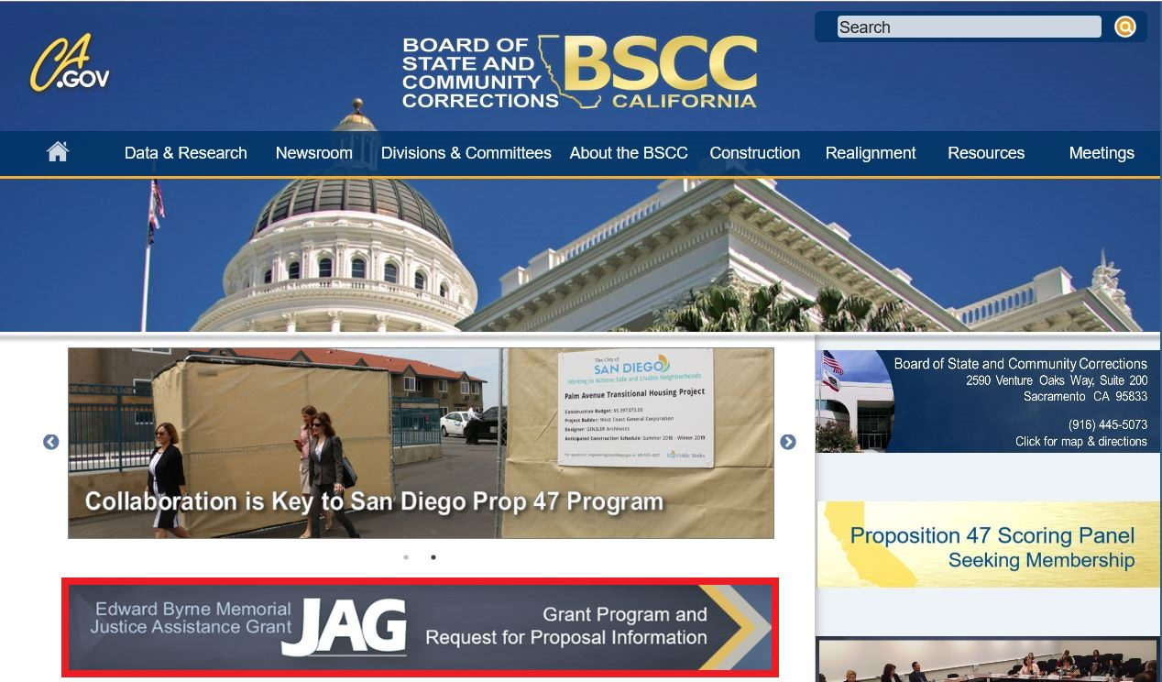
Where to Locate the New Budget Attachment
1. Go to BSCC Homepage
Click ‘JAG Grant Program and RFP Information’

Slide 17
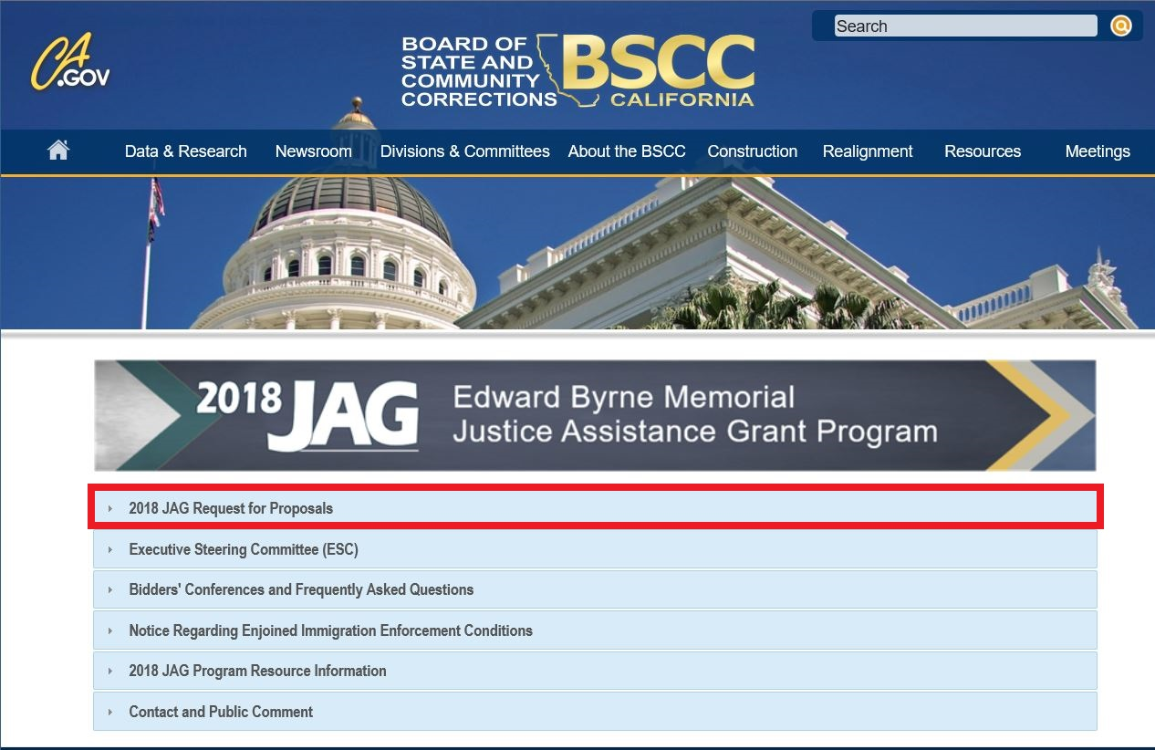
2. On 2018 JAG Page
Click ‘2018 JAG Request for Proposals’

Slide 18
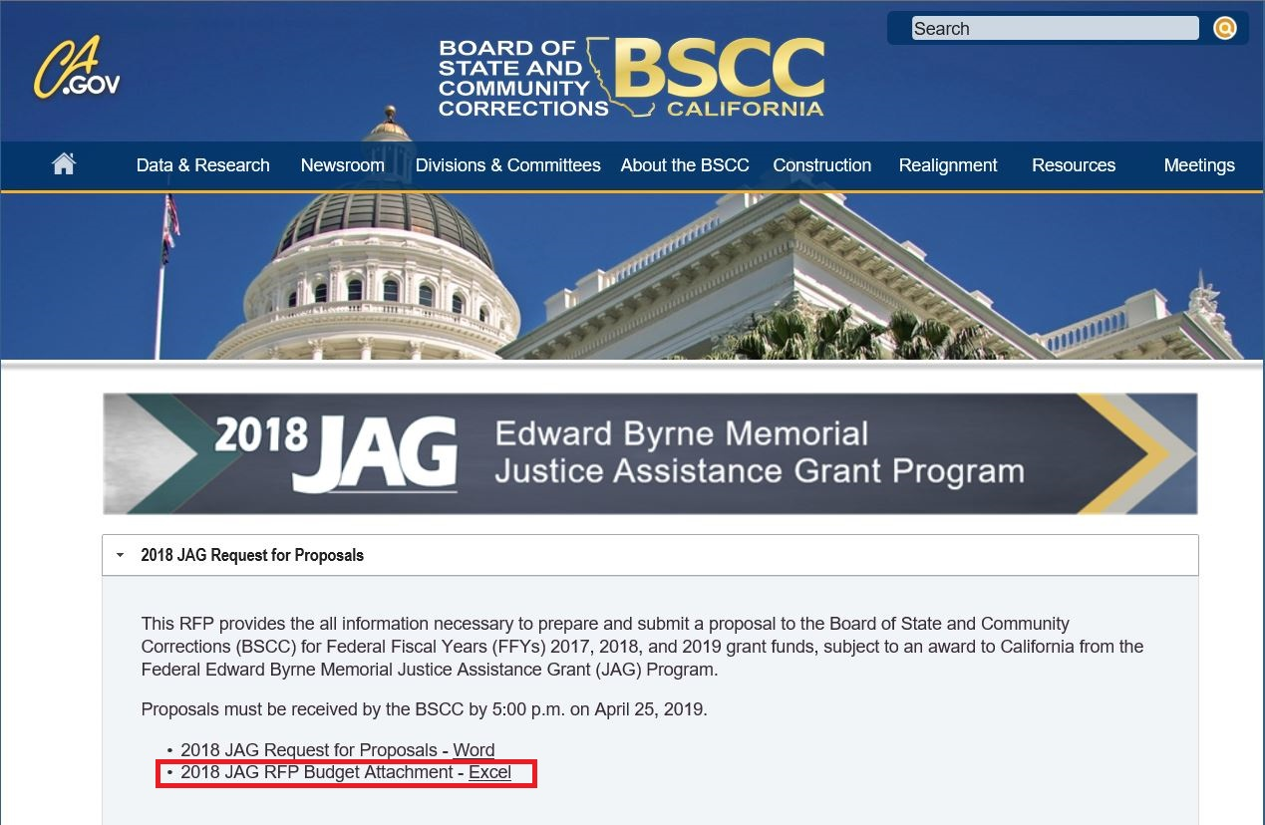
3. On 2018 JAG RFP Page
Click ‘Excel Link Next to 2018 JAG RFP Budget Attachment’

Slide 19
Contact Information
Cami Leeson, Analyst
Email: camina.leeson@bscc.ca.gov
Desk: (916) 322-8409
Greg Donkerbrook, Manager
Email: gregory.donkerbrook@bscc.ca.gov
Desk: (916) 322-1427
Daryle McDaniel, Field Representative
Email: daryl.mcdaniel@bscc.ca.gov
Desk: (916) 341-7392

Slide 20
QUESTIONS?

