Slide 1
Youth Reinvestment Grant - Tribal Youth Diversion Program
Bidder’s Conference
February 13, 2019

Slide 2
Agenda
Introductions
Grant Summary
Executive Steering Committee
Tribal Advisory Group
Request for Proposals Overview
Proposal Rating Process
Proposal Instructions
Key Dates
Questions

Slide 3
Tribal Youth Diversion
The Youth Reinvestment Grant was established during the budget development process last Summer
The Tribal Youth Diversion Program is one component within the larger Youth Reinvestment Grant
$1,119,000 for California Indian Tribes
Diversion programs for Indian children
Trauma-informed, community-based, and health-based interventions.

Slide 4
Tribal Youth Diversion
Federally recognized tribes may apply
No minimum and no maximum amount
Multiple applications allowed
Regional applications allowed
Preference points for proposals that include a consortium of tribes
Successful applicants will be funded for 3 years
July 1, 2019 – June 30, 2022

Slide 5
Tribal Youth Diversion
Target population is Indian children who are:
Under 18
Facing entry to the juvenile justice system or further involvement in the system
Experience:
High rates of juvenile arrests
High rates of suicide
High rates of alcohol & substance abuse
Low high school graduation rates

Slide 6
Tribal Youth Diversion
Diversion services must be trauma-informed, community-based, and health-based.
Trauma-informed diversion services provided under this grant must be sensitive to the issues of historical trauma.
Health-based approaches under this grant must be grounded in an overall wellness approach.

Slide 7
Executive Steering Committee
14-Members representing various disciplines and communities
Co-chairs: David Steinhart & Mark Varela
Full roster is included in the RFP – p. 38

Slide 8
Tribal Advisory Group
Five Tribal experts with broad experience
TAG Chair: Olin Jones
Full roster is in the RFP – p. 39
Develop the RFP, read & rate proposals, and develop award recommendations
Conflict of interest policies prohibit anyone who participated on the Tribal Advisory Group from receiving funds

Slide 9
RFP Overview (1)
Proposal Due Date:
March 29, 2019
One original signed proposal packet and
One electronic copy of the signed proposal packet-
YouthReinvestmentGrant@bscc.ca.gov
RFP, Pages 1-2

Slide 10
RFP Overview (2)
Eligible Applicants
Federally recognized Indian Tribes in California
Presumption of:
High rates of juvenile arrests
High rates of suicide
High rates of alcohol and substance abuse
Lower than average high school graduation rates
RFP, Page 2

Slide 11
RFP Overview (3)
Non-Governmental Organizations
Be duly organized, in existence, and in good standing at least six months…
Be registered with the California Secretary of State’s Office, if applicable
Have a valid business license, if required by the applicable local jurisdiction
Have any other licenses or certifications necessary to provide the services requested
Have an address
RFP, Page 3

Slide 12
RFP Overview (4)
Letters of Intent due:
February 20, 2019
Non-Binding
Tribes that submit a Letter of Intent and decide later not to apply will not be penalized
Applications will be accepted from eligible applicants who did not submit a Letter of Intent
RFP, Pages 3-4

Slide 13
RFP Overview (5)
Projects funded for 3 years beginning July 1, 2019
$1,119,000 available
No minimum or maximum
No match
Supplanting of funds not allowed
Flexibility to define diversion program
RFP, Page 4

Slide 14
RFP Overview (6)
Project Requirements
Tribal Project Review Plan
Identify goals and objectives
How will effectiveness be assessed?
Tribal Project Review Report
Was the overall project successful in meeting the goals?
RFP, Page 5

Slide 15
RFP Overview (7)
Other Requirements
Grant Agreement
Governing Board/Tribal Council Resolution
Audit Requirements
Grantee Orientation
Funding Disbursement
RFP, Pages 9-10

Slide 16
RFP Overview (7)
Other Requirements (cont’d)
Quarterly Progress Reports
Travel
Debarment, Fraud, Theft, Embezzlement
Comprehensive Monitoring Visits
Effective Programs & Data-Driven Approaches
RFP, Pages 9-13

Slide 17
Proposal Rating Process (1)
Technical Compliance Review
Disqualification
Notification
ESC Rating Process

Slide 18
Proposal Rating Process (2)
Rating Factors
RFP, Page 8 for table above
RFP, Pages 16-24 for actual rating factors
 | Rating Factors | Point Range | Percent of Total Value
1 | Program Need | 1-5 | 35%
2 | Project Description | 1-5 | 50%
3 | Data Collection | 1-5 | 10%
4 | Program Budget | 1-5 | 5%
 | Total |  | 100%

Slide 19
Proposal Rating Process (3)
Scoring Rubric
RFP, Page 9
Poor 1 | Fair 2 | Satisfactory 3 | Good 4 | Excellent 5
The response addresses the criteria in a very inadequate way. | The response addresses the criteria in a non-specific or unsatisfactory way. | The response addresses the criteria in an adequate way. | The response addresses the criteria in a substantial way. | The response addresses the criteria in an outstanding way.

Slide 20
Proposal Rating Process (4)
Preference Points
Regional applications consortium of tribes – 5 points
RFP, Page 8

Slide 21
Proposal Components
Proposal Abstract – 1 page
Proposal Narrative – 12 pages
Program Need
Program Description & Work Plan
Data Collection
Program Budget – Excel Document
Additional Documents – 5 pages or less
Letter(s) of Commitment
RFP, Pages 15-22

Slide 22
Program Budget
The Budget Table and Narrative are submitted in a separate document
The link is built into the RFP
RFP, Page 21 & Proposal Package

Slide 23
Budget Reminders
Funds must be requested in whole dollars only
Budget line items are limited to those contained in the Budget Attachment
If no money is requested for a particular line item, enter $0 in the budget table and “N/A” in the corresponding narrative

Slide 24
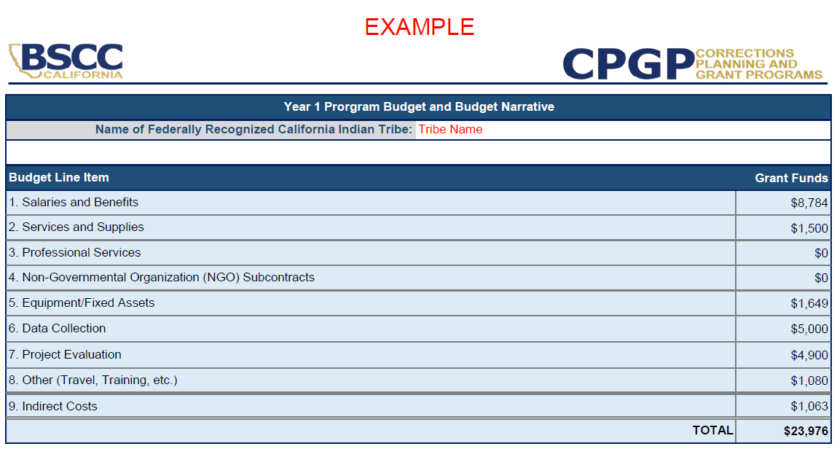
Using The Budget Tables
Tribal applicants must enter their name
Dollars will automatically populate from each budget line item table

Slide 25
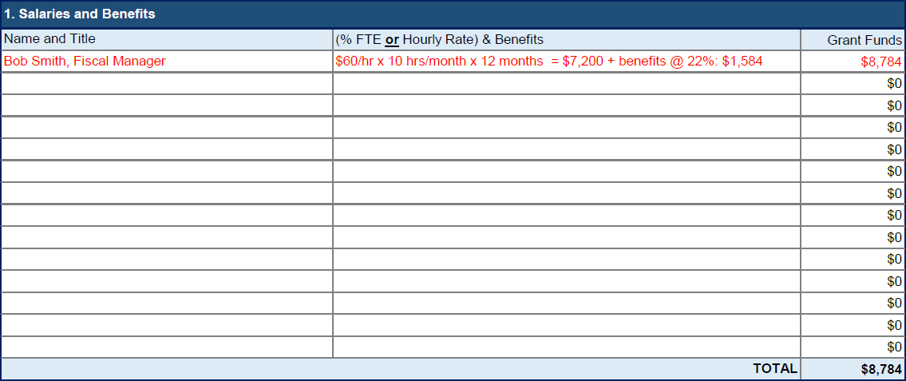
Using The Budget Tables
List the classification/title, percentage of time, salary or hourly rates, and the benefits (if applicable) for every staff person that will be funded from the grant
In the corresponding narrative, briefly describe their roles and responsibilities

Slide 26
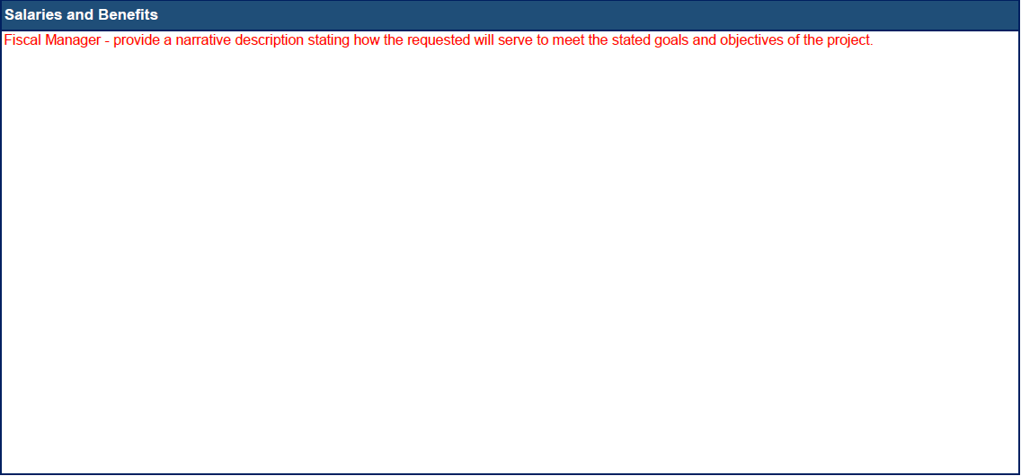
Using The Budget Tables
Provide a narrative description of the item(s), and how the item(s) and amounts requested will serve to meet the stated goals and objectives and planned activities of the project
Starting a new paragraph within a narrative cell, hold down the Alt key and then press Enter

Slide 27
Indirect Costs
Indirect Costs for Tribes are limited to:
10% of salaries and wages or
5% of project costs, excluding equipment
Budget Attachment, Instructions

Slide 28
Appendices
Appendix A: Eligible Tribes - Pg. 25
Appendix B: NGO Criteria - Pg. 31
Appendix C: Glossary - Pg. 33
Appendix D: Tribal Project Review Plan - Pg. 37
Appendix E: ESC & TAG Rosters - Pg. 38
Appendix F: Sample Agreement - Pg. 40

Slide 29
Appendices
Appendix G: Resolution - Pg. 58
Appendix H: Sample Quarterly Progress Report - Pg. 59
Appendix I: Compliance w/ Policies - Pg. 65
Appendix J: Sample Monitoring Tool - Pg. 66
Appendix K: Evidence-Based Resources - Pg. 76

Slide 30
Proposal Instructions
Proposal Checklist
Applicant Information Form
Proposal Narrative
Budget Section
Budget Table and Budget Narrative
RFP, Pages 78-end

Slide 31
Activity | Date
Release Request for Proposals | January 18, 2019
Letter of Intent to Apply Due to the BSCC | February 20, 2019
Proposals Due to the BSCC | March 29, 2019
Proposal Rating Process and Development of Funding Recommendations | April-May 2019
BSCC Board Considers Funding Recommendations | June 13, 2019
New Grants Begin (planned) | July 1, 2019
Mandatory New Grantee Orientation | August - Sept 2019 (Date to be determined)

Slide 33
Summary
Proposals due March 29, 2019
Submit questions to YouthReinvestmentGrant@bscc.ca.gov
BSCC will respond to questions through the proposal due date
Q&A will be posted on the BSCC website and updated as needed

