Slide 1
Senate Bill 81
Local Youthful offender Rehabilitative Facility Construction Funding Program:
Camp Sweeney replacement
Alameda County Probation Department
Notes:
Good morning Madame Chair, and members of the Board. I am pleased to be here with you this morning to present an update on Alameda County’s SB81 project.

Slide 2
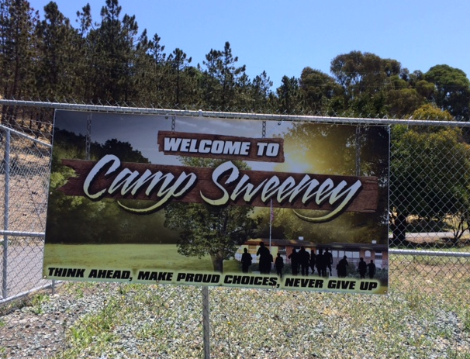
Alameda County Probation Department
SB81 Camp Sweeney replacement Project
Notes:
In 2007 Alameda County submitted an application to your Board for $35 million to replace the existing Camp Wilmont Sweeney.

Slide 3
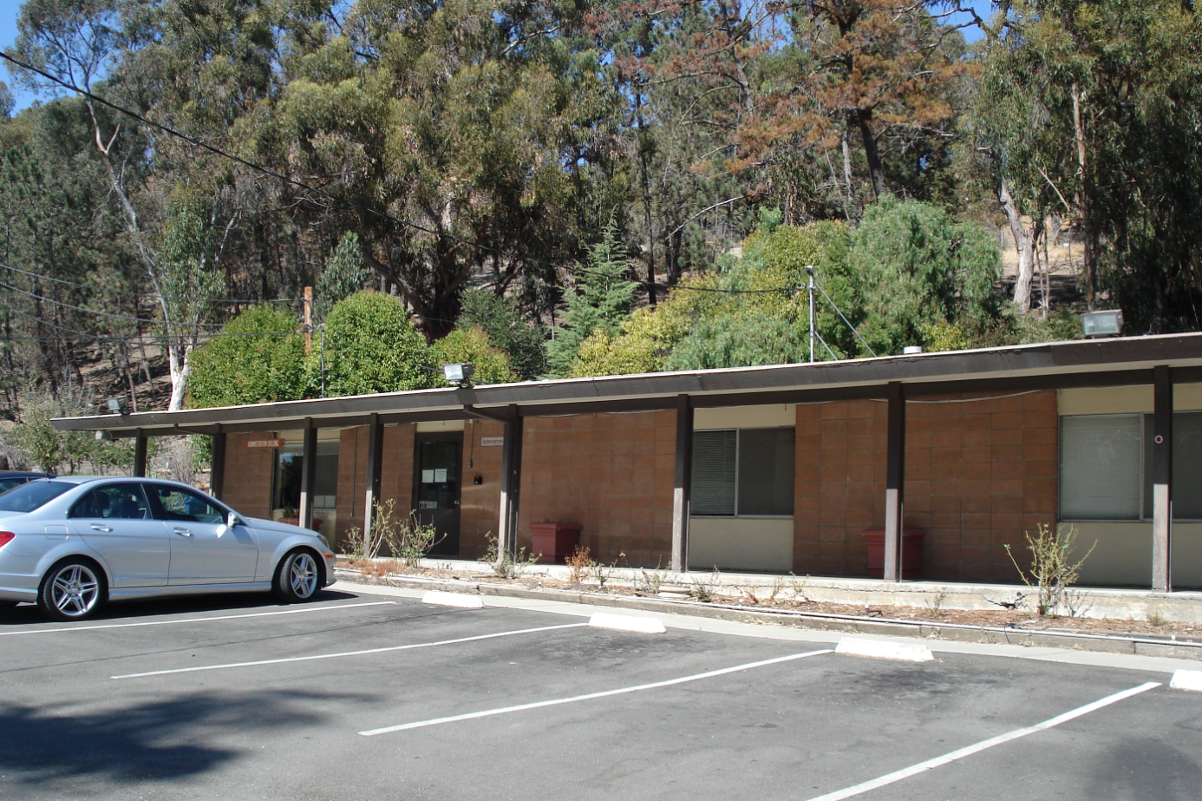
Alameda County Probation Department sb81 Camp Sweeney replacement Project
Notes:
Our current Camp is a minimum security facility for boys ages 15-18. Camp Sweeney was built in the 1950s and was formerly known as the Los Cerros Sr. Boys Ranch. At one point Alameda County operated 3 Camp & Ranch programs for girls and boys, serving as many as 300 youth with these local placement options.

Slide 4
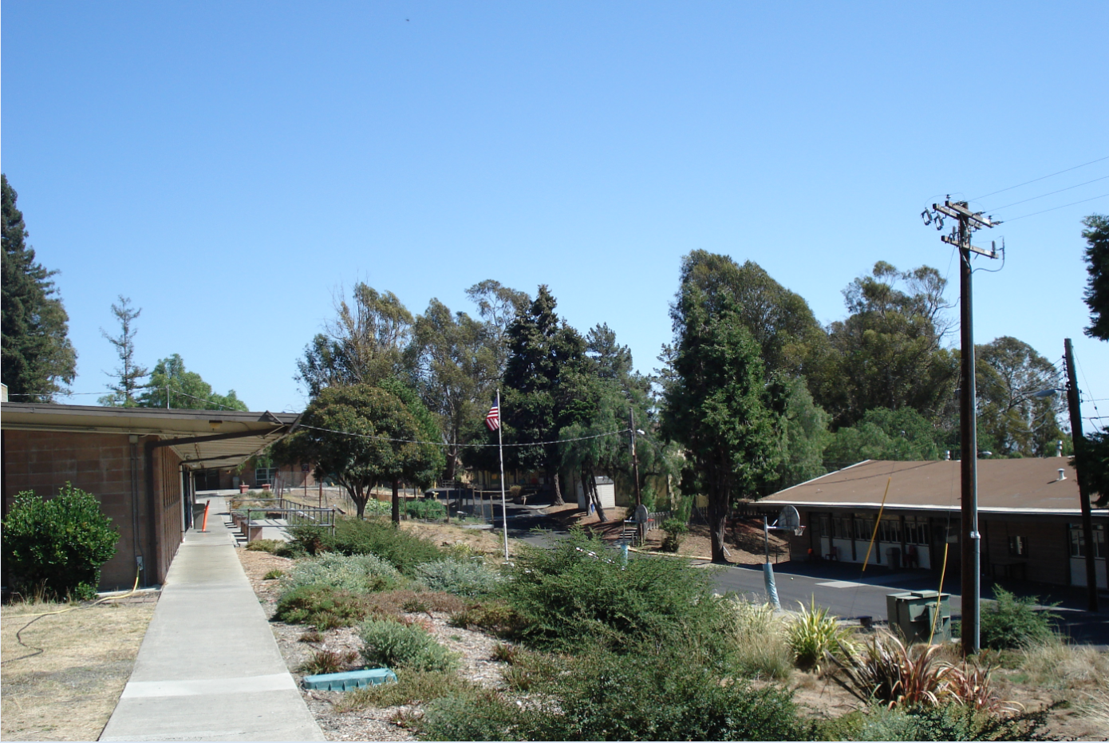
Alameda County Probation Department
SB81 Camp sweeney replacement project
Notes:
Camp Sweeney is the only remaining camp in Alameda County. Because it only serves males, the County relies heavily on group home and residential treatment facilities for our female youth. These options are primarily out of county and out of state, which hinders reunification efforts and aftercare planning for this fragile population. Our proposed replacement project is co-ed, allowing us to serve our female clients in a local facility, and better coordinate the young women’s transition back to the community.

Slide 5
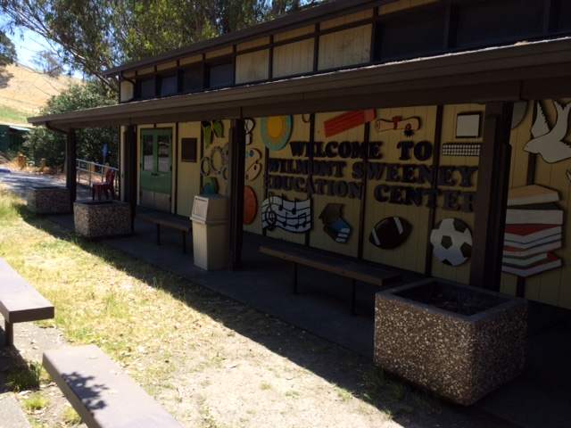
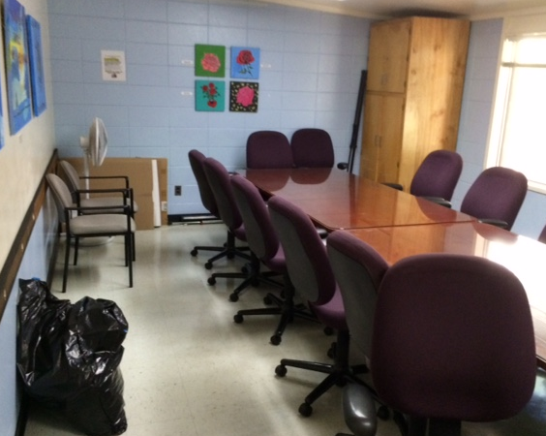
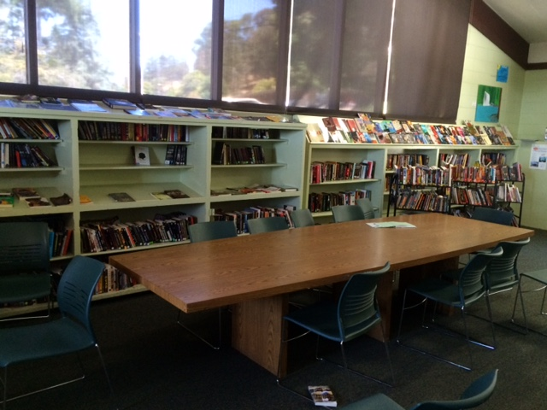
Alameda County Probation Department
Camp Sweeney Replacement
Inadequate facilities
  Limited academic and programming space
Notes:
Our current Camp has inadequate space to creatively and effectively address the needs of our youth. Programming space consists of a small library that is poorly ventilated, and one meeting room that can accommodate approximately 12 people comfortably.
With no air conditioning and limited electrical outlet capacity, summertime use of these spaces is extremely uncomfortable. Our space challenges frequently result in having to cancel and reschedule groups and other planned activities with our partners, service providers and youth.

Slide 6
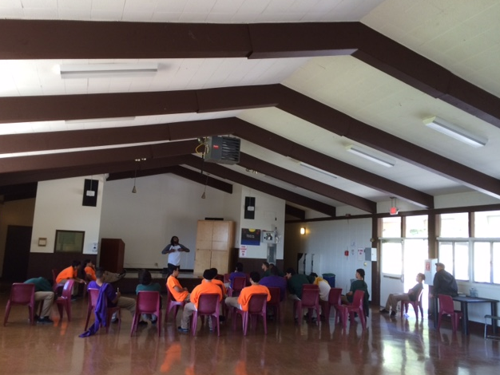
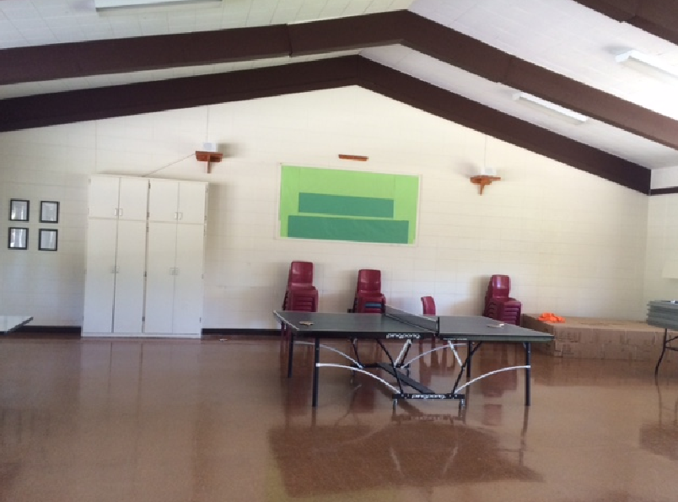
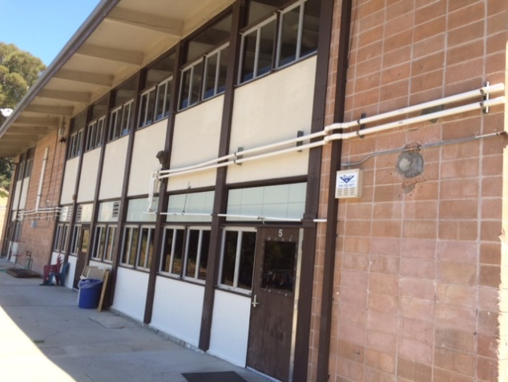
Alameda County Probation Department
Camp Sweeney Replacement
Inadequate facilities
  Limited recreation and vocational opportunities
Notes:
Indoor recreational space consists of an open multipurpose room that often gets co-opted for additional programming space.

Slide 7
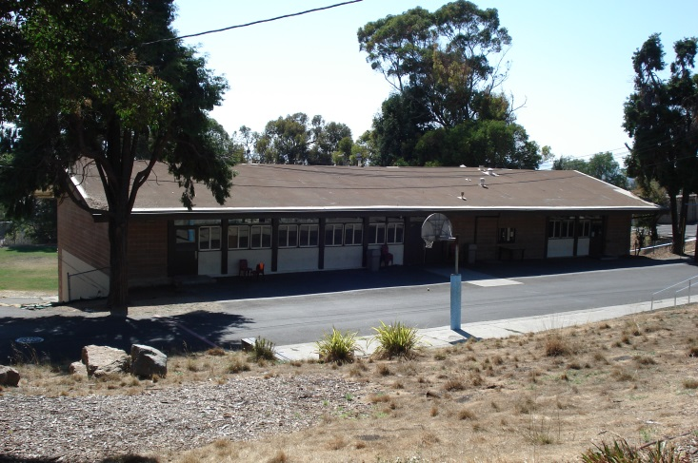
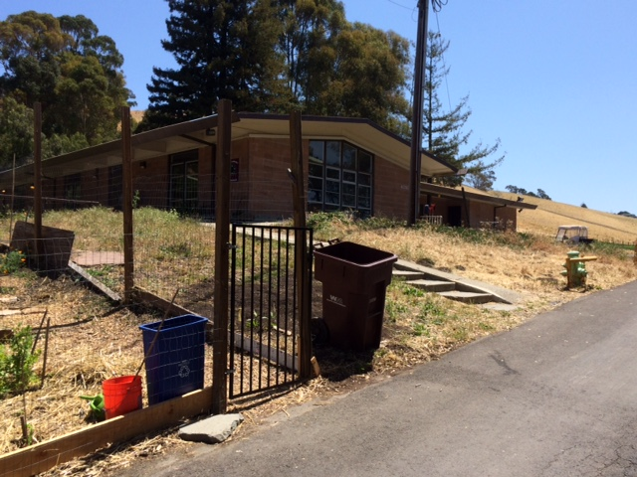
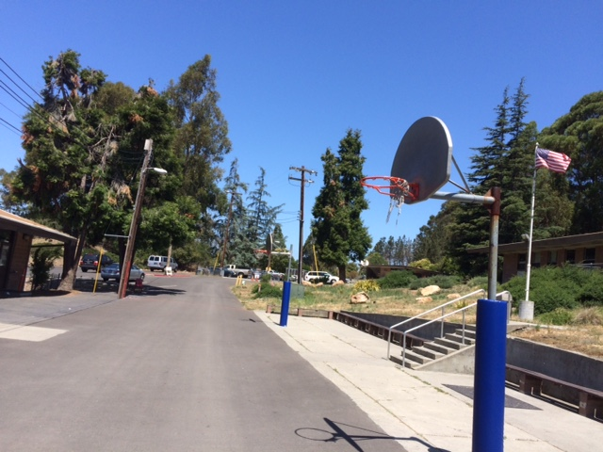
Alameda County Probation Department
Camp Sweeney Replacement
Inadequate facilities
  Limited recreation and vocational opportunities
Notes:
Outdoor recreational space consists of 2 basketball hoops and a yard with a baseball field. Despite this, Camp Sweeney remains active and highly successful in the intramural athletics league with regional camps and ranches.

Slide 8
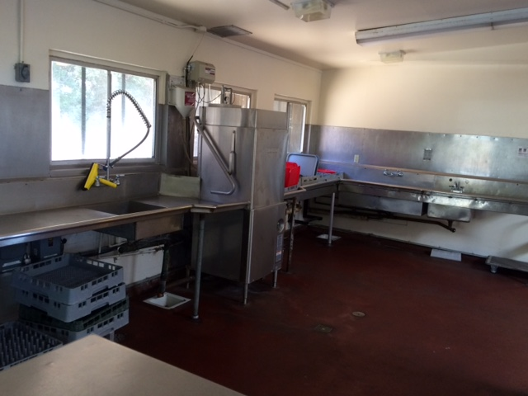
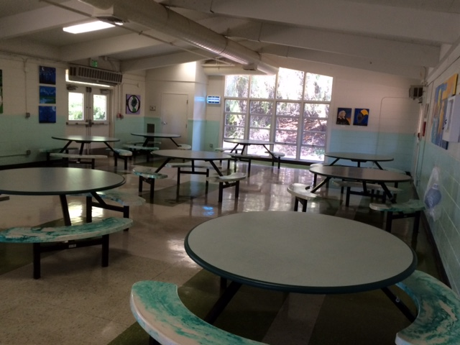
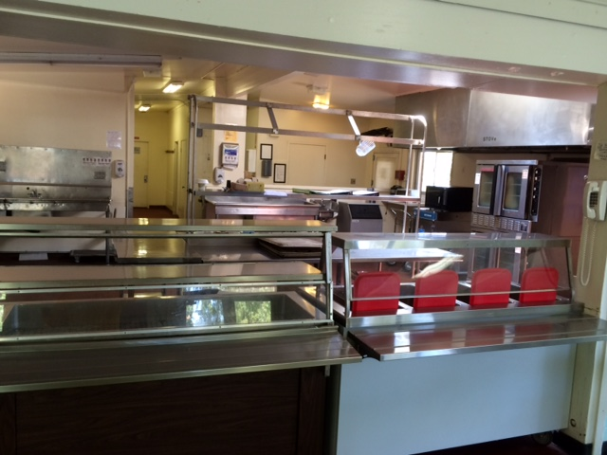
Alameda County Probation Department
Camp Sweeney replacement
Limited recreation and vocational opportunities
Notes:
The Camp kitchen is inoperable, requiring all meals to be prepared offsite and brought in daily. The proposed new camp features a fully operational teaching kitchen, with the ability to host a culinary arts vocational program.

Slide 9
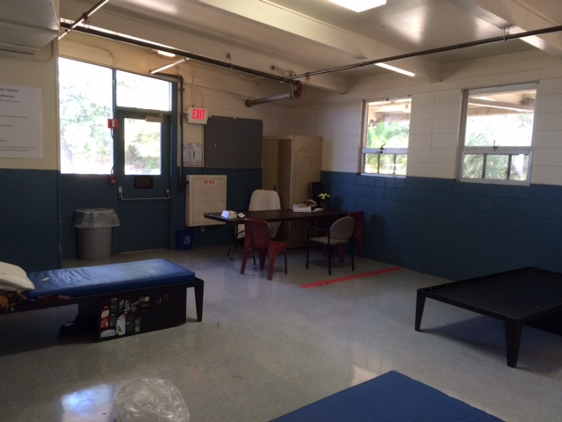
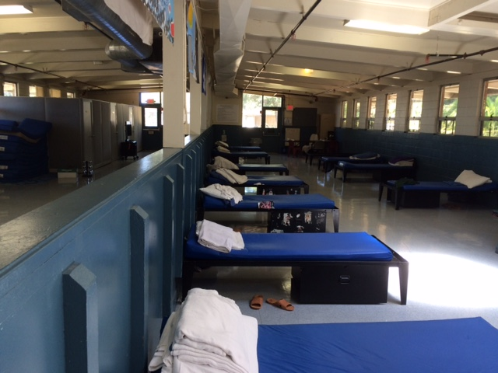
Alameda County Probation Department
Camp Sweeney replacement
Antiquated dormitories
  Limited housing and classification options
  Reduce the ability to provide rehabilitative opportunities to the youth
Notes:
Due to the open bay dormitory style setting, youth cannot be classified by risk level. If youth need to be separated, they are often taken to juvenile hall until the situation can be resolved. The replacement camp will have multiple buildings containing smaller dorms, as well as a secure unit for youth returning from, or in lieu of, DJJ.

Slide 10
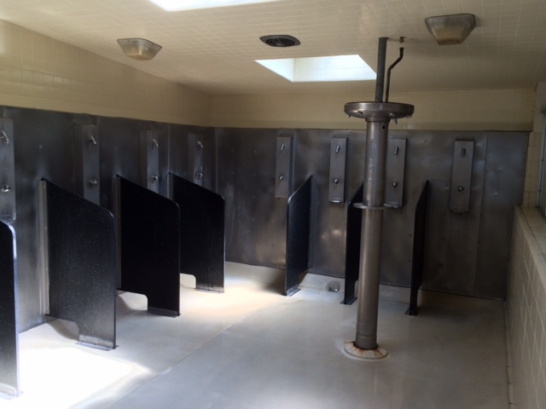
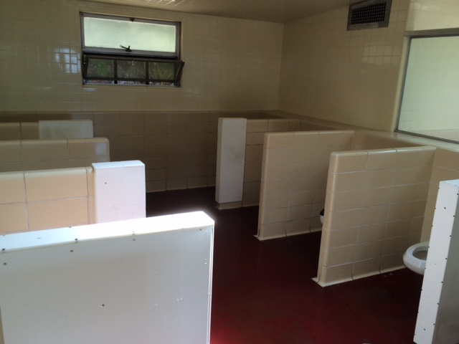
Alameda County Probation Department
Camp Sweeney replacement
Antiquated dormitories
  Open bay showers and toilets
  Concerns with PREA compliance
Notes:
Given the age of the facility, considerable work is required to create a less institutional environment and to ensure compliance with the Prison Rape Elimination Act.

Slide 11
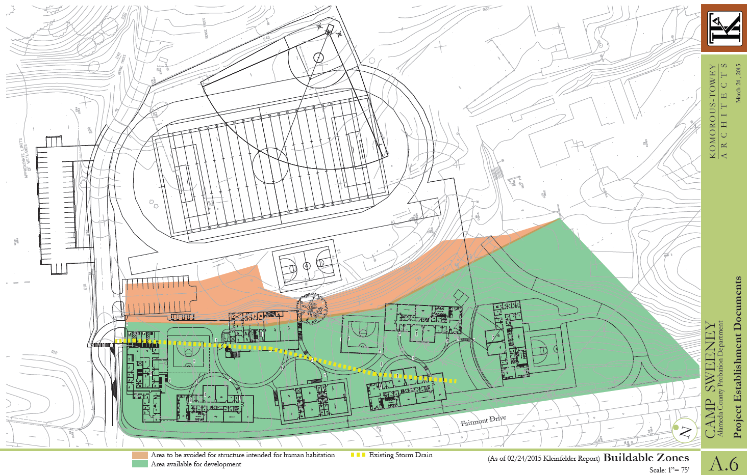
Alameda County Probation Department
Site Overview
Notes:
Significant seismic challenges were discovered in our preliminary environmental site inspections. The green area is considered “buildable” space, and as you can see, the Hayward fault line runs through this site. In addition to compromised programming and quality of life issues, structurally, there are obvious concerns about the safety of the youth and staff in the existing Camp. The relocated space contains the same square footage, with none of the safety concerns.

Slide 12
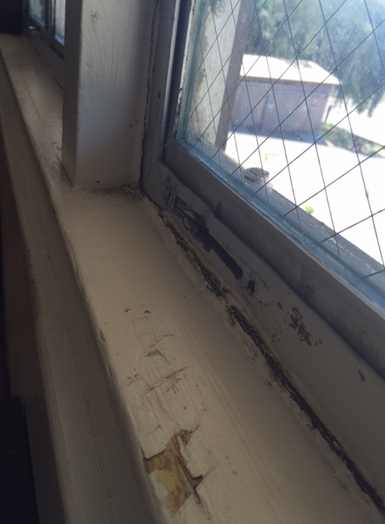
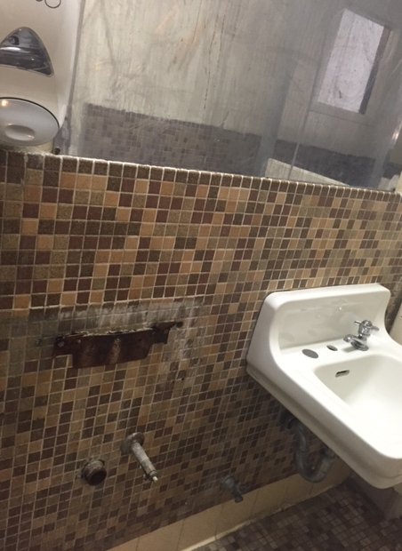
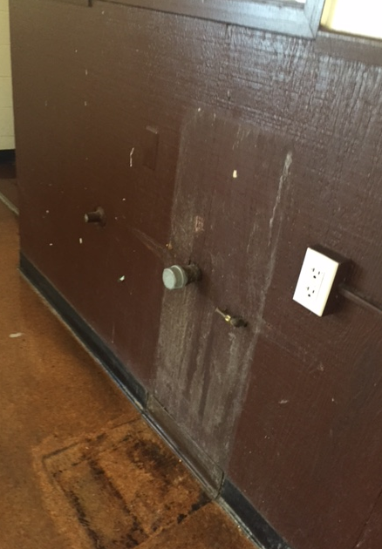
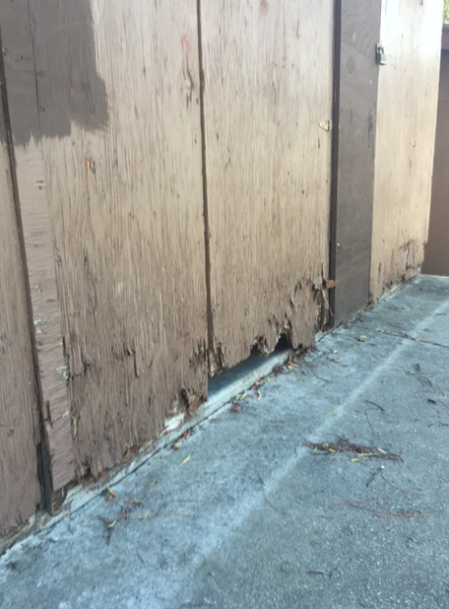
Alameda County Probation Department
Camp Sweeney replacement
Quality of life concerns
  Poorly ventilated
  Issues with moisture, mold and pest control
Notes:
We are committed to replacing this aged institution with a facility that is reflective of the value we place on the youth we serve; one that is modern, safe, comfortable and inspires learning, transformation, creativity and hope.

Slide 13
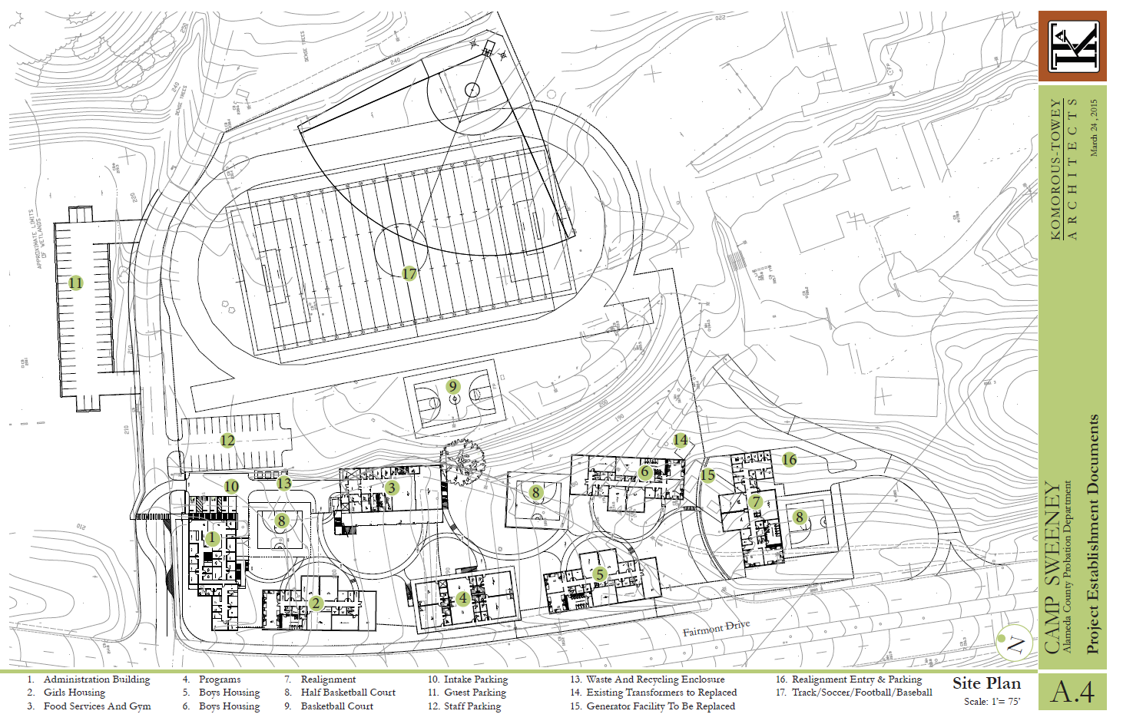
Alameda County Probation Department
Site Overview
Notes:
We are requesting your Board’s approval to reduce the scope of this project from 150 beds to 120 beds. With the compromised original site and our declining population, this relocation and redesign will better meet our needs. 120 beds will allow us to provide robust rehabilitative and reentry opportunities to our youth, in a local, safe and therapeutic atmosphere. The proposed project scope features enhanced recreational and vocational opportunities, and state of the art academic facilities. While this is an overall increase in our locally served client population, the 120 beds includes 32 beds for females, and a 24 bed living unit designated for the realigned juvenile population.
This will provide currently unavailable, high quality local options for a significantly challenged clientele. We remain committed to our ongoing efforts to keep youth in the least restrictive environment suitable, as evidenced by our steadily and intentional declining population in our juvenile hall. With the new Camp, we will better serve the youth who most need our local services, treatment and support.
Thank you for your attention, and we are prepared to answer any questions.

