Slide 1
Board of State and Community Corrections
Proposition 47 Grant Program Executive Steering Committee Meeting
November 17, 2021

Slide 2
PROP 47 PROGRAM
Agenda
Welcome back
Review of Day 1 RFP development
Public Comment
Continue review of Issue Paper & development of RFP
Data & evaluation, rating proposals
Final review of Day 1 & Day 2 RFP development
Public comment
Discuss ESC future meetings
Adjourn meeting

Slide 3
PROP 47 PROGRAM
Review of day 1 developments
Public Comment

Slide 4
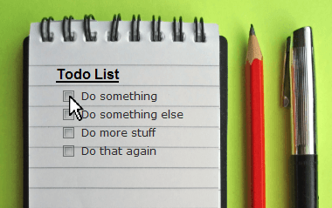
PROP 47 PROGRAM
Review binder material
Continue review of Issue Paper
Data & Evaluation

Slide 5
PROP 47 PROGRAM
Review Day 1 & 2 RFP development
Cohort 3 RFP Notes

Slide 6
PROP 47 PROGRAM
Public Comment

Slide 7
PROP 47 PROGRAM
Next ESC meeting
Rater training - May 24, 2022
ESC review of proposals
May 25 – June 24, 2022

Slide 8
PROP 47 PROGRAM
ADJOURN MEETING

