Slide 1
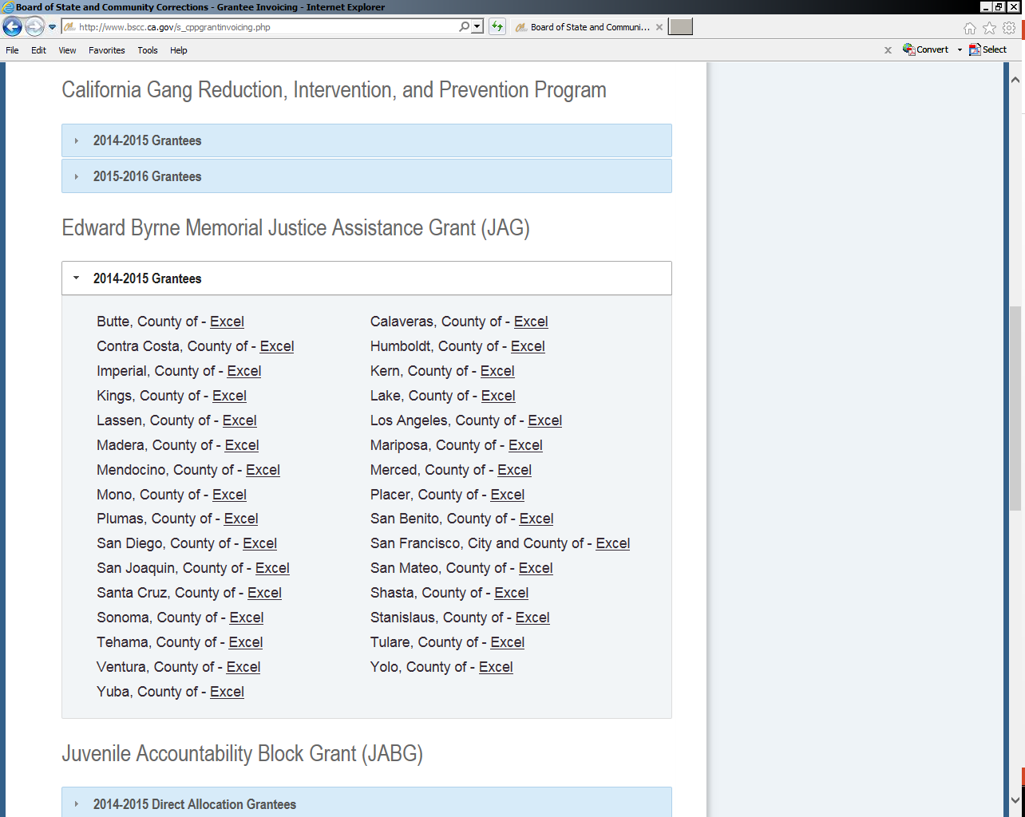
The current folders listed on the BSCC website need to be replaced with the 2016 JAG invoices and updated as the 2016 Grantees. Please see link below.
In addition, both the 2016_JAG-DOJ1 & 2016_JAG-DOJ2 will need to be added to the BSCC website.
JAG 2016 P:\(H)-PROGRAMS-CPP\JAG\Invoices\2015-16\Ready for Web
Thank you!

