Slide 1
Adult Reentry Grant Program
Bidders’
Conference
February 6, 2019

Slide 2
ARG PROGRAM
Agenda
Welcome and Introductions
Overview of the Adult Reentry Grant Program
Overview of the BSCC and ESC Processes
Request for Proposals (RFP) Overview
Rating Process
Components of the RFP
Proposal Instructions

Slide 3
ARG Program
Adult Adult Reentry Grant Program
$50,000,000
Competitive grants to community-based organizations (CBOs)
Support for people formerly incarcerated in state prison

Slide 4
ARG Program
Funds are to be allocated as follows:
$25,000,000 for rental assistance;
$15,000,000 for the rehabilitation of existing property or buildings to house people released from state prison;
$9,350,000 to support the “warm hand-off” and reentry of people transitioning from state prison;
$150,000 to support the Berkeley Underground Scholars Initiative; and
$500,000 to the BSCC for administrative costs and to report on program outcomes

Slide 5
ARG Program
Project Update
This project brings policy, legal, and programmatic requirements/responsibilities related to adherence to state housing laws and regulations that are new to the BSCC
One RFP component, rehabilitation of existing property/buildings, needs further evaluation of these requirements to determine how best to respond to these potential responsibilities and compliance issues
To keep the rest of the project moving forward, the ESC completed their work on the development of an RFP for the other two components of the program, which are contained in two sub-applications

Slide 6
ARG Program
Applicants May Submit a Sub-proposal for
One or Both of the Following:

Slide 7
ARG PROGRAM
About the BSCC…
Reports directly to the Governor's Office
Organized under a Governor appointed Board made up of 13 members
Responsibilities include providing statewide leadership, coordination, and technical assistance to promote effective state and local efforts and partnerships in California’s adult and juvenile criminal justice system, including providing technical assistance and coordination to local governments related to public safety

Slide 8
ARG PROGRAM
The 5 Divisions of the BSCC
Facilities Standards and Operations (FSO)
Inspections, Regulations, Compliance Monitoring
Standards and Training for Corrections (STC)
Selection, Training and Standards
Corrections Planning and Grant Programs (CPGP)
Criminal and Juvenile Justice Grant Programs
County Facilities Construction (CFC)
Admin. of construction financing for facilities
Administration, Research and Program Support
Admin., data collection, research, IT support

Slide 9
ARG PROGRAM
Executive Steering Committee
(ESC)
BSCC uses ESCs to inform decision-making related to the Board’s programs
Subject matter experts and stakeholders representing public and private sectors
Overview of the ESC’s role in the ARG Grant

Slide 10
ARG PROGRAM
Role of the ESC
Use local/state expertise to:
Determine what the project should include to support the overall goal
Determine what applicants must do to compete effectively for the grant funds
Identify the factors that will be used to evaluate the proposals
Rate the proposals
Make funding recommendations to the Board

Slide 11
ARG PROGRAM
The Goal of the ESC is to:
Select the most meritorious proposals
Use a process that is transparent and fair to all applicants
Use accepted measurement principles
Ensure all applicants feel they have been treated fairly
Use a process that will withstand challenges

Slide 12
ARG PROGRAM
12 Basic Steps Of the ESC
ESC meets to develop the RFP
RFP is released to the field
Applicant proposals submitted to BSCC
Proposals reviewed for technical compliance
ESC is given rater training
Proposals are distributed to ESC for reading

Slide 13
ARG PROGRAM
12 Basic Steps of the ESC (Cont.)
ESC reads proposals and submits initial rating to BSCC
ESC meets to view and discuss ratings
Rating changes are made if warranted
Proposal rankings are viewed and discussed
Project funding recommendations are made
Recommendations go to the BSCC Board for approval

Slide 14
ARG Program
Dissecting the RFP
Mark Sections with Flags
Grant Information pg.1
Rental Assistance Application and Instructions pg.16
Warm Hand-Off Application and Instructions pg. 27
Appendices
SB 840 page pg.39
SB 1380 page pg.40
Resource and Glossary pg. 46
Sample Agreement pg. 49
Certification of Compliance pg. 69
Monitoring Sample pg. 70
Project Work Plan pg.79
ESC Roster pg.80

Slide 15
ARG PROGRAM
RFP Overview (pg. 2)
Notice of Intent to Apply: Feb. 8, 2019
Non-Binding
Public agency applicants that submit a Notice of Intent to Apply and decide later not to apply will not be penalized
AdultReentryGrant@bscc.ca.gov

Slide 16
ARG Program
RFP Overview (pg. 3)
Proposal Due Date: March 25, 2019
One original signed hard copy of proposal AND one electronic copy of the signed proposal is required
One or the other must be received by March 25, 2019 5:00 p.m. and applicant will not be automatically disqualified as long as the other copy is received in a reasonable amount of time (2-3 days)

Slide 17
ARG PROGRAM
RFP Overview
Description of the Grant (pg.4)
Support to individuals formerly incarcerated in state prison
Grant Period
August 1, 2019 to February 28, 2023
Three-years and 7 months = grant period
Eligibility
Community-Based Organizations (CBOs)
501(c)(3) status (i.e., nonprofit)
Limit - One sub-proposal for Rental Services and one sub-proposal for Warm Hand-Off Reentry
NGO requirements

Slide 18
ARG PROGRAM
RFP Overview
More About Non-Governmental Organizations
Be duly organized, in existence, and in good standing at least six months…
Be registered with the California Secretary of State’s Office, if applicable
Have a valid business license, if required by the applicable local jurisdiction
Have a physical address

Slide 19
Target Population (pg. 5)
People who have been formerly sentenced to and released from state prison
Includes:
People leaving state prison that are on parole
Those monitored by the probation departments of each county through Post-Release Community Supervision (PRCS)(P).
Does not include:
DJJ
1170(h)
ARG PROGRAM

Slide 20
ARG Program
Housing First (pg. 5-6)
The Adult Reentry Grant is subject to Welfare and Institutions Code § 8255-8257
Requires a state administering agency that provides housing or housing-related services to people experiencing homelessness or at risk of homelessness to adopt the core components of Housing First
Authorizing legislation-Senate Bill 1380 Sept. 20 2016

Slide 21
ARG Program
What Is Housing First ?
Approach to service delivery and evidence-based model
Uses housing as a tool, rather than a reward for recovery
Provides or connects homeless people to permanent housing as quickly as possible
Offers services as needed and requested on a voluntary basis
Housing not contingent on participation in services or a lack of criminal history or abstinence
Adult Reentry Grantees will be expected to implement a Housing First model to the extent that it applies to the specific services they offer

Slide 22
ARG Program
Housing First
Core Components- RFP- pg. 6
Senate Bill 1380- Appendix B pg. 40
Resource List and Glossary Terms- Appendix C pg.46

Slide 23
ARG Program
ARG offers two (2) sub-applications and applicants may submit a separate sub-proposal for one or both of the following:
Eligible activities and funding for each of the sub-applications will be identified separately

Slide 24
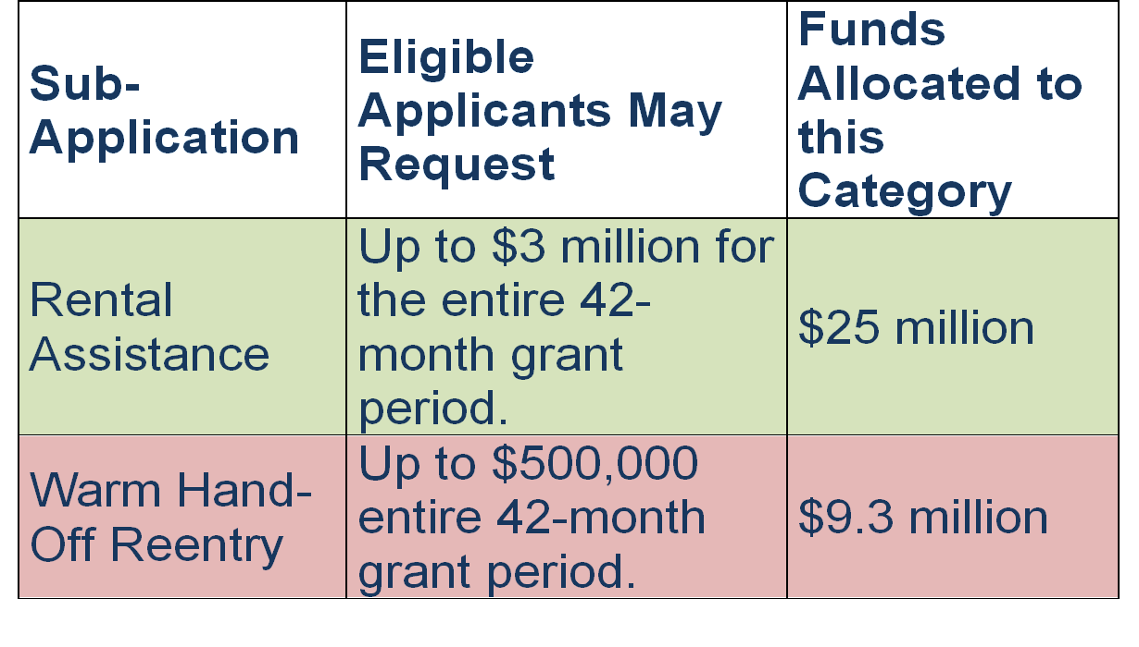
ARG PROGRAM
Funding pg. 8
df

Slide 25
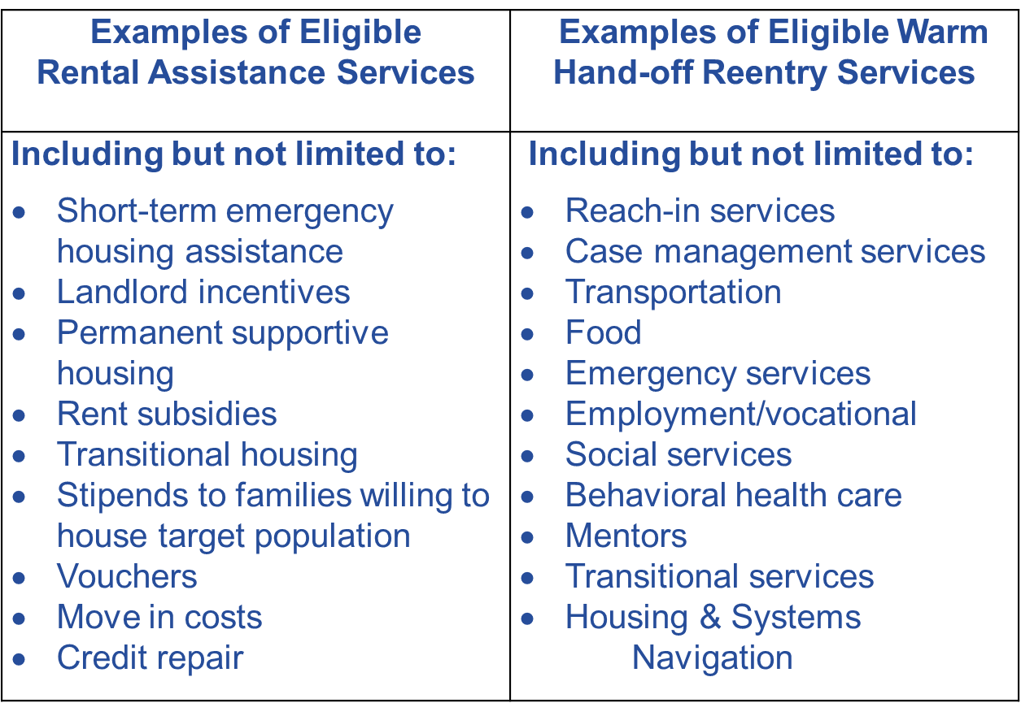
ARG Program Services pgs. 7-8

Slide 26
ARG PROGRAM
Evidence-Based Practices
pgs. 8-9
Applicants are strongly encouraged to:
Provide services and use practices that are evidence-based and appropriate for target population
Identify the evidence that shows that the practice is effective
Discuss the population for which this practice has been shown to be effective

Slide 27
ARG PROGRAM
Evidence-Based
Causal Evidence
Generally obtained through one or more outcome evaluations
Documents a relationship between an activity or intervention and its intended outcome
Measures the direction and size of a change
Measures the extent to which a change may be attributed to the activity or intervention
Depends on the use of scientific methods to rule out, alternative explanations for the documented change
The strength of causal evidence will influence the degree to which a program or practice is evidence-based

Slide 28
ARG PROGRAM
Evidence-Based Practices
The BSCC Point of View…
On a basic level it includes the following elements:
Evidence that the intervention is likely to work,
i.e., produce a desired benefit
Evidence that the intervention is being carried out as intended; and
Evidence that allows an evaluation of whether the intervention worked

Slide 29
ARG PROGRAM
Evidence-Based Practice
Involves using research-based interventions that produce reductions in recidivism through the use of the following four principles of effective intervention:
Risk Principle – focuses attention on the crucial question of WHO is being served and calls for targeting the higher risk offenders
Need Principle – requires that priority be given to addressing criminogenic risk/need factors with a clear focus on WHAT programs are delivered

Slide 30
ARG PROGRAM
Responsivity Principle – conveys the importance of using behavioral treatment approaches to achieve the best possible outcomes and requires attention to the questions of HOW programs are delivered
Fidelity Principle – draws attention to HOW WELL programs are delivered and reiterates the necessity that programs be implemented as designed

Slide 31
ARG PROGRAM
Grant Requirements pg. 9-10
Grant Agreement
Governing Board Resolution
Provide evidence of signing authority (e.g., articles of incorporation, bylaws, or board resolution conferring authority to the signatory)
No Match Requirement
Supplanting
Audit

Slide 32
ARG PROGRAM
Grant Requirements pg.10
Funding Disbursement
1/3 awarded funds within 45 days
Deposit in separate account and not comingled
Interest
When grantee has expended 80% of $ and met requirements an additional 1/3 of awarded funds will be disbursed
Final 1/3 of funds will be returned if unspent

Slide 33
ARG PROGRAM
Grant Requirements Cont. pgs. 10-11
t
Invoicing-Quarterly
Progress Reports-Quarterly
Grantee Orientation Meeting
Travel
Gov. agencies
CBOs/ NGOs
Out-of-State Travel

Slide 34
ARG PROGRAM
Grant Requirements Cont.
Pgs. 11-12
Debarment, fraud, theft, embezzlement (Appendix E pg. 69)
Site Visits - Monitoring
Periodic monitoring by BSCC for program and fiscal and to provide technical assistance and training
(Appendix F pg.70

Slide 35
ARG PROGRAM
RFP Process pg.12-13 t
Confirmation of receipt
Technical Compliance Review
Disqualification
Notification
Scoring Panel Rating Process

Slide 36
Summary of Key Dates pg. 13
ACTIVITY | TENTATIVE TIMELINE
Release Request for Proposals (RFP) Solicitation | January 18, 2019
Bidders’ Conference | February 6, 2019
Grant Proposal/Application Due to (COB) | March 25, 2019
Technical Compliance Review (TCR) | March 26 TBD
Non-substantive Changes Due | Following TCR (est. 3-day window April 1-4)
Rating Process and Development of Funding Recommendations | April – June 2019
BSCC Board Meeting for Funding Approval | July 11, 2019
Grants Begin/Contracts Commence | August 1, 2019
Mandatory Grantee Orientation | TBD Aug- Sept.

Slide 37
ARG PROGRAM
Adult Reentry Grant Rating Factors pg.14
 | Rating Factors | Point Range | Percent of Total Value | Weighted RF Score
1 | Program Need | 1-5 | 30% | 45
2 | Program Description | 1-5 | 60% | 90
3 | Budget Section | 1-5 | 10% | 15
Maximum Possible Proposal Score: |  |  | 100% | 150

Slide 38
ARG PROGRAM
Proposal Rating Process pg. 14
t
5 point Scoring Rubric

Slide 39
ARG PROGRAM
Sub-Proposal Instructions
Cover Sheet pg.17
Completed with Name of Sub-Applicant and Date of Submission
Sub- Proposal Checklist pg.18
Completed and included with RFP Package
Must be signed in blue ink by authorized individual
Sub-Applicant Information Form pg. 20
Completed information in each section
Must be signed in blue ink by authorized individual

Slide 40
ARG PROGRAM
Proposal Instructions Cont.
Sub-Proposal Narrative Sections
Address each of the two (2)required sections below
Project Need
Project Description

Slide 41
ARG PROGRAM
Proposal Instructions
Narrative Sections
Each section must be titled according to its section header as provided
Within each section, address the information requested in the rating factors in a cohesive, comprehensive narrative format
Do not include website links
Number the pages
Narrative for each sub-proposal cannot exceed 9 pages in length

Slide 42
ARG PROGRAM
Proposal Instructions
Narrative Sections
Unless otherwise noted, each narrative section must be formatted in:
Ariel 12-Point Font
1.5-line spacing
One (1) inch margins on all four sides
9 Page limit for the narrative section

Slide 43
ARG PROGRAM
Proposal Instructions
Sub-Proposal Budget
Address the Budget by completing the:
Amended Budget Table and that includes a Budget Narrative
The Amended Budget Table is accessed through a link to an excel document contained in Amended RFP ( pg. 25)
The Budget section does not count toward the 9 pages of the narrative section

Slide 44
ARG PROGRAM
Rating Factors
Pg. 23-25
The ESC will evaluate the merits of each proposal received in terms of how well each applicant responds to the rating factors found in the:
Project Need Narrative Section
Program Description Narrative Section
Budget Tables
Respond to the instructions

Slide 45
ARG PROGRAM Rating Factors Pg. 23
Section 1. Rental Assistance Program Need (Percent of Total Value: 30%)
1.1 | Describe the community(ies) need to be addressed by the Rental Assistance Program.
1.2 | Describe the target population to be served by the Rental Assistance Program, including: Relationship of the identified target population to the purpose of the Rental Assistance Program. Needs of identified target population. The extent to which the project will address people who are homeless or at risk of being homeless
1.3 | Identify service gaps that contribute to the need for the Rental Assistance Program.
1.4 | Identify relevant key local qualitative and/or quantitative data in support of the need.

Slide 46
ARG PROGRAM
Rating Factors Pg. 23 and 24
t
Sub Factors 2.1- 2.7
Section 2: Rental Assistance Program Description (Percent of Total Value: 60%)

Slide 47
ARG PROGRAM Pg. 24
Section 3: Rental Assistance Project Budget (Percent of Total Value: 10%)
 | Provide complete and detailed budget information in each section of the Rental Assistance Budget Attachment (link below) that includes: Language supporting each expense Expenses that are tied to program goals and planned activities.
3.2 | The implementation timeline, contained within the Work Plan document (Attachment A of the Rental Assistance sub- proposal), describes how contracts and services will be in place to support completion of the Rental Assistance Program project by the end of the grant cycle.

Slide 48
ARG PROGRAM
Budget Attachment
Pg. 25
Rental Assistance Budget Attachment- LINK

Slide 49
ARG Applicants: 2019 ARG RFP Budget Attachment

Slide 50
What we will Cover…
Locating the Budget Attachment on BSCC Website
Using the New Attachment
RFP Funding
Requirements
New Budget Tables/Narrative

Slide 51
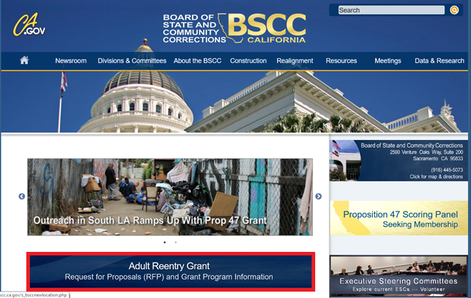
Where to Locate the New Budget Attachment
Go to BSCC Homepage
http://www.bscc.ca.gov/
Click ‘ARG RFP and Grant Program Information’

Slide 52
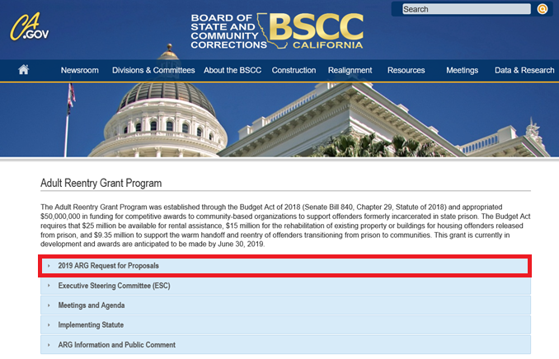
2. 2019 ARG Page
Click ‘2019 ARG Request for Proposals’

Slide 53
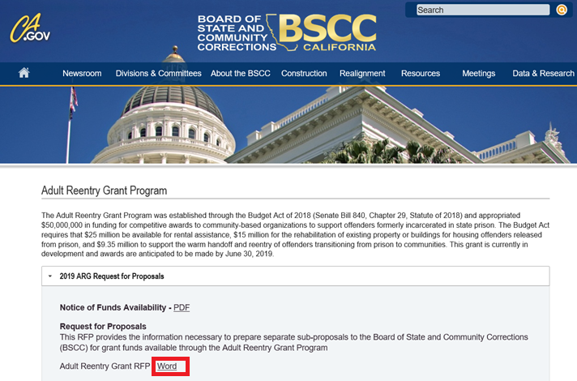
3. 2019 ARG RFP Page
Click ‘Word Link Next to Adult Reentry Grant RFP’

Slide 54
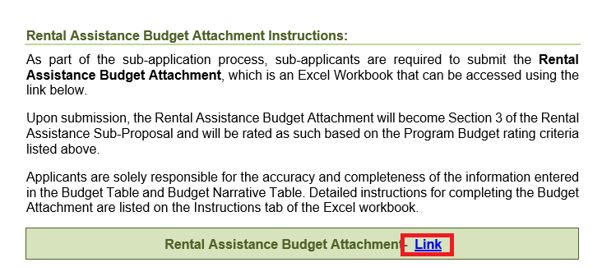
4. 2019 ARG Grant RFP
Click ‘Word Link Next to Rental Assistance Budget Attachment’

Slide 55
RFP Funding
Apply only for the amount of funds needed
No match is required

Slide 56
Requirements
Funds must be requested in whole dollars only
Budget line items are limited to those contained in the Budget Attachment
If no money is requested for a particular line item, enter $0 in the budget table and “N/A” in the corresponding narrative

Slide 57
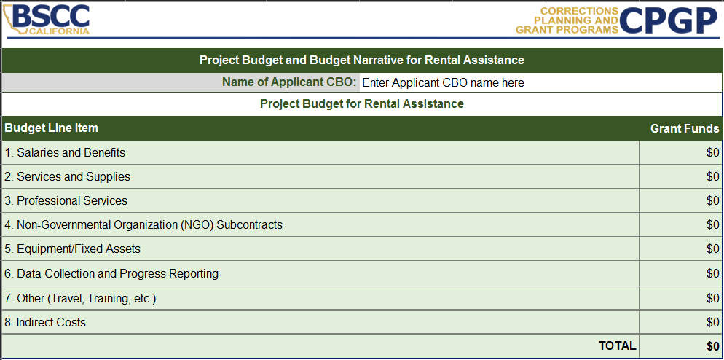
Using The Budget Tables
Applicants must enter their CBO name
Dollars will automatically populate from each budget line item table

Slide 58
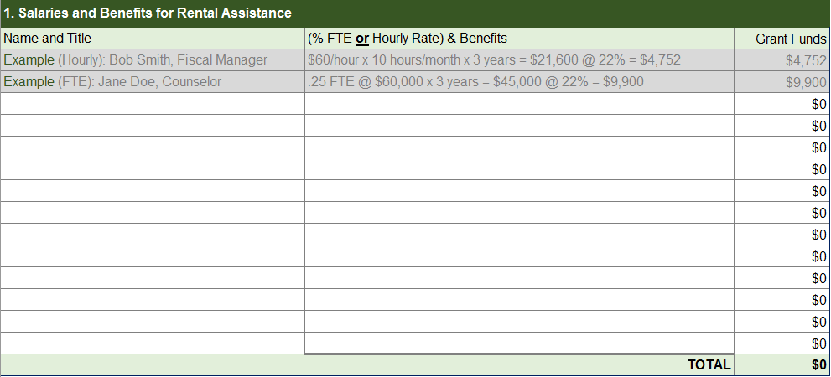
Using The Budget Tables
List the classification/title, percentage of time, salary or hourly rates, and the benefits (if applicable) for every staff person that will be funded from the grant
In the corresponding narrative, briefly describe their roles and responsibilities

Slide 59
Using The Budget Tables
Provide a narrative description of the item(s), and how the item(s) and amounts requested will serve to meet the stated goals and objectives and planned activities of the project
Starting a new paragraph within a narrative cell, hold down the Alt key and then press Enter

Slide 60
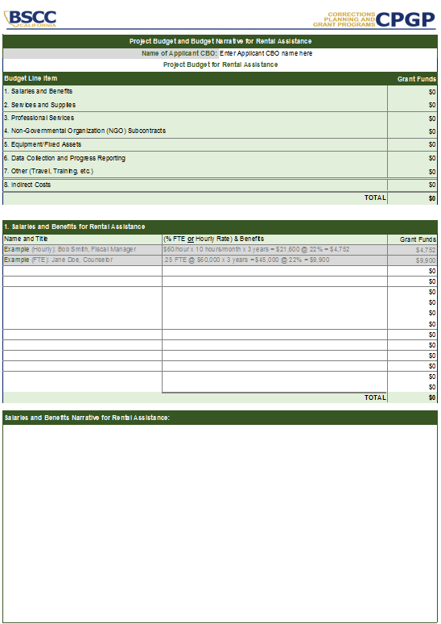
Using The Budget Tables

Slide 61
Using The Budget Tables
Include and itemize all services and supplies to be purchased by the applicant only.
Services and supplies purchased by NGOs, partner agencies, subgrantees, or subcontractors should be included in the applicable budget section (e.g. Professional Services, NGO Contracts, etc.)

Slide 62
Using The Budget Tables
List the names of any public agencies or professional consultants that will work on the project
Demonstrate amount of funds allocated to each and itemized the services that will be provided
List any positions to be funded, including classification/title, percentage of time, salary or hourly rates, and benefits (if applicable)

Slide 63
Using The Budget Tables
Include grant funds associated with Non-Governmental Organization (NGO) subcontracts
Include the amount of funds allocated to each and itemize the services that will be provided
List any positions to be funded, including classification/title, percentage of time, salary or hourly rates, and benefits (if applicable)
If a community partner has not been selected as of the date of the submission of the application, identify the amount of grant funds that will be allocated and describe services to be provided

Slide 64
Using The Budget Tables
Include grant funds associated with equipment and fixed assets purchased by the applicant
Equipment and fixed assets are nonexpendable property having a useful life of more than one year and acquisition costs of $5,000 or more per unit.
Equipment and fixed assets included in proposed budget does not guarantee approval, separate and prior approval from the BSCC will be required

Slide 65
Using The Budget Tables
Include grant funds associated with the project’s data collection and reporting efforts and/or necessary enhancements to an existing data collection mechanism that will be used to capture grant-program data

Slide 66
Using The Budget Tables
Include only training, travel, or other costs set aside for such purposes for use by the applicant agency
Similar costs allocated by partner agencies, subgrantees, or subcontractors should be included in the applicable budget section
Out-of-State travel using grant funding is permissible in rare cases. Prior and Separate BSCC approval will be required, even if proposed out-of-state travel is outlined proposed budget

Slide 67
Using The Budget Tables
An amount not to exceed ten percent (10%) of direct salaries and wages, either including or excluding benefits; or
An amount not to exceed five percent (5%) of the actual total direct project costs, excluding equipment
In the corresponding narrative, identify the types of categories of expenses that will be supported by the indirect costs rate and what record keeping process will be used to provide source documentation

Slide 68
Contact Information
Veronica Silva, Analyst
Email: veronica.silva@bscc.ca.gov
Desk: (916) 322-1050

Slide 69
QUESTIONS?

Slide 70
ARG PROGRAM
Pg. 26
Applicants for Rental Assistance grant funds shall complete a 1-page Project Work Plan. This Project Work Plan identifies measurable goals and objectives, activities and services, the responsible parties, and a timeline. To build the Project Work Plan, applicants should copy and paste the following tables into a separate document. List only the top three goals of the project. Use Appendix C pg. 46 for information related to developing goals and objectives.
Attachment A: Rental Assistance Sub-Proposal Work Plan pg. 26

Slide 71
ARG PROGRAM
11 Required Forms To Be Submitted
for Each Sub-Proposal
Sub-Proposal Cover Sheet
Sub-Proposal Proposal Checklist
Sub-Applicant Information Form
Sub-Proposal Narrative
Sub-Proposal Budget Table and Narrative (Excel)

Slide 72
ARG PROGRAM
(Forms to be submitted continued)
Certification of Compliance with BSCC Policies on Debarment, Fraud, Theft and Embezzlement (Appendix E pg.69)
Verification of Compliance as a 501(c)(3) must be submitted via a Letter of Determination from the IRS or the most recent 990 IRS form
Work Plan
Rental Assistance (Attachment A pg. 26)
Warm Hand-Off (Attachment A pg 37)

Slide 73
ARG PROGRAM
(Forms to be submitted continued)
BOS Resolution
Signing authority (e.g., articles of incorporation, bylaws, or board resolution conferring authority to the signatory)
If the sub-proposal includes collaboration and active involvement with a local government agency for which their agreement is needed, a letter of support signed by the agency head must be received from the agency

Slide 74
ARG PROGRAM
(Forms to be submitted continued)
Optional Document
One (1) Sub-Project flowchart or other visual representing the proposed rental assistance project workflow, process, and/or intended outcomes and activities (not part of the 9 pages)

Slide 75
ARG PROGRAM
Pg. 27
Repeat Proposal/Application Process for
Warm Hand-Off Reentry Services
Part III: Warm Hand-Off Reentry Services Sub-Proposal Instructions

Slide 76
ARG PROGRAM
Rating Factors for
Warm Hand-Off Reentry Services
Pgs. 34-36
Same rating factors and percent total value
Project Need (30%)
Program Description (60%)
Budget (10%)
Some differences in the sub-factors

Slide 77
ARG PROGRAM
Submittal Instructions Review
Applicants must submit one original signed Proposal AND one electronic copy of the original signed Proposal
The signed original or electronic Proposals must be received by the BSCC by 5:00 p.m. on March 25, 2019

Slide 78
ARG PROGRAM
Submittal Instructions
Mail one original signed Proposal packet to:
Board of State and Community Corrections
Corrections Planning and Grant Programs Division
2590 Venture Oaks Way, Suite 200
Sacramento, CA 95833
Attn: ARG Grant

Slide 79
ARG PROGRAM
Submittal Instructions
AND
Email one signed scanned copy of each signed sub-proposal to:
AdultReentryGrant@bscc.ca.gov
Acceptable formats include Microsoft Word, Microsoft Word Open XML Format Document, Portable Document Format (PDF) or Google Docs.
Reminder: Either the original signed hard copy or electronic signed scanned version must be received by 5:00 p.m. March 25, 2019. The applicant will not be automatically disqualified as long as the other copy is received in a reasonable amount of time. (2-3 days)
Proposals received after the due date and time will not be considered.

Slide 80
ARG PROGRAM
Submit additional questions about the ARG Grant or RFP to:
Colleen Stoner
colleen.stoner@bscc.ca.gov
Or
to electronic mailbox
AdultReentryGrant@bscc.ca.gov

Slide 81
ARG PROGRAM
To-Dos:
Read the RFP Several Times
Be Familiar with the ARG Program Requirements
Be Familiar with the Rating Factors and Criteria
Design Your Program
Identify/Select Services, Resources & Providers
Develop Work Plan
Follow Proposal Submittal Instructions to the Letter

Slide 82
ARG PROGRAM

