Slide 1
NOVEMBER 2010
“In 2010, as part of my role in our Probation Department, I was serving on our County’s Interagency Council on Child Abuse and Neglect. I was asked by a judge to be a part of a sub-committee on sex trafficking. While I had no idea why a probation officer, or our department, would be involved in human trafficking, I thought great – I love to travel – who wouldn’t want to go to Thailand, Indonesia, or Cambodia?
Then came November 16, 2010. I remember the date so vividly because it was a day that had a profound impact on my life. It was the first meeting of this Domestic Minor Sex Trafficking sub-committee. It was here that I learned that this exploitation wasn’t something happening in a faraway country. In fact, it was happening right here, in our community, to the very young women I was charged to protect. “

Slide 2
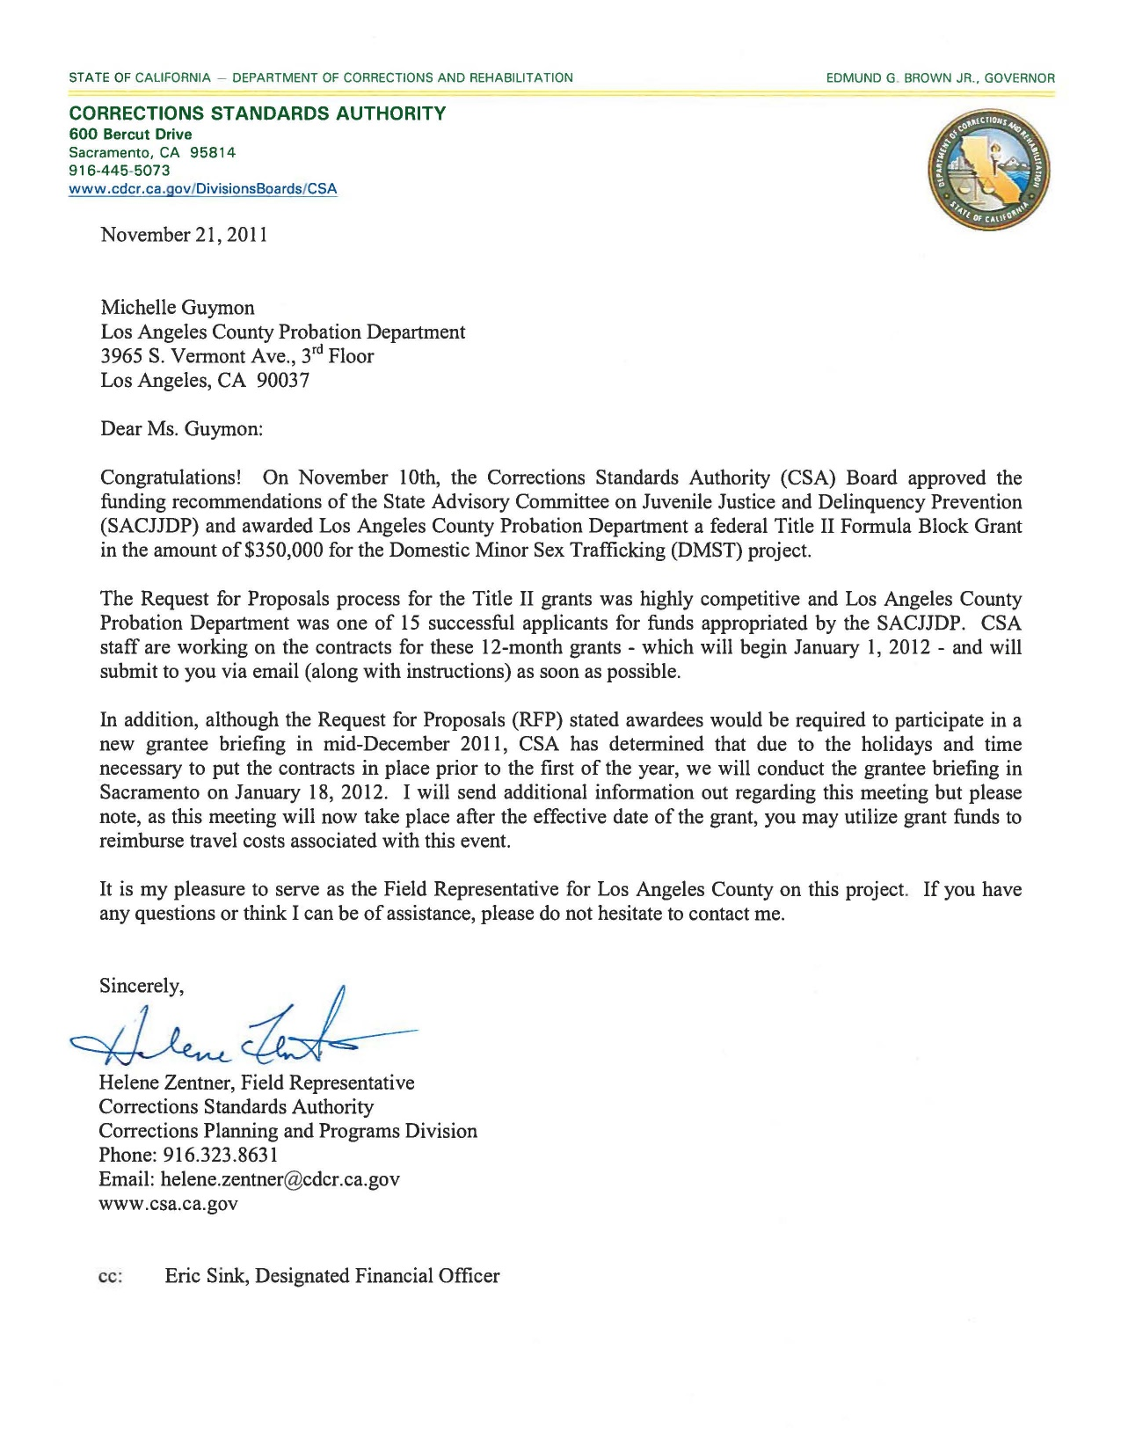
Grant Opportunity: Alternatives to Detention

Slide 3
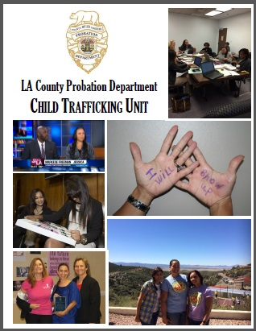

Slide 4
2012 - Board of State and Community Corrections (BSCC)
Corrections Planning and Programs Division
Title II Formula Grant
“Child Trafficking Unit”
SDPO
(4/3) DPO II’s – CSEC cases
(1) DPO II – TAY/Locate Team
(1) DPO II – STAR Court Liaison
ELD-PROB ChildTrafficking
ChildTrafficking@probation.lacounty.gov

Slide 5
Roles of Probation Officers
Supervision Deputy Probation Officers
Caseload size
Primary / Secondary Cases
Contact expectations
Transition MDTs
Collaboration
Showing up!
Star Court Liaison
Assess new cases
Facilitate weekly MDT case review meetings
Create missing person flyers/coordinate with Probation Specialized Enforcement Operations Unit.
Update Court regarding AWOL’s, urgent matters, etc.

Slide 6
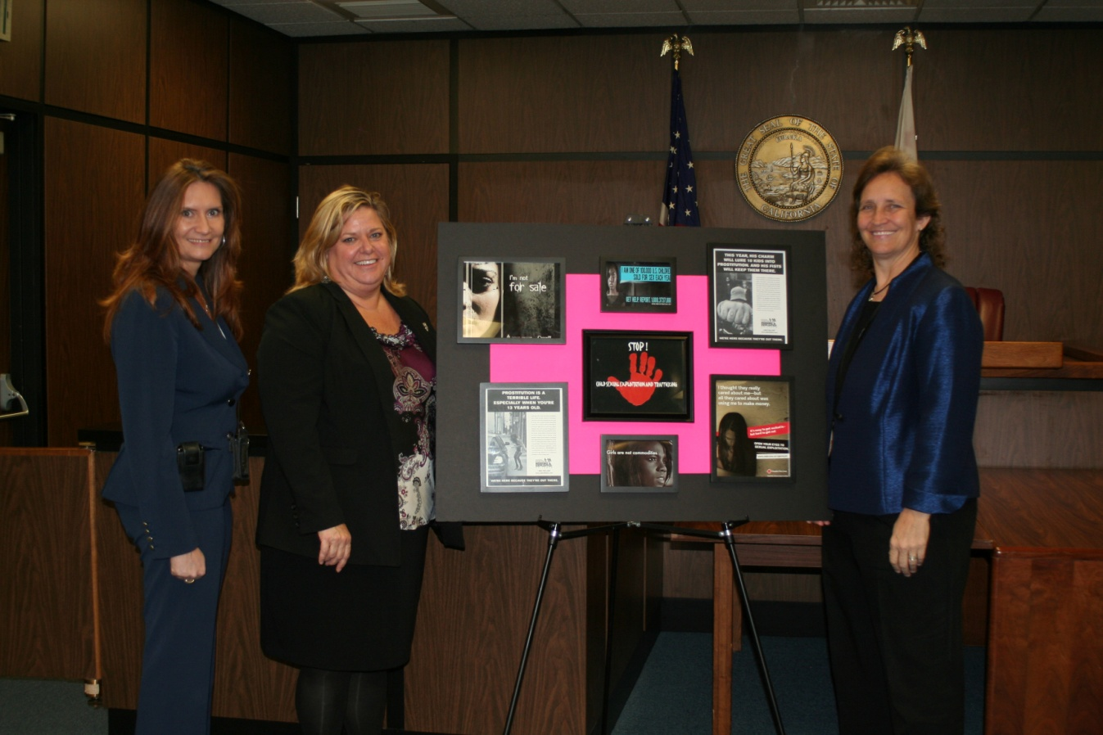
S.T.A.R. Court
“Success Through Achievement and Resilience”
Dedicated: January 11, 2012
Notes:
Finding that testifying is very traumatic. Often the first time they have seen their trafficker since they were arrested. Have likely received pressure from his “family” or gang. Think they are “in love” with him. Have to testify about intimate sexual details, asked identify traffickers by body parts or tattoos. Usually causes a significant set back in their recovery.
6

Slide 7
STAR Court
Specialized CSEC Juvenile Delinquency Court
Frequent Review Hearings
Weekly MDT Meetings – decisions made by collaborative team
Dedicated CSEC Public Defender
Probation Officers from specialized CSEC unit
Advocates / Survivor Advocates
Legal Advocate
Consistent & Non-Adversarial

Slide 8
STAR Court - OUTCOMES
Three-year grant 2012 t0 2014
Served over 350 victims of commercial sexual exploitation
Low recidivism rates
73% have NOT been rearrested
Less time spent in juvenile halls
28% reduction in days spent in locked facilities
Contact with advocates while AWOL
Ongoing connection to necessary medical and mental health services
Ongoing contact after probation terminated
25% of former STAR Court youth are voluntarily in touch with someone from their STAR Court Team

Slide 9
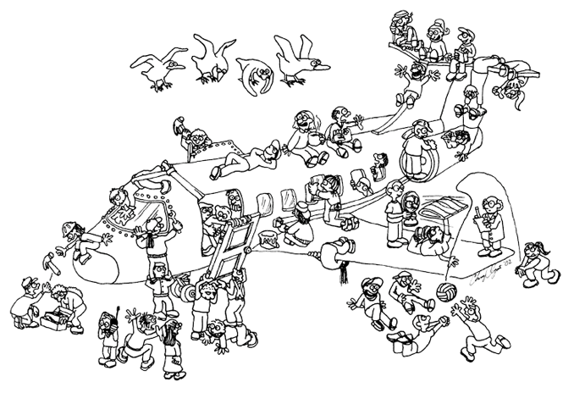

Slide 10
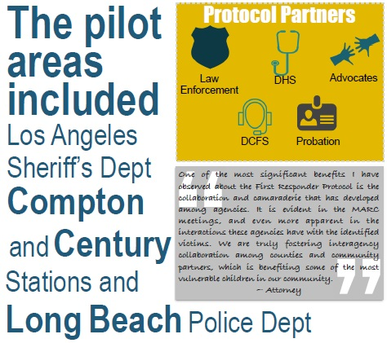
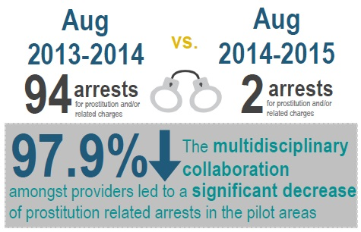
Outcomes…

Slide 11
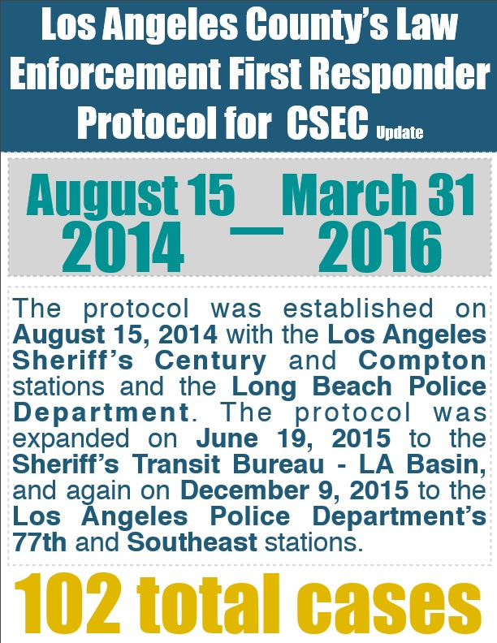
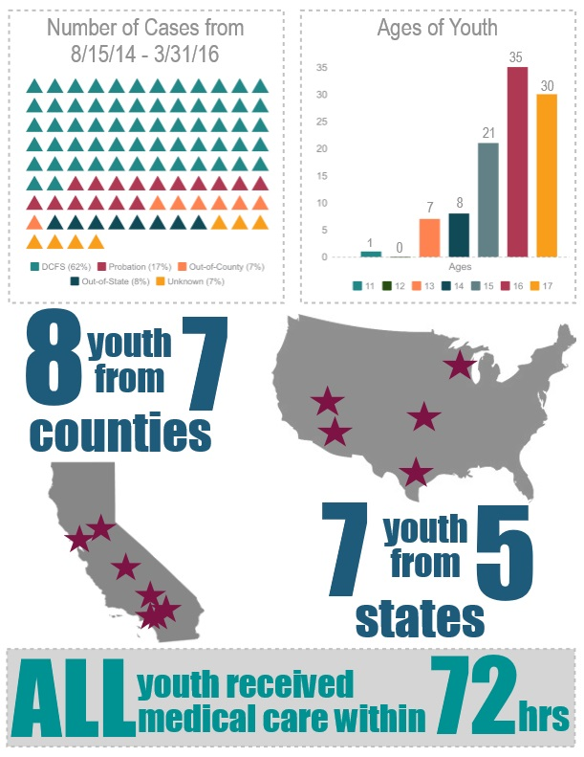
To Date…

Slide 12
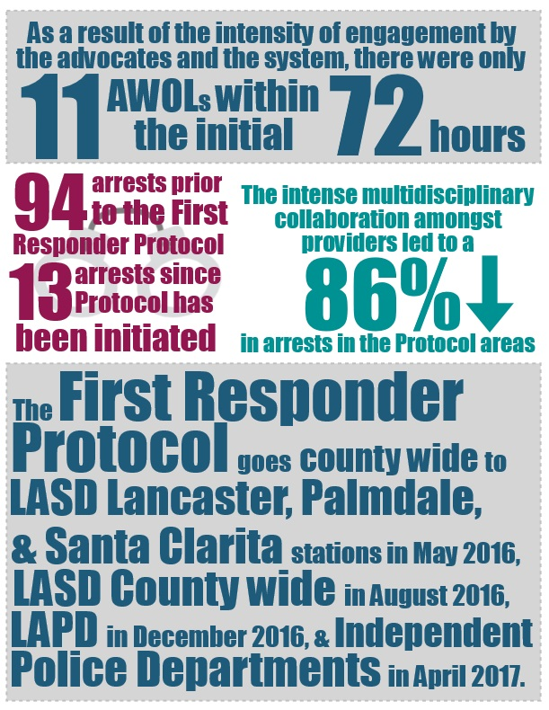

Slide 13
VICTIM WITNESS PROTOCOL
Law Enforcement
Court / Child’s Attorney
District Attorney
VICTIM WITNESS
Dept. of Mental Health
Probation / Child Welfare
Advocates
Case Filing
Preparation for Trial
Day of Testimony
Post Testimony

Slide 14
ADVOCACY
“My advocate is more like family to me than anyone ever. She has helped me trust again and believe in myself. If I am in trouble, I can’t call my mom or dad, but I can call her and I know that she will help me. She is someone I can really actually count on. Because of her I want to help other girls like me when I grow up.” – Kate*, age 16
“My advocate talks to me as a best friend and doesn’t judge me like other people do. She’s always there if I need her.” - Sara*, age 12
“I didn’t know I could trust people. Saving Innocence has shown me that they are there for me when I need someone and they helped me see that I deserve something more than the life. I can count on them.” – Jackie*, age 14
* Names have been changed to protect the victims’ identity
Notes:
14

Slide 15
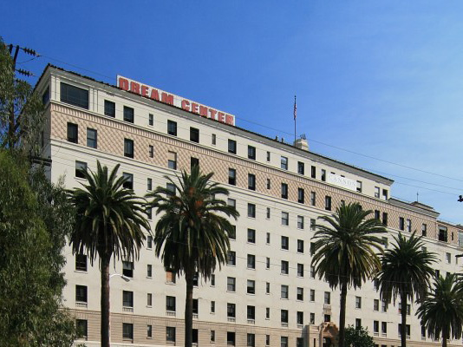
The Women on the street today are the children we failed to protect yesterday

Slide 16
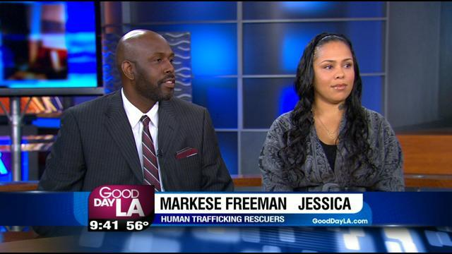

Slide 17
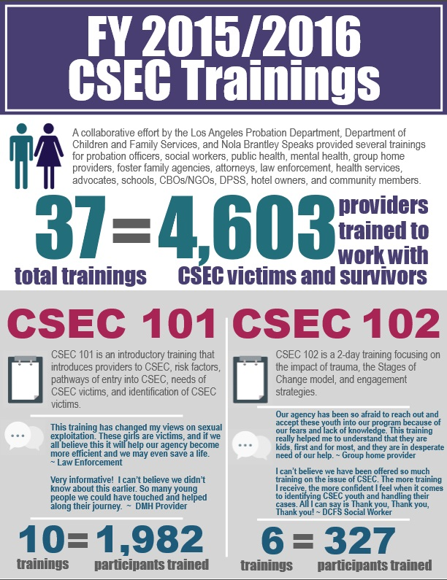
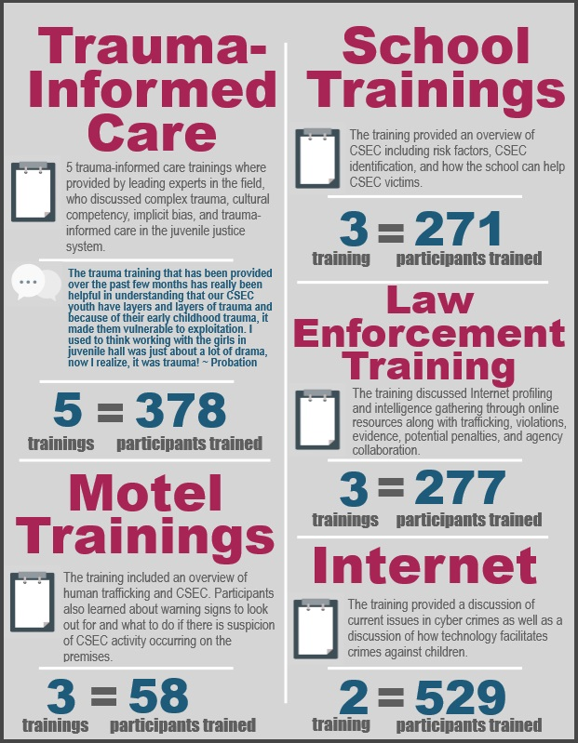
Extensive Training (12,000+)

Slide 18
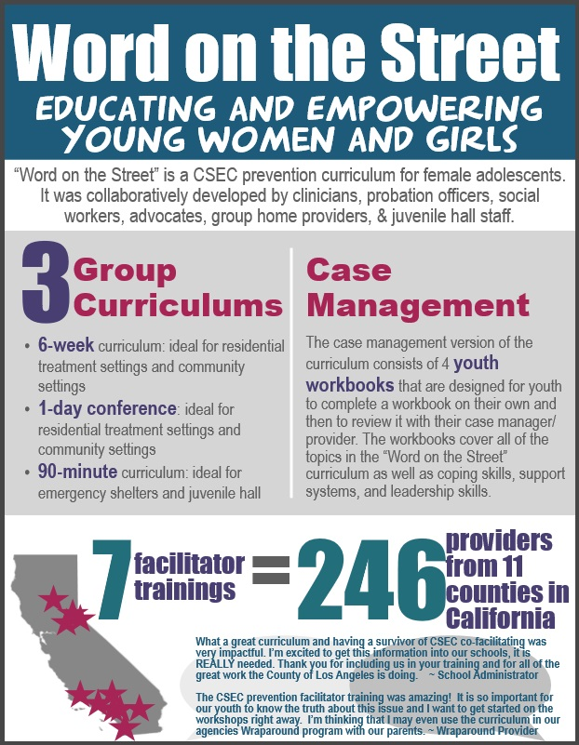

Slide 19
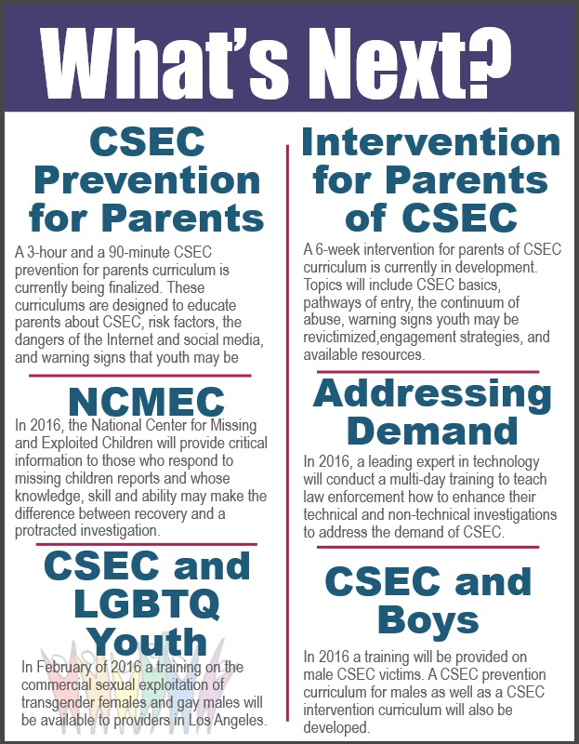
LA County Employees
On-line Training
(125,000)

Slide 21
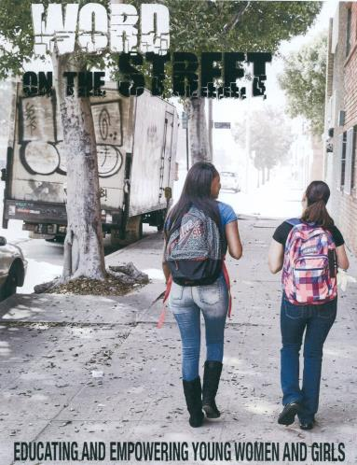
PREVENTION CURRICULUM
Workgroup:
Probation Officers / DCFS
Survivors-Advocates
Foster Care Providers
Alliance for Children’s Rights
Kick-off: January 24, 2015
Curriculum options…
6 Week sessions
1-day Conference
90-minute (in-custody/shelter)
Case management/youth workbook

Slide 22
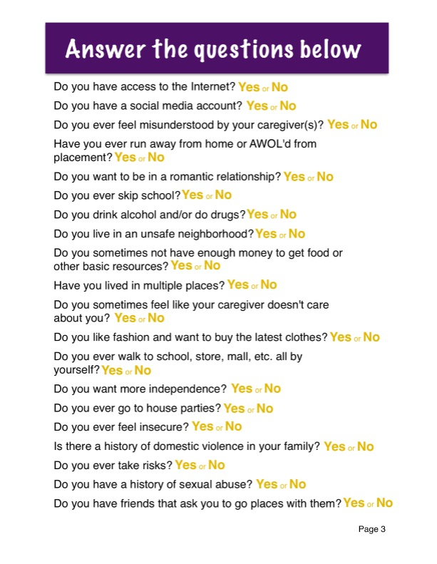
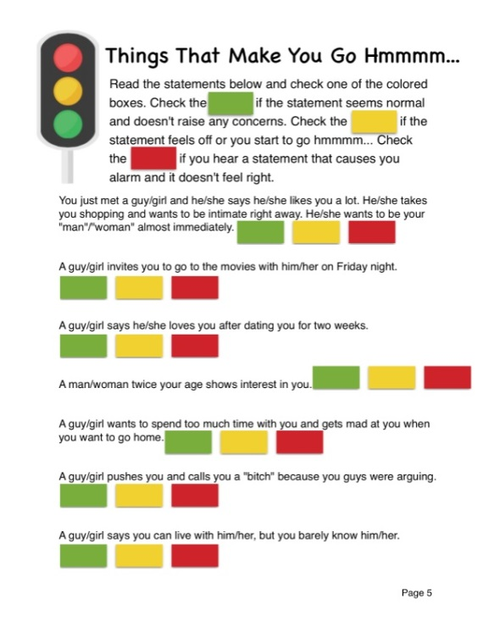

Slide 25
The Law Enforcement First Responder Protocol reflects Los Angeles County’s commitment to treating commercially sexually exploited children (CSEC) as victims of child abuse and human trafficking, rather than criminalizing them as delinquents.
It reflects an understanding that CSEC have often experienced and been exposed to severe violence, threats and trauma. will guide the child-serving agencies on their roles and responsibilities for
responding when they encounter suspected or identified victims of commercial sexual exploitation and the steps to take within the first seventy-two hours to address their immediate and on-going needs.

Slide 26
Lack of Support /
Timely response
What do you mean you don’t want us to arrest?

Slide 27
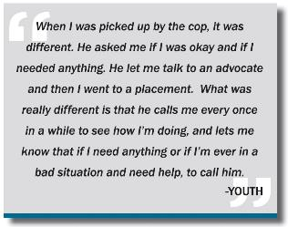
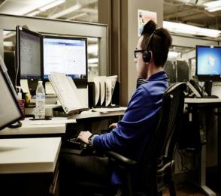
LAW ENFORCEMENT interfaces with Youth
Law Enforcement Transports Youth to Staging Area
Mandatory Report to DCFS Child Abuse Hotline

Slide 28
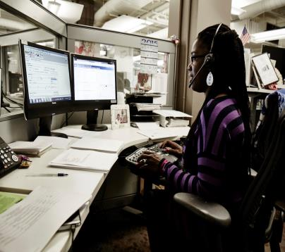
DCFS Hotline
Identifies Youth
DCFS Multi-Agency Response Team Dispatched
Probation Department Child Trafficking Unit Responds
Advocate Responds

Slide 29
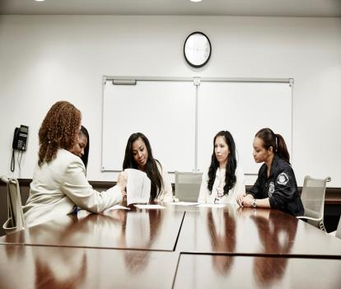
Informal Safety Planning Meeting
72-hr Advocacy Plan
Return Home / SP Emergency Housing
Detention
NCIC missing person

Slide 30
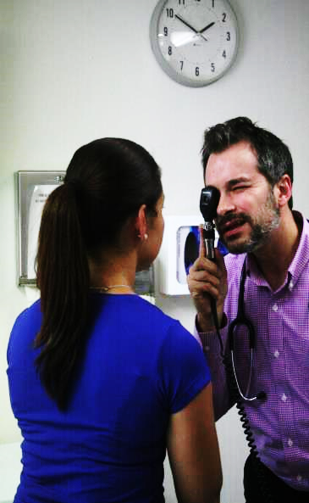
DHS Medical Hub

Slide 31
90-Day Advocacy
"Having an advocate at the teens' side from the very beginning is invaluable in helping survivors through all the winding steps of moving forward with their lives."

Slide 32
Outcomes…

Slide 33
To Date…

Slide 35
VICTIM WITNESS PROTOCOL
Law Enforcement
Court / Child’s Attorney
District Attorney
VICTIM WITNESS
Dept. of Mental Health
Probation / Child Welfare
Advocates
Case Filing
Preparation for Trial
Day of Testimony
Post Testimony

Slide 36
Detention Interagency Protocol
Law Enforcement
Dept. of Health Services
Probation
IDC, DSO’s
CSEC Youth
Dept. of Public Health
Probation Child Trafficking Unit
Child Welfare
Dept. of Mental Health
Advocates
Identification
Notification
Assessment
MDT
Programming
Transition
Notes:
Programming:
Prevention
Disclosures – girls groups – that’s
Since January
3 juvenile halls - 1 juvenile hall 71 disclosures
Talking about the issue
Creating a different culture

Slide 38
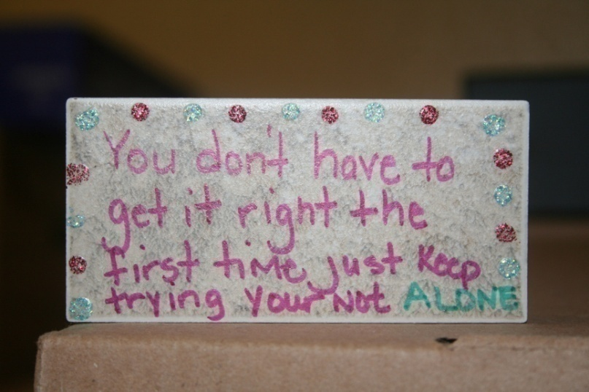
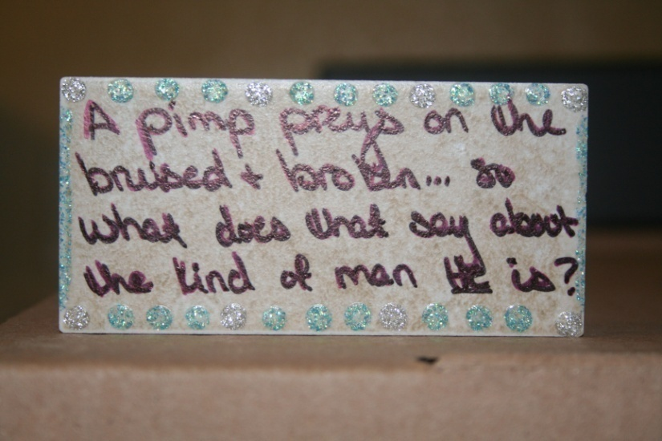
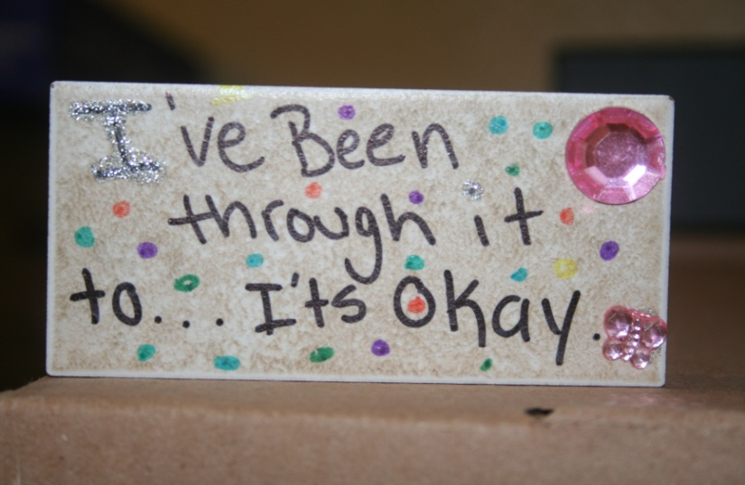

Slide 39
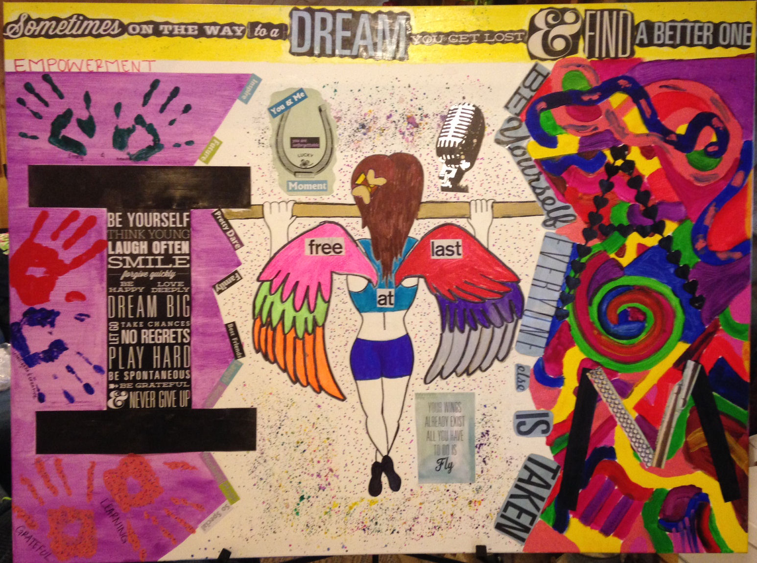

Slide 41
