Slide 1
Tribal Youth Diversion Grant
Grantee Orientation
  Administrative Responsibilities

Slide 2
Topics
Communication
Grant Agreement - STD 213
Exhibits to the Grant Agreement
Non-Governmental Organization (NGO) Assurances
Prior Approvals
Grant Administration Guide

Slide 3

Communication
A reminder…
Project Director
Financial Officer
…must be employees of the grantee
Day-to-Day Program and
Fiscal contacts could be
other staff

Slide 4
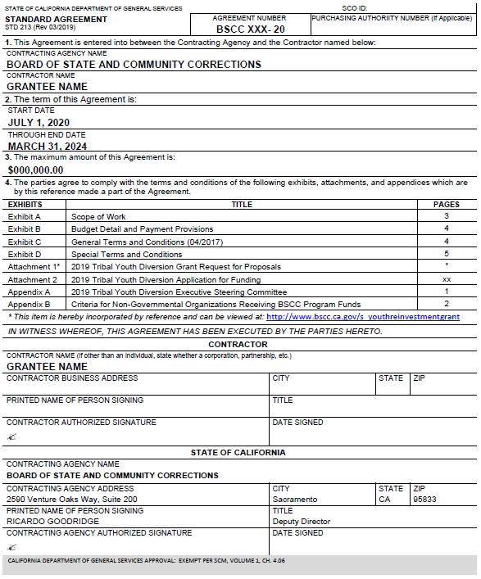
Standard
Agreement
Notes:
3 names: Standard Agreement, Grant Agreement, Contract

Slide 5
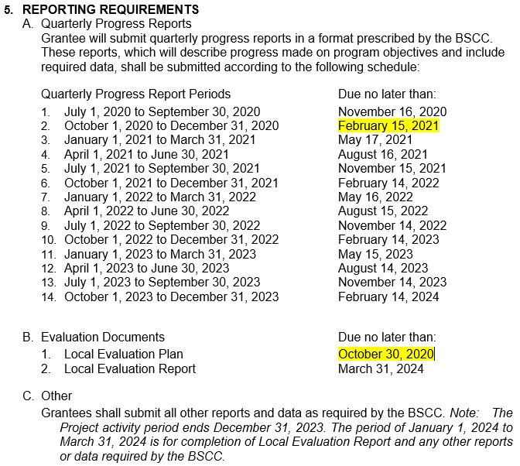
Report Due Dates
Notes:
Exhibit A: Scope of Work
Page 1 of 3

Slide 6
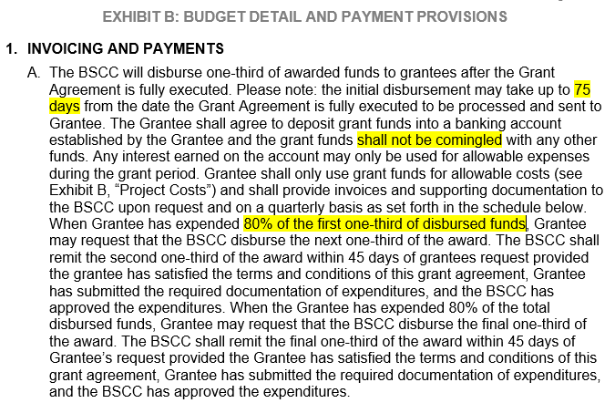
Advance Payments
Notes:
Define full execution
Funds must be deposited into an account and you must be able to track these funds separately from all other funds
YOU initiate 2nd Advance

Slide 7
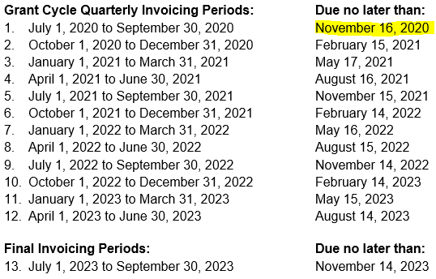
Invoices
Notes:
This is what most of your contracts look like but this listing is incomplete.

Slide 8
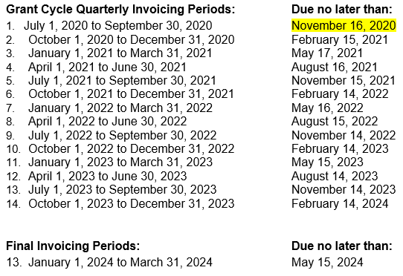
Invoices – All Due dates
Notes:
This is the complete list of due dates for your grants.
Also in Invoice Workbooks
Do NOT send reminders, so know where to find these and MEET them!
If, for any reason, you do not feel you will be ready to meet the November 16th due date, I want to hear your questions before we hang up today!

Slide 9
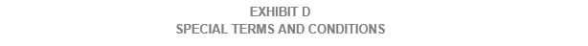
Special Conditions
Notes:
If you use a sub for anything – service delivery, eval, case mgmt. – must adhere to these requirements

Slide 10
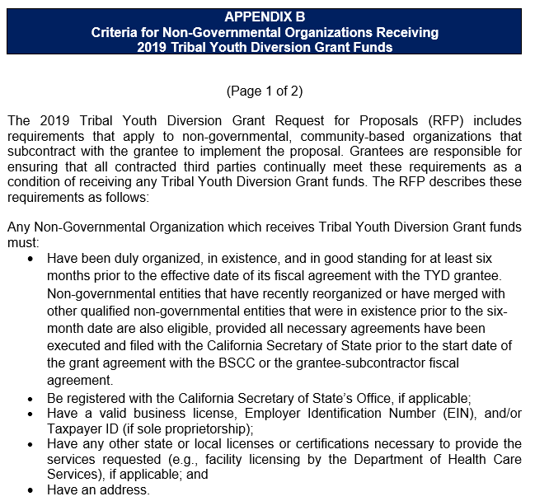
NGO Assurance
Notes:
If you use an NGO as a sub, then you must also be mindful of Appendix B and ensure compliance with these criteria
This isn’t the whole form - 2nd pg requires name of NGO and your signature attesting to all of the above
Must continue to send in updates throughout the life of the grant if changes occur

Slide 11
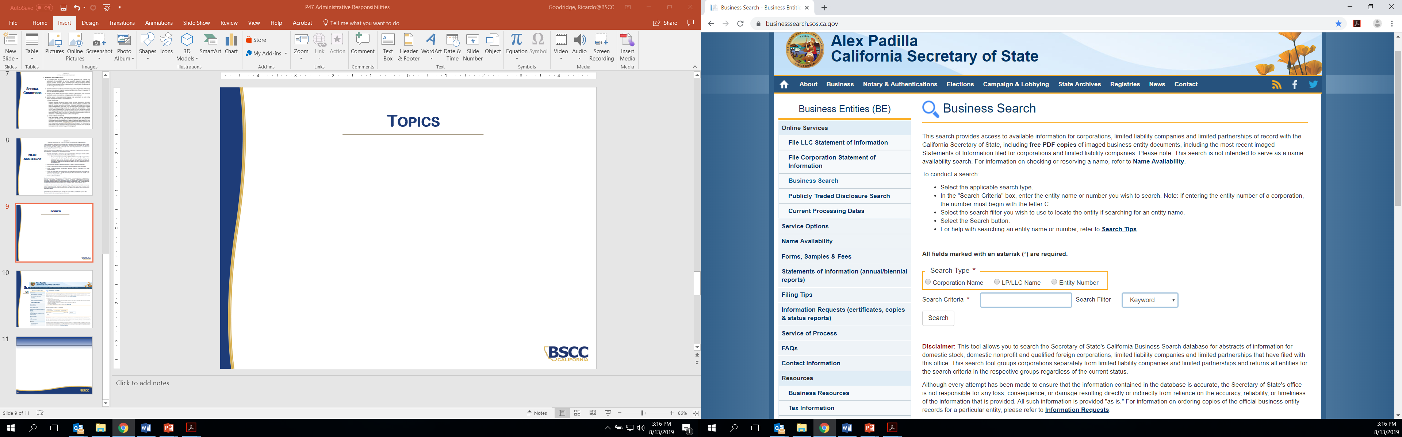
Secretary of State
Notes:
In thinking about how to ensure the criteria on the prior slide, this is what we use
You should too

Slide 12
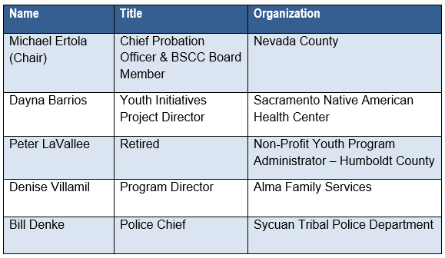
Conflict of Interest
2019 Tribal Youth Diversion Grant
Executive Steering Committee
Notes:
Look at the name of the individual and the organization
Requirement lasts full grant cycle

Slide 13
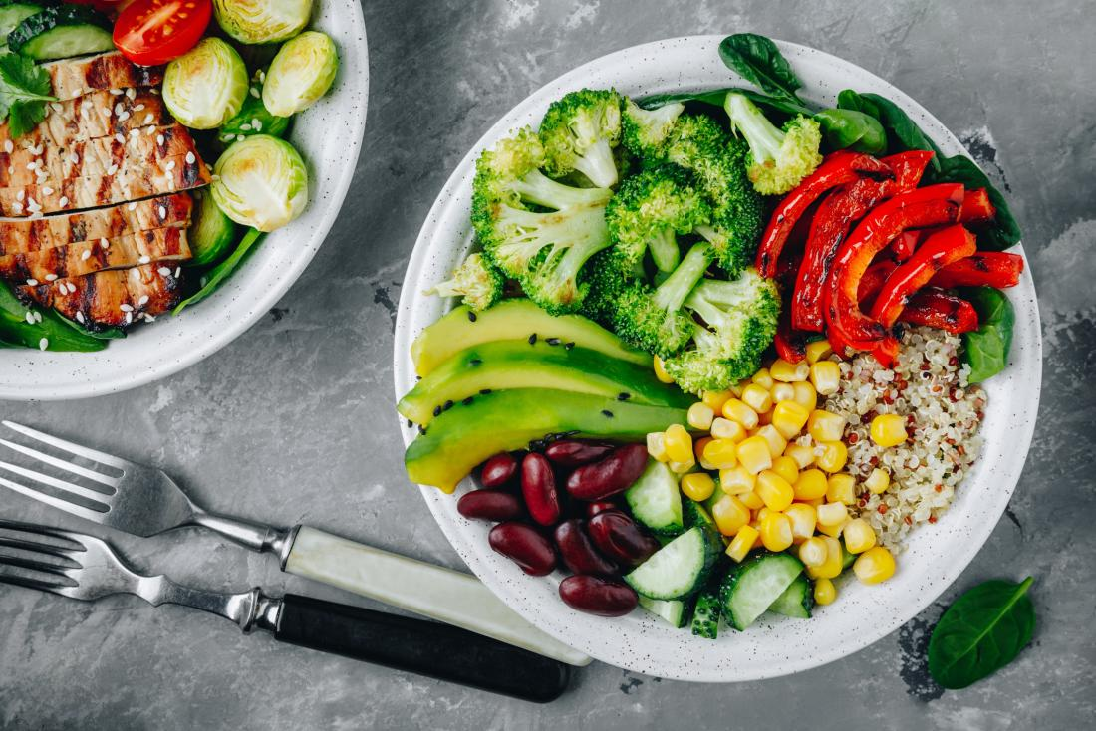



Prior Approval Required
Food & Beverages
Gift Cards
Incentives
Vehicles
Out-of-State Travel
Notes:
ALL of these require prior approval
Could be allowed… could be disallowed
Have some supporting docs to help

Slide 14

Grant Administration Guide
BSCC Website:
http://www.bscc.ca.gov/wp-content/uploads/ BSCC-Grant-Admin-Guide-July-2020-Final.pdf
Notes:
Hot off the press!
Take them to it online

Slide 15
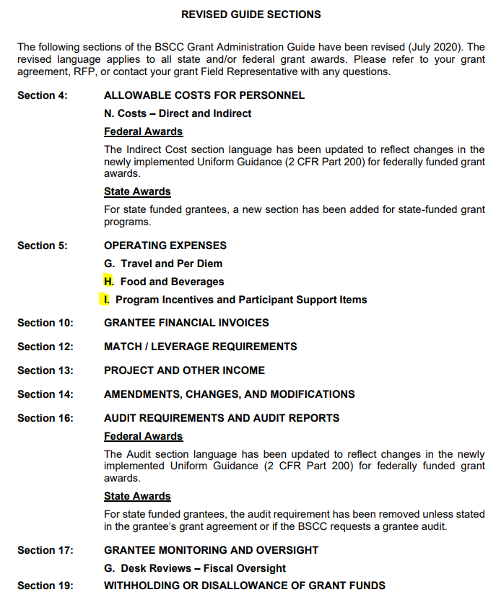
Revised Sections
Notes:
2020 Guide identifies the sections that have been revised
Some we just talked about

Slide 16

Takeaways
Adhere to Grant Agreement!!!
Meet the due dates
Include BSCC required language in subcontracts & update NGO Assurances
Keep Contact Information Current
Know when you need prior approval
Read the Admin Guide!!
Notes:
Add Admin guide

Slide 17
QUESTIONS?

