Slide 1
Proposition 64 Public Health & Safety Grant Program
Cohort 4 Grantee Orientation

Slide 2
Welcome & Introductions
Colleen Curtin, Deputy Director
Adrienne Winuk, Assistant Deputy Director
Tony Knapp, Field Representative
Amanda Abucay, Staff Service Manager I
Allexus Dominguez, Analyst II
Ayesha Arata, Research Data Analyst II
Dr. Emma Welsh, Research Data Specialist II
Megan Jones, Research Data Specialist I

Slide 3
Day 1 Agenda
BSCC Overview
Prop 64 Public Health and Safety Grant Program Background Review
Program Evolution Into Prop 64 Cohort 4
Grantee Introductions
Administrative Responsibilities
DCC Presentation
Program Responsibilities

Slide 4
Day 2 Agenda
Welcome and Agenda Review
Review of SharePoint Software
Fiscal Responsibilities (Invoices, Desk Reviews, IDC and Modifications)
Program Specific Compliance Audit
Recap and Q&A

Slide 5
Overview of the BSCC
Who We Are
The BSCC is California’s statewide public safety agency that supports local justice partners.
Reports directly to the Governor’s Office.
Organized under a Governor‑appointed Board made up of 15 members.
Why We Exist
Provide statewide leadership, funding, standards, and oversight.
Support safe, effective, and legally compliant local justice systems.
Strengthen partnerships across state and local agencies.
Promote consistent practices that improve community safety and outcomes.

Slide 6
BSCC Divisions
Corrections Planning & Grant Programs (CPGP)
Administers state and federal grant programs that support local justice, public safety, and community‑based initiatives.
Provides technical assistance, oversight, and statewide consistency in how grant funds are used.
Ensures programs align with statutory requirements and evidence‑based practices.
Standards & Training for Corrections (STC)
Sets statewide training standards for local corrections staff and ensures agencies meet minimum training requirements.
County Facilities Construction (CFC)
Oversees state‑funded construction and renovation of local detention facilities to ensure safe, modern infrastructure.
Facilities Standards & Operations (FSO)
Inspects local detention facilities and enforces state regulations to ensure safe, humane, and compliant operations.
In‑Custody Death Review (ICDR)
Reviews all deaths in local detention facilities to identify trends and support improvements in safety and care.
Administration, Legal & Research Units
Provides agency‑wide support in budgeting, HR, contracts, legal guidance, research, and data analysis.

Slide 7
Origins of the Prop 64 Grant Program
How It Started
Proposition 64 (Adult Use of Marijuana Act) passed in 2016, legalizing adult‑use cannabis in California
Created a dedicated cannabis tax revenue stream
Revenue & Taxation Code § 34019 directs funds to BSCC
Purpose for those funds: support local programs addressing public health and safety impacts of legalization

Slide 8
Legislative Foundation
“What the Law Requires”
Statutory Authority
Revenue & Taxation Code § 34019, subd. (f)(3)(C)
Funds must support:
Law enforcement
Fire protection
Local programs addressing public health & safety impacts of AUMA
Eligibility tied to local cannabis retail or delivery policies

Slide 9
Early Implementation (Cohorts 1–3)
“What We’ve Done So Far”
Program Growth
More than $125 million awarded statewide
Cohort 1 (2019): 10 projects – $9.9M
Cohort 2 (2021): 22 projects – $21M
Cohort 3 (2023): 37 projects – $93.8M
Cohort 4 (2026): 71 projects – $227M
Supported a wide range of local efforts:
Enforcement
Public Health
Youth prevention & intervention
Environmental mitigation

Slide 10
2025 Statutory Changes (SB 141)
Key Updates
RTC § 34019 amended in June 2025
Eligibility expanded to jurisdictions that:
Allow storefront retail, or
If population ≤ 10,000, allow delivery to medicinal & adult‑use
consumers
Jurisdictions “in the process of legalizing” are not eligible
BSCC must now prioritize illicit cannabis enforcement in scoring

Slide 11
Program Evolution Into Cohort 4
What’s New for Cohort 4
Enforcement receives priority points (70%+ of budget)
Stronger alignment with Department of Cannabis Control (DCC)
Updated eligibility verification through Letter of Eligibility
Continued focus on:
Law Enforcement and compliance
Public Health
Youth development
Environmental impacts

Slide 12
Key Dates
Activity | Date
Grant Period Begins | July 1, 2026
Mandatory Cohort 4 Grantee Orientation | August 26,27 2026
Local Evaluation Plan (LEP) Due | November 20, 2026
Grant Service Delivery Period Ends | June 30, 2031
Final Evaluation Report (LER) and Audit Due/Grant Ends | December 31, 2031

Slide 13
Questions
Q&A

Slide 14
Grantee Introductions
Project Director or Designee –
Please introduce yourself and tell us:
Project Directors
Name
Title
Tell us about your project
Please limit your remarks to one minute.

Slide 15
Group 1
City of Adelanto – Adelanto Police Department
City of Belmont – Belmont Police Department
City of Benicia – City of Benicia
City of Cathedral City – Cathedral City
City of Ceres – Ceres Police Department
City of Chico – City of Chico
City of Chula Vista – City Manager’s Office
City of Chula Vista – Fire Department
City of Clearlake – City of Clearlake
City of Colfax – City of Colfax

Slide 16
Group 2
City of Colusa – Dept. of Parks and Recreation
City of Covina – City of Covina
City of Daly City – City of Daly City
City of El Monte – Police Department
City of Eureka – Police Department
City of Firebaugh – Firebaugh Police Department
City of Fresno – City Attorney’s Office
City of Fresno – Police Department
City of Grass Valley – Police Department
City of Hanford – City of Hanford

Slide 17
Group 3
City of Hollister – Police Department
City of Imperial – Police Department
City of La Mesa – City of La Mesa
City of Lancaster – City of Lancaster
City of Lemoore – City of Lemoore
City of Live Oak – City of Live Oak
City of Lompoc – City of Lompoc
City of Long Beach – Dept. of Health & Human Services
City of Los Angeles – Mayor’s Office
City of Los Angeles – Police Department

Slide 18
Group 4
City of Madera – Dept. of Public Health
City of Mendota – Police Department
City of Modesto – Police Department
City of Nevada City – Police Department
City of Oakland – Special Activity Permits Division
City of Oceanside – Police Department
City of Oxnard – Police Department
City of Palm Desert – City of Palm Desert
City of Pomona – Police Department
City of Redwood City – Police Department

Slide 19
Group 5
City of Richmond – Office of Neighborhood Safety
City of Sacramento – Dept. of Finance
City of San Bernardino – City of San Bernardino
City of San Diego – City of San Diego
City & County of San Francisco – Dept. of Children, Youth & Their Families
City of San José – Parks, Recreation & Neighborhood Services
City of Santa Monica – Police Department
City of Sonora – Police Department
City of South El Monte – City of South El Monte
City of Stockton – City of Stockton

Slide 20
Group 6
City of Tulare – City of Tulare
City of Union City – Police Department
City of Vista – City of Vista
City of Watsonville – Police Department
County of Alameda – Office of Education
County of Alameda – Dept. of Public Health
County of Calaveras – Dept. of Public Health
County of Contra Costa – Health Dept. – Tobacco Prevention Program
County of Humboldt – Sheriff’s Office
County of Lake – Dept. of Probation

Slide 21
Group 7
County of Mendocino – Dept. of Public Health
County of Mendocino – Sheriff’s Office
County of Monterey – District Attorney’s Office
County of Monterey – Sheriff’s Office
County of Nevada – Sheriff’s Office
County of Riverside – First 5 Riverside
County of San Benito – San Benito County
County of San Diego – Sheriff’s Office
County of Santa Cruz – County of Santa Cruz
County of Trinity – Dept. of Community Development
County of Yolo – Dept. of Environmental Health

Slide 22
Administrative Responsibilities
Topics
Communications
Grant Agreements and Exhibits
Invoicing & Reporting Due Dates
Subcontractors and Non-Governmental Organizations (NGOs)
Grant Administration Guide

Slide 23
Communications
BSCC Communications are limited to staff identified on the official Contact Information Sheet.
Changes to the Contact Information Sheet must be authorized by the Project Director.
Update Contact Sheet anytime there is a change in key project staff:
  Project Director
  Authorized Officer
  Financial Officer (AFO)
  Day-to-Day Fiscal Contact
  Day-to-Day Program Contact
  Project Director and Financial Officer must be employees and cannot be the same person.
  Financial Officer cannot be the preparer of the BSCC Invoice
Notes:
Some Grantees may need to submit new contact sheets to address these requirements
Manage Staff Turnover – Refer new staff to orientation & materials

Slide 24
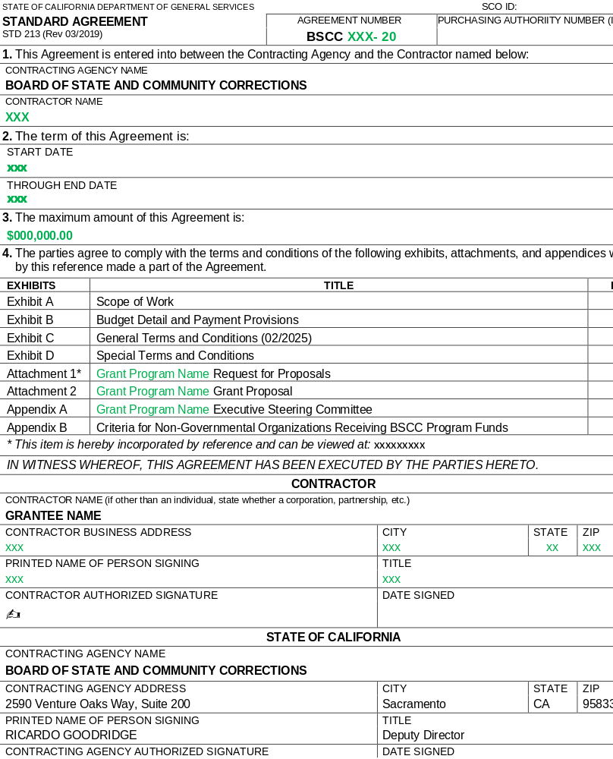
Standard Agreement
Keep a Fully Executed Copy on File
Review Agreement Carefully
Incorporates the RFP and the Proposal

Slide 25
GRANT PERIOD
Grant Agreement Term: July 1, 2026 to December 31, 2031
Grant Service Period: July 1, 2026 to June 30, 2031
Additional six months (July 1, 2031 to December 31, 2031) solely for finalizing and submitting the:
    Required Local Evaluation Report
    Required Program Specific Compliance Audit

Slide 26
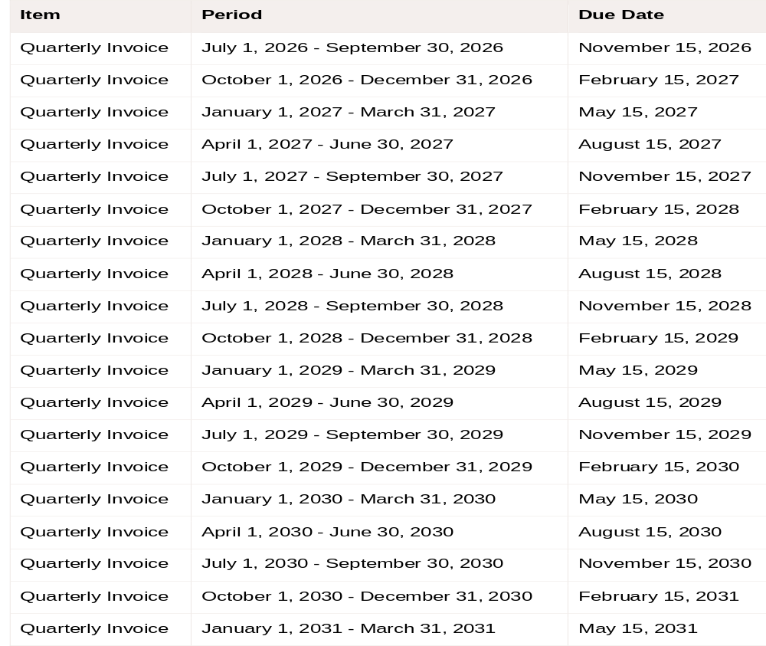
Invoicing Requirements (Quarterly)
Invoice Due Date (even if $0)
Report expenses on a cash basis (not accrual)
Final Invoices (# 13 & 14) is for LER and audit expenses only.

Slide 27
Reporting Requirements
Quarterly Progress Report | July 1, 2026 – September 30, 2026 | November 15, 2026
Quarterly Progress Report | October 1, 2026 – December 31, 2026 | February 15, 2027
Quarterly Progress Report | January 1, 2027 – March 31, 2027 | May 15, 2027
Quarterly Progress Report | April 1, 2027 – June 30, 2027 | August 15, 2027
Quarterly Progress Report | July 1, 2027 – September 30, 2027 | November 15, 2027
Quarterly Progress Report | October 1, 2027 – December 31, 2027 | February 15, 2028
Quarterly Progress Report | January 1, 2028 – March 31, 2028 | May 15, 2028
Quarterly Progress Report | April 1, 2028 – June 30, 2028 | August 15, 2028
Quarterly Progress Report | July 1, 2028 – September 30, 2028 | November 15, 2028
Quarterly Progress Report | October 1, 2028 – December 31, 2028 | February 15, 2029
Quarterly Progress Report | January 1, 2029 – March 31, 2029 | May 15, 2029
Quarterly Progress Report | April 1, 2029 – June 30, 2029 | August 15, 2029
Quarterly Progress Report | July 1, 2029 – September 30, 2029 | November 15, 2029
Quarterly Progress Report | October 1, 2029 – December 31, 2029 | February 15, 2030
Quarterly Progress Report | January 1, 2030 – March 31, 2030 | May 15, 2030
Quarterly Progress Report | April 1, 2030 – June 30, 2030 | August 15, 2030
Quarterly Progress Report | July 1, 2030 – September 30, 2030 | November 15, 2030
Quarterly Progress Report | October 1, 2030 – December 31, 2030 | February 15, 2031
Quarterly Progress Report | January 1, 2031 – March 31, 2031 | May 15, 2031
Quarterly Progress Report | April 1, 2031 – June 30, 2031 | August 15, 2031
Local Evaluation Deliverable | Local Evaluation Plan | November 20, 2026
Local Evaluation Deliverable | Final Local Evaluation Report | December 31, 2031
Other Required Item | Program‑Specific Compliance Audit | December 31, 2031
Quarterly Progress Reports (QPR’s)
Local Evaluation Plan (LEP)
Local Evaluation Report (LER)

Slide 28
Questions
?

Slide 29
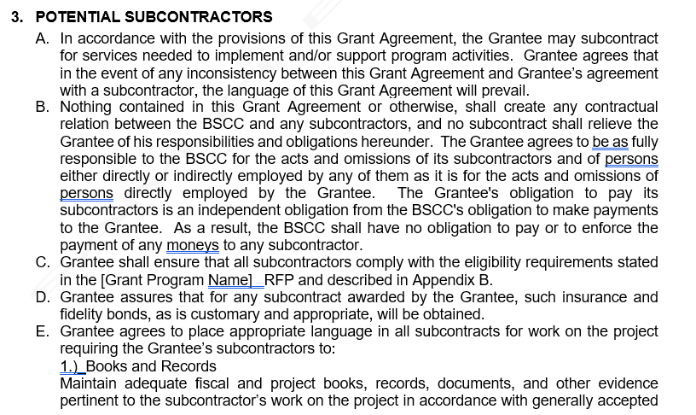
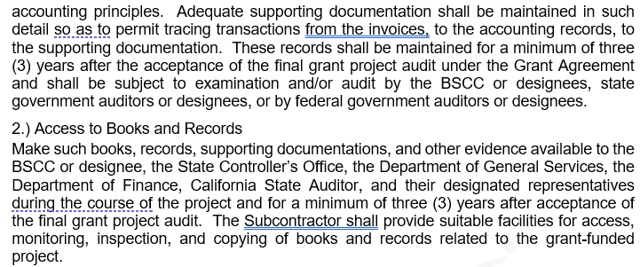
Subcontractors
BSCC Grant Requirements apply to subcontractor.
Specific language required in subcontracts
Monitor your subcontractors!
Notes:
Ensure subcontractors expenses are in line with proposal budget and subcontract
Supporting Docs
Desk Audits
Site Visits

Slide 30
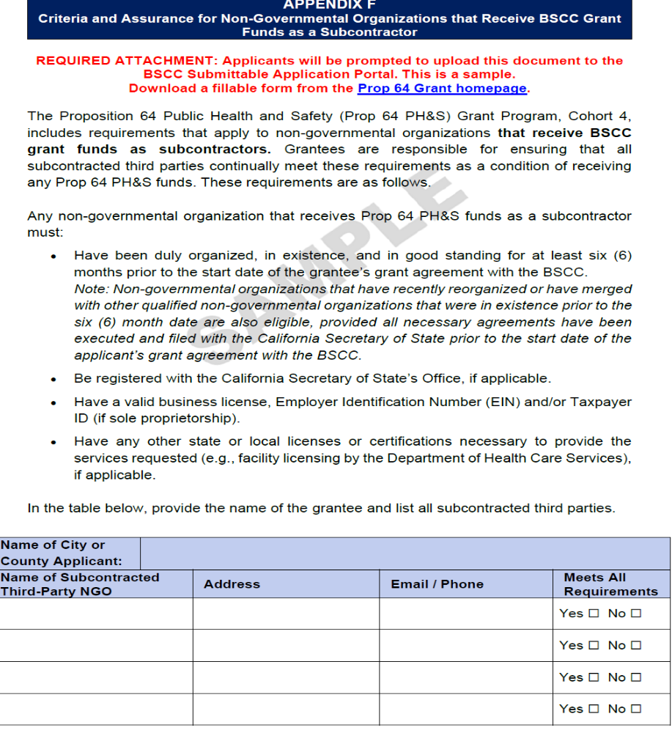
Criteria for Non-Governmental Organizations (NGO) Receiving BSCC Grant Funds
Grantee must ensure NGOs are eligible if receiving grant funds.
Submit an updated Appendix B if NGO subcontracts change.
“The BSCC will not reimburse for costs incurred by NGOs that do not meet the BSCC’s requirements.”

Slide 31
Conflict of Interest
Prop 64 Cohort 4 Scoring Panel
Jason Gundel — Office of the State Public Defender
Nancy O'Malley — Alameda County
Doug Snell — CDCR
Jacqueline Campion — DCC
Kellie Vasen — DCC
Douglas Smurr — DCC
Colin Medigovich — Cal OES
Jim Keddy — Youth Forward
Ella Ban — Water Boards
George Tiongson — DCC
Brittney Falcon — BSCC
Nikkole Melgoza — CDCR
Jose Barajas — DCC
Kahekili Seto — San Joaquin County Sheriff’s Office
Grantee must review the Scoring Panel membership and;
Ensure that no grant dollars are passed through to any entity represented by any member of the Prop 64 Cohort 4 Scoring Panel

Slide 32
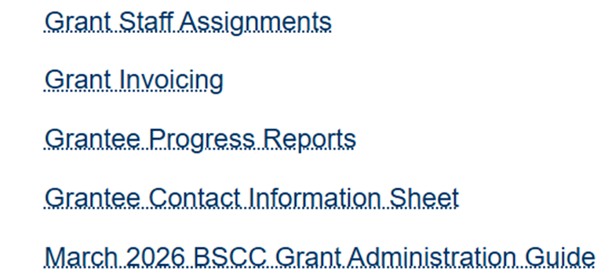
Grant Administration Guide
March 2026

Slide 33
Questions
?

Slide 34
Research Division
Data Collection & Evaluation Presentation

Slide 35
Lunch Break
1200-100pm

Slide 36
Department of Cannabis Control
Presentation

Slide 37
Program Responsibilities
Topics
Leadership & Communication
Model Program Integrity
Program Modifications
Expenses Requiring Prior Approval
Prohibited Expenses
Project Director Calls
Monitoring Visits
Notes:
Fiscal People – Stay Engaged

Slide 38
Leadership & Communication
Ensure the Project Team is informed and familiar with the project in terms of:
Project Goals and Timeline
Key Activities and Due Dates
Roles and Responsibilities
Project Budget
Allowable and Unallowable Expenses
Terms of the Grant Agreement
Notes:
Experienced Managers & Supervisors
Recognize multiple duties
Grants don’t run well on autopilot

Slide 39

Leadership & Communication
Who is on the Project Team:
Program Staff
Fiscal Staff
Agency Administration
NGOs / Subcontractors
Evaluator
Others?
Your Program Analyst, Research, and Field Rep!
Notes:
Recommend Regular Meetings
Avoid Silos between fiscal and program
Don’t forget to consistently communicate with your subcontracted NGOs & Evaluators

Slide 40

Maintaining Program Integrity
Ensure safeguards are in place to ensure the program is being implemented as designed/proposed:
  Program Policies and Procedures
  Grant Specific Org Chart & Duty Statements
  Staff Training (Initial and On-Going)
  Quality Assurance / Fidelity Monitoring
  Review of Case Files / Service Documentation
Avoid Program Drift!

Slide 41
Program modification
If modification is required, discuss with Field Representative well in advance to determine if the modification is within the scope of the proposed project.
Program Modification requests require a detailed narrative description and justification.
Notes:
Program Modifications are not the exact same thing as Budget Modifications. Program Modifications mean an alteration/adjustment to the scope of the proposed project work. A Budget Modification is generally moving underspent funds in one budget category to another budget category. Program Modification requests are generally rare for a grantee.

Slide 42
Questions
?

Slide 43

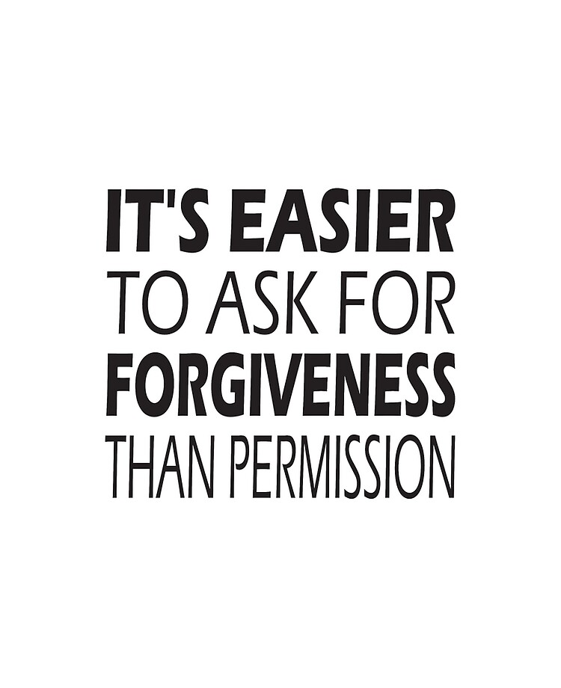
Expenses Requiring Prior Approval

Slide 44
Expenses Requiring Prior Approval
Program Incentives & Participant Support Items
(BSCC Grant Admin Guide, Pg. 31–32)
Food, beverages, gift cards, and stipends require a tracking process (distribution logs, signatures, quantities, dates, purpose).
Equipment / Fixed Assets
(BSCC Grant Admin Guide, Pg. 34)
Any item with an acquisition cost of $5,000 or more (includes tax, shipping, and installation).
Applies to per‑unit cost or total package cost.
Must be tracked on inventory.
Out‑of‑State Travel
(BSCC Grant Admin Guide, Pg. 28)
Requires prior approval and must align with allowable program activities.
Must include supporting documentation.

Slide 45
Questions
?

Slide 46
Prohibited Expenses
(BSCC)
Including but not limited to:
Bonuses/Commissions
Lobbying
Real Property and Improvements
Interest, Charges, Fees, and Penalties
Dues, Licenses, and Fees
Depreciation
BSCC Admin Guide Pg. 32-34

Slide 47
Project Director Calls
Quarterly Meeting (Virtual)
  Mandatory Attendance - Project Director and Authorized Fiscal Officer
  Project Updates & Announcements
  Training
  Networking

Slide 48
Monitoring Visits
Monitoring Visits (may be in-person or virtual)
  Initial Monitoring Visit (IMV)
  Comprehensive Monitoring Visit (CMV)
  Technical Assistance Monitoring Visit
  Closeout Monitoring Visit (as needed)
  Special Event (Monitoring)

Slide 49
Contact information
Field Representative Tony Knapp – tony.knapp@bscc.ca.gov
Prop 64 C4 Inbox
Prop64_Grant4@bscc.ca.gov
Notes:
Please cc CalVIP 5 email if corresponding directly with me.
Keeps Christy and Destiny in the loop.
Allows them to respond if I am away.

Slide 50
Grantee Orientation
Prop 64 Cohort 4
Program Specific Compliance Audit

Slide 51
What is a Program Specific Compliance Audit?
Program Specific Compliance Audit
A Program Specific Compliance Audit is an independent examination of a grantee’s adherence to:
Laws
Regulations
Grant Agreement terms
BSCC Grant Guide requirements
It assesses whether activities, financial transactions, and information comply with all material requirements. (2 CFR § 200.507)

Slide 52
Compliance Audit vs. Financial Audit
Compliance Audit
Checks whether the grantee followed:
Laws
Regulations
Internal policies
Grant Agreement terms
BSCC Grant Guide requirements
VS
Financial Audit
Evaluates:
Financial statements
Accounting processes
Material misstatements

Slide 53
Audit Parameters
Grant Service Period:
July 1, 2026 – June 30, 2031
Audit Preparation Period:
July 1, 2031 – December 31, 2031
Audit Report Due:
December 31, 2031
Requirements:
Audit sample must include the entire service period
Final invoice must match management’s prepared financial statements
Only evaluation and audit preparation costs may be billed during the final six months
Audit must be performed by an independent CPA or organizationally independent county/city auditor

Slide 54
Auditor Responsibilities
The auditor must:
Audit financial statements including grant and leverage funds under GAGAS
Review internal controls and test program management controls
Determine compliance with:
  State statutes
  Regulations
  Grant Agreement
  BSCC Grant Guide
Follow up on prior audit findings
Report all audit findings to BSCC — even immaterial ones

Slide 55
What BSCC Expects in the Audit Report
The audit report must include:
Statement that audit followed GAGAS
Opinion on whether financial statements are fairly presented
Report on internal controls
Report on compliance with laws, regulations, Grant Agreement, and Grant Guide
Schedule of findings and questioned costs
Signature of CPA or firm partner with license number

Slide 56
What BSCC Expects from Grantees
Grantees must ensure:
Audit report is submitted on time
Engagement letter allows BSCC access to auditor working papers
Grantee pays for audit preparation and completion
Audit costs may be reimbursed (see RFP/Grant Agreement)
Grantee submits a corrective action response within 90 days for any findings

Slide 57
Failure to Submit Audit Report
BSCC may decline future funding if:
A BSCC grant was terminated in the past 3 years
Required deliverables (LER, audit) were not submitted
Grantee has unpaid financial obligations
Audit report is not submitted by the deadline
Impact:
Failure to submit the audit may affect all BSCC funding streams.

Slide 58
Contact Information
Contact Information
For questions, concerns, or assistance:
Juanita Reynaga: Juanita.Reynaga@bscc.ca.gov
BSCC Audit Unit: Audits@bscc.ca.gov

