Slide 1
Proposition 64 Grant
Fiscal Responsibilities - Invoicing
Notes:
Good morning and welcome back to day 2 of the P64-C4 Grantee Orientation.
My name is Allexus, and I will be assisting Tony and our Research team to ensure the smooth operation of this project.
Please submit all questions in the chat as we progress
Questions will be addressed via the chat and during a Q&A segment for each topic.

Slide 2
Topics of discussion:
SharePoint Live demonstration
  Invoice Process
  Modifications Request Process
  Special Requests:
    Fixed Assets
    Food & Beverage
    Incentives
    Trainings
Communications
Supporting Documenation
Desk Reviews
Notes:
Today’s presentation is an overview- we will be providing and hosting webinars on each of the topics I am covering today.
This will include instructions on how to locate the Invoice Workbook and the forms contained within it.

Slide 3
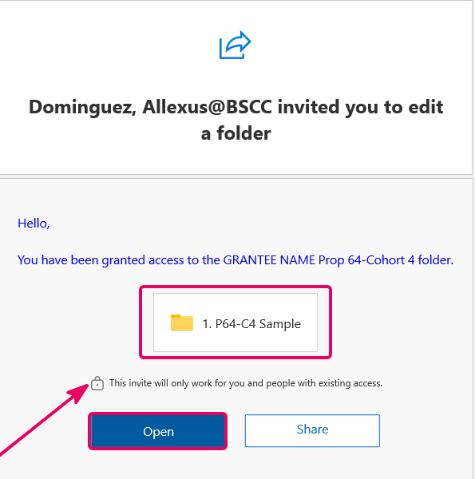
SharePoint grant folder
Notes:
It's important to note that we use the Grantee Contact Sheet to manage SharePoint. Please ensure it is kept up to date at all times.
Once your grant agreement is fully executed, you will receive your access links.
To the left of your screen, you can see an example of the email you will receive from SharePoint.
If you are not already signed in, Microsoft will require you to do-so. Important to ensure you are using the email listed on your GCS.
Once you are in, bookmark the link for easy access.
If you do not see an email in your inbox, Please be sure to check your spam folder!

Slide 4
COMMUNICATIONS
Send All Communications to the Grant Inbox:
Prop64_Grant4@bscc.ca.gov
Program/Scope Specific: | Invoicing, Desk Reviews, Administrative Questions:
To Tony Knapp with the Grant inbox CCd Tony.Knapp@bscc.ca.gov | Grant inbox directly
Notes:
Multiple people managing this grant whom all have access to the inbox
Inquires will be routed as needed
All inquires must be documented/stored in the Grant inbox

Slide 5
COMMUNICATIONS
Please keep your Grantee Contact Sheet updated
  BSCC will only communicate with individuals listed on this sheet
  This sheet grants access to your Prop 64-Cohort 4 folder
Please keep Cohort 3 inquires SEPARATE from Cohort 4
There are 71 Cohort 4 Grantees
  Include agency name in the subject line:
“City of XXX, XXX Dept – Invoice #1 Question”

Slide 6
Supporting Documentation Reminder
Grantees must maintain supporting documentation for all grant expenditures claimed on invoices.
All supporting documentation must be maintained by the grantee on-site and be readily available for review during BSCC site visits (including virtual visits).
Examples:
  Receipts
  Invoices
  Work orders, etc.
Notes:
Reminder:
Grantees must maintain supporting documentation for all grant expenditures.
All Supporting documentation must be maintained by the grantee internally and be readily available for the BSCC as requested.
Sub-recipients or sub-grantees, along with any community based or non-governmental organization you are contracted with, are required to keep the same level of documentation as our primary grantees.
Examples of supporting documentation are receipts, invoices, work orders, etc. Anything following the transactions of your purchases and salaries.

Slide 7
INVOICE SUPPORTING DOCUMENT PACKET
A.K.A. DESK REVIEW
Notes:
The Invoice Supporting Documentation Packet, is referred to as the Desk Review.

Slide 8

Completing the Invoice Supporting Documentation Packet
MUST SUBMIT:
Supporting Document Checklist
Grantee Salaries and Benefits Worksheet
Labeled Supporting Documents
Different than a Quarterly Invoice
Notes:
Desk Review Instructions
Requirement: Submit supporting documentation for all expenditures claimed on the invoice.
Rule: If you claim it, you must document it.
Provide documentation for each item with the exact amounts you want reimbursed.
Process:
Gather and organize all supporting documents.
Label and number them clearly.
Submit for review.
Forms Provided: Use the Grantee Salaries and Benefits Worksheet and the Grantee Invoice Supporting Documentation Checklist.
Forms are in your Grantee OneDrive folder.

Slide 9
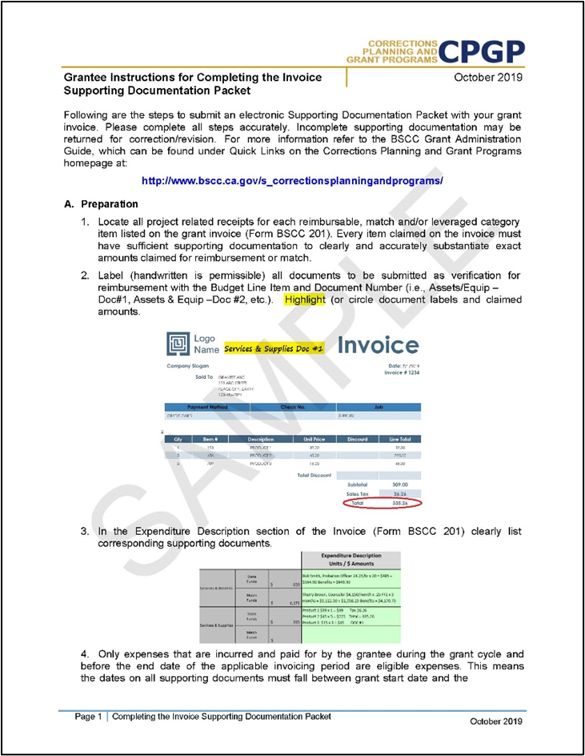
Preparation
Gather and label all project related receipts.
Dates on all supporting documents must fall between grant start date and the end of the applicable reporting period.
Notes:
Preparation steps:
Gather Receipts: Collect all project‑related receipts for each reimbursable item listed on the grant invoice for the reporting period.
Reference Guide: If you have questions, see the updated BSCC Grant Administration Guide on our website.
Label Documents: Mark each document with the budget line‑item name and a document number (e.g., Services & Supplies – Document #1). Handwritten labels are acceptable.
Eligible Expenses: Only costs incurred and paid during the grant cycle and before the end of the invoicing period are eligible.
Date Requirement: All supporting documents must show dates between the grant start date and the end date of the reporting period.

Slide 10
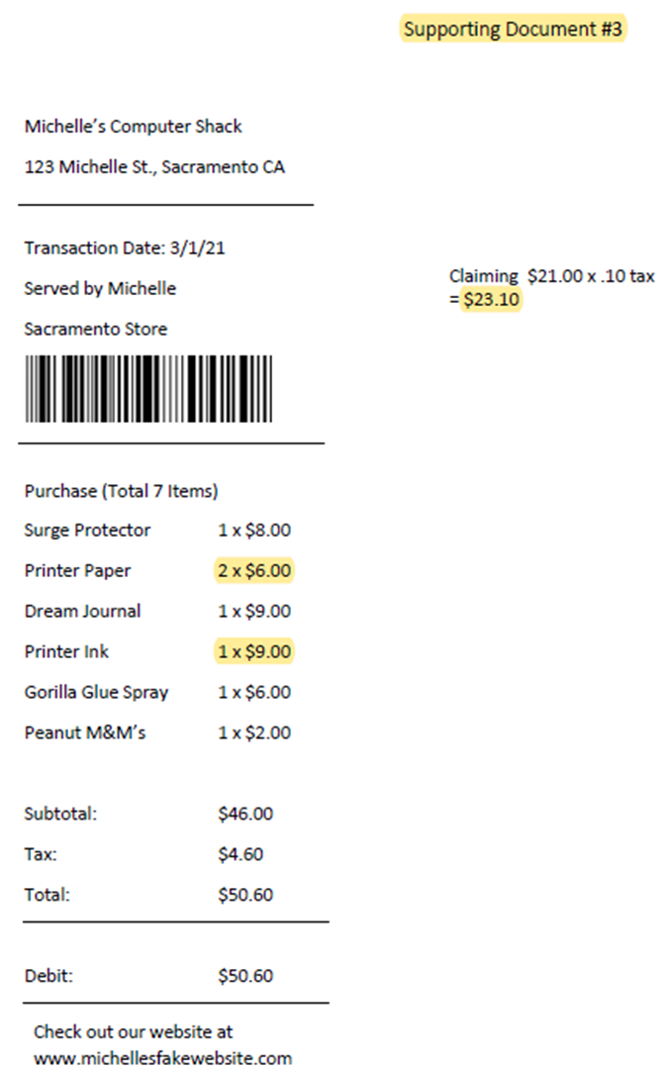
Highlight What You Claimed
Clarify the Total Claim per
document
Show Us the Calculations
Notes:
Let’s go over an example.
Number Each Document: Assign a number to each supporting document (or receipt).
You’ll likely submit several receipts for the quarter, ensure each one is clearly labeled and specifies exactly what is being claimed.
Identify: Make it clear which document corresponds to which claim.
Highlighting: You may highlight or add notes directly on the documents to make them clear.
Mark the specific items you are claiming.
Document tax and shipping fees if you are claiming them.
4. Breakdown: Show the total amount being claimed for those items.
How Can I do this?
Use Adobe to highlight and label if available.
Handwriting and highlighting is fine too (neat and legible).

Slide 11
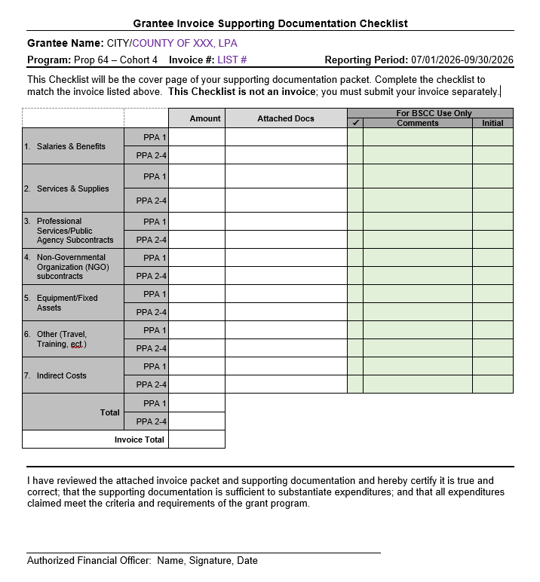
Supporting Documentation Checklist
Required with every Desk Review.
Each invoiced item must include supporting documentation that verifies the exact amount claimed for reimbursement.
You will list the amount and support documents provided for each category here.
Notes:
What is the Invoice Supporting Document Checklist?
Use this checklist to record the amounts claimed on your invoices and link them to the supporting documents.
Write the invoice number and reporting period at the top.
Match categories and line items with your invoice workbook.
Fill in the line items: include the amount and supporting documents for each category corresponding to the claim on said invoice.
Obtain the Authorized Financial Officer’s signature and date at the bottom before submitting.

Slide 12
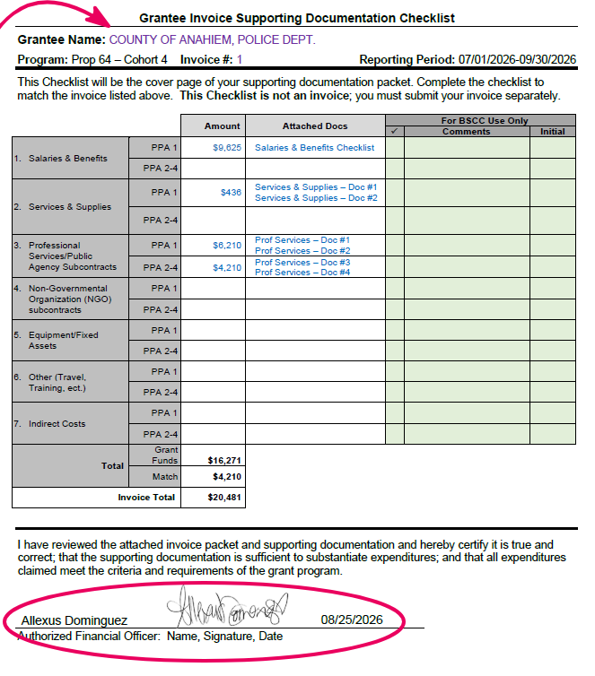
Using the Supporting Document Checklist
Notes:
Using the Grantee Invoice Supporting Documentation Checklist
PP1 & PPA 2-4: Make sure you are documenting which expenses correlate to which PPA (as shown on INV).
Salaries & Benefits: Enter the total grant funds claimed, then attach the Grantee Salary and Benefits Worksheet.
DO NOT SUBMIT TIMESHEETS.
Additional Categories:
List the total amount claimed.
List which supporting documents (by your label) correlates to this claim
Ensure all supporting documents are easy to follow and clearly match the amounts claimed.

Slide 13
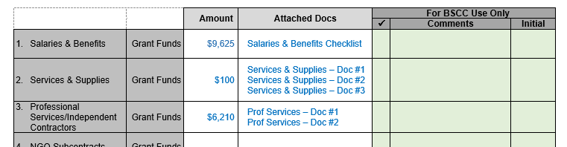
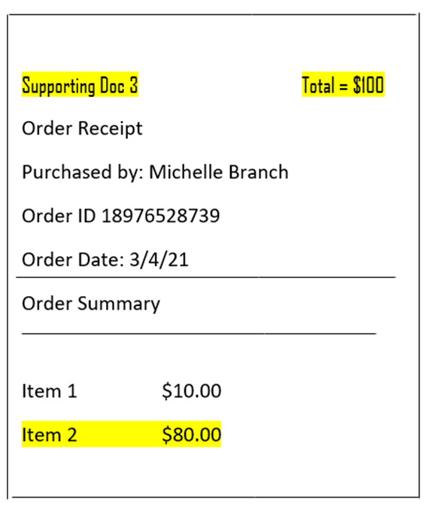
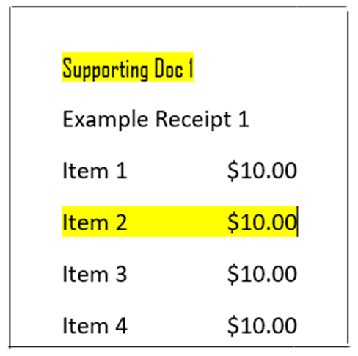
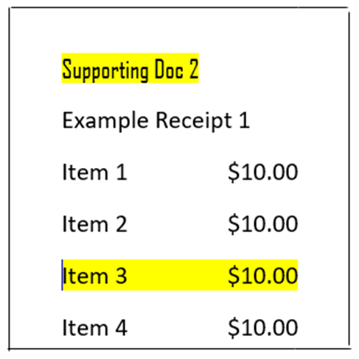
SAMPLE CHECKLIST & LABELING GUIDE
Notes:
Complete Checklist: List each document in the correct line on the Supporting Documentation Checklist.
Desk Review: Expect possible follow‑up questions for clarification
This is normal and ensures everything is complete, especially since this is our first round.
Are there any questions about the desk review or anything else we’ve covered?

Slide 14
Salaries & Benefits Worksheet
NO TIMESHEETS

Slide 15
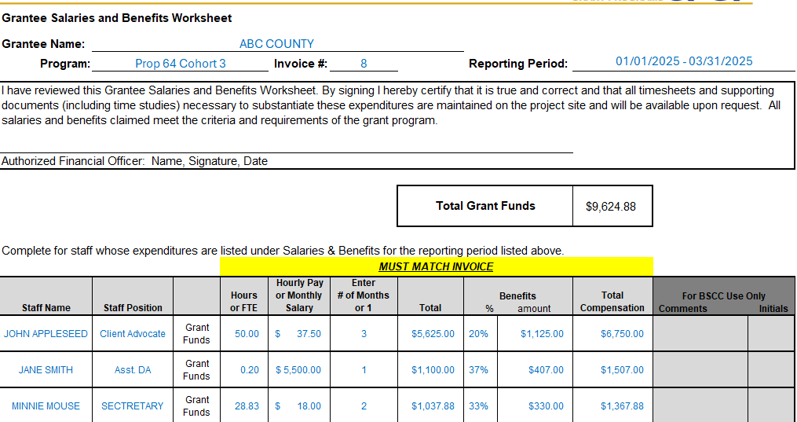
Using the Salaries & Benefits Worksheet
Report Salaries & Benefits by using the Worksheet
Do NOT submit timesheets.
Keep timesheets internal
Notes:
Using the Salaries & Benefits Worksheet:
List each employee’s name and title.
Indicate if they are paid fully or partially with grant funds.
Provide a breakdown of hours, pay, and benefits.
NOTE: Do NOT submit timesheets with Desk Reviews.
Keep them internal.
Timesheets may be requested later during a monitoring visit or by your field representative.

Slide 16
Prop 64 Cohort 4
Notes:
Sample Salaries & Benefits Worksheet
NOTE: Complete a separate line for each employee funded by the grant.
Hourly vs. Salaried:
Hourly → list hours worked and hourly rate.
Salaried → list % of time on project and monthly salary.
Months Claimed:
Salaried → enter number of months (3 for a quarter).
Hourly → enter 1, since hours and rate are already listed.
Totals:
Enter salary claimed, then add benefits (% and amount).
Any questions?

Slide 17
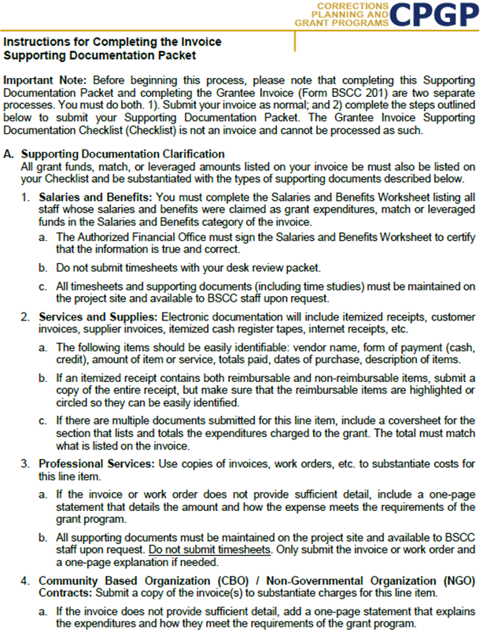
Instructions:
Outlines the type of documentation that should be provided in each category.
Difference in each category; please read instructions you receive for your Desk Review fully.
Notes:
Instructions outline examples of what to submit for each category.
Refer to the BSCC Grant Administration Guide for complete details. (on web)
These Instructions are posted within your OneDrive Folder.
Review Carefully: The instructions explain what is required and how to present it clearly.
Questions: Email for clarification if needed prop64_grant4@bscc.ca.gov
Reminder: Keep BSCC updated on any new Community‑Based Organizations you partner with.

Slide 18
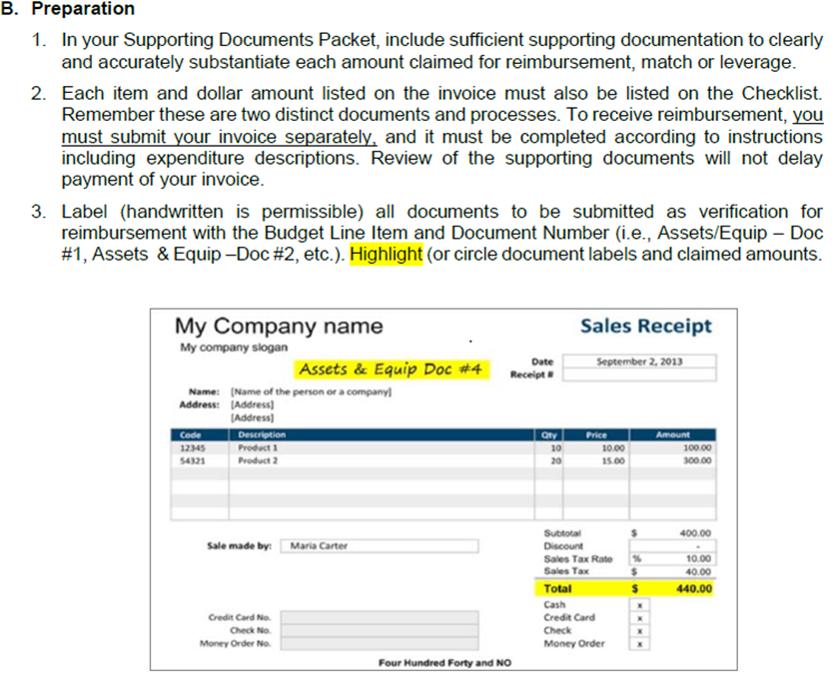
How to assemble and submit the completed Packet.
Invoice Supporting Documentation Packet
Scan into a single PDF in the order outlined here.
Notes:
Ensure all supporting documents are clearly labeled and tied to the correct invoice.
Have the Authorized Financial Officer sign the Grantee Invoice Supporting Documentation Checklist.
Use this checklist as the cover page for the Desk Review Packet.
Combine all supporting documents into a single PDF file for submission.
Include every document reviewed in the process.

Slide 19
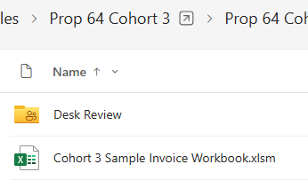
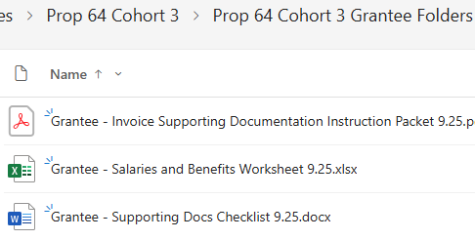

SharePoint Folder
Desk Review Folder
Contents
Need Assistance?
prop64_grant4@bscc.ca.gov
Notes:
Place the completed packet in your Grantee SharePoint folder under the “Desk Drive” folder.
Email prop64_grant4@bscc.ca.gov once it’s uploaded.
Resources: The “Desk Review” folder already contains copies of the Instructions, Supporting Docs Checklist, and Salaries & Benefits Worksheet for your convenience.
Contact me if you need clarification while assembling your packet.

Slide 20

Any
Questions?

Slide 21
Project director (PD) call #1
SAVE THE DATE
NOVEMBER 2 , 2026
Attendees:
  Project Director (Required)
  Day-to-day Program (Required)
  Financial Officer (Required)
  Day-to-day Finance (Required)
  Additional contacts may join at your program’s discretion.
Topics of Discussion:
  Requesting a Modification
  Requesting a Special Request
  Invoicing
  Knowledge Share
  New Information & Upcoming Events
Meeting invitation with formal agenda to come

Slide 22
Thank you for attending
Prop 64 - Cohort 4 Contacts
Programmatic:
Tony Knapp | Field Rep. | Tony.knapp@bscc.ca.gov
Allexus Dominguez | Analyst II | Prop64_grant4@bscc.ca.gov
Research & Data Reporting:
Dr. Emma Welsh | Research Data Specialist II | Emma.Welsh@bscc.ca.gov
Megan Jones | Research Data Specialist I | Megan.Jones@bscc.ca.gov
Ayesha Arata | Research Data Analyst II | Ayesha.Arata@bscc.ca.gov

