Slide 1
Youth Reinvestment Grant
Budget Attachment

Slide 2
We will Cover…
The Budget Attachment for the 2019 Youth Reinvestment Grant RFP
How to locate the Budget Attachment
Budget Line Item Examples

Slide 3
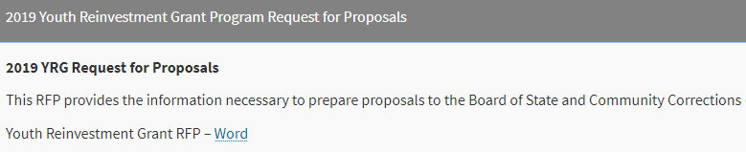
Locating the Budget Attachment
Navigate to the Youth Reinvestment Grant website
http://www.bscc.ca.gov/s_youthreinvestmentgrant/
Expand the 2019 Youth Reinvestment Grant Program Request for Proposals accordion
Select the Youth Reinvestment Grant RFP word link

Slide 4
Locating the Budget Attachment
The budget table and budget narrative are in a separate excel form
The link to the Budget Attachment is built into the RFP on pages 24 and 84

Slide 5
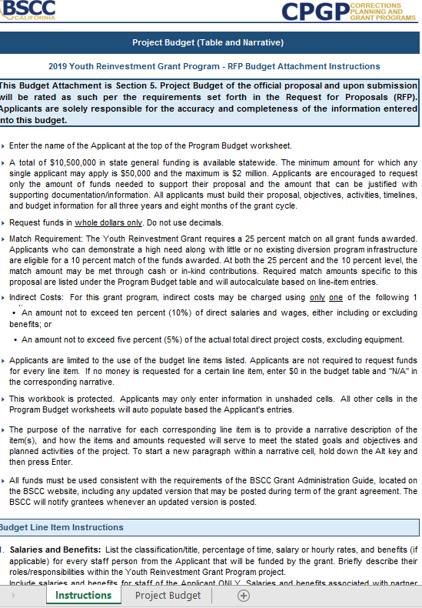
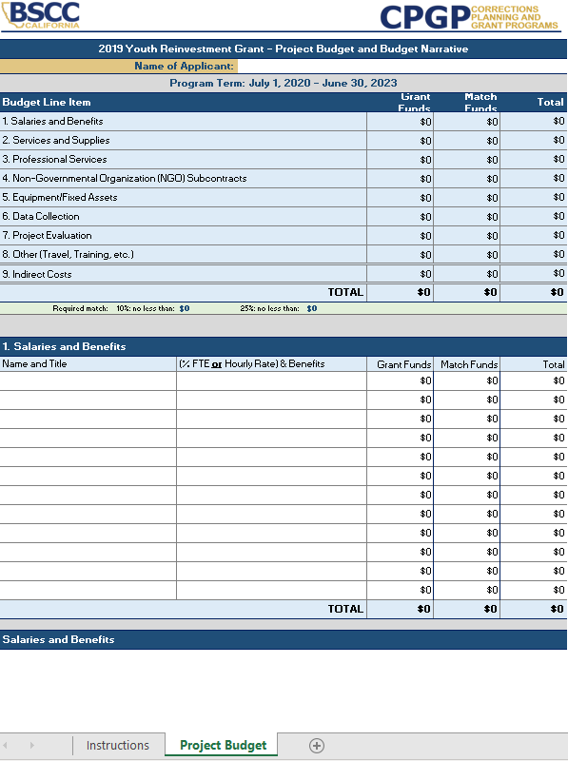
Budget Attachment

Slide 6
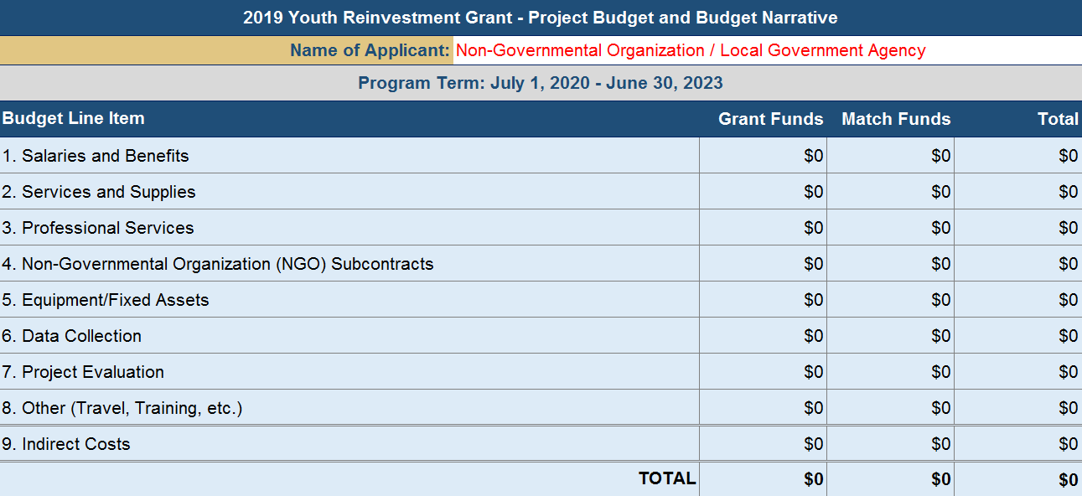
Budget Attachment
Applicants are limited to the budget line items contained in the Budget Attachment
The dollar amounts automatically populate within all blue shaded cells

Slide 7
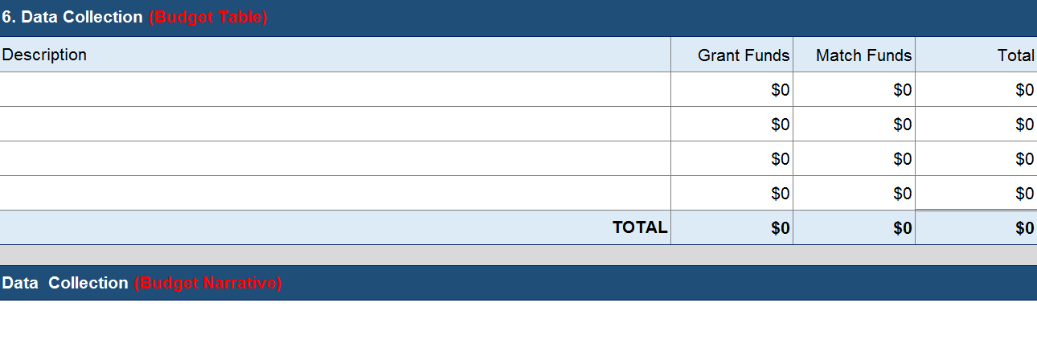
Budget Attachment
Each budget line item will have a budget table and narrative section
Each expenditure shall be listed in the table followed by a description in the narrative
The narrative should describe how the requested expenditure will serve to meet the goals and objectives of the proposed project

Slide 8
Budget Attachment
Applicants must enter their organization/agency information
The budget should reflect the applicant’s budget for the entire grant term (3 years)
Funds must be requested in whole dollars
If no money is requested for a particular line item, enter $0 in the budget table and “N/A” in the corresponding narrative

Slide 9
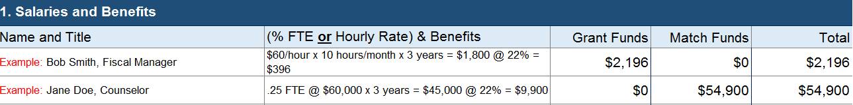
Line Item Examples – Salaries & Benefits
Local Government Agency Applicants
The Applicant should identify staff from their department that will be funded by the grant
The salaries & benefits associated with the required pass-through should be identified in the NGO line item
Nonprofit Organization Applicants
The applicant should identify staff from the organization that will be funded by the grant
The salaries & benefits associated with partner agencies or subcontractors should be included in the applicable line item (e.g. Professional Services, NGO Subcontracts, etc.)

Slide 10
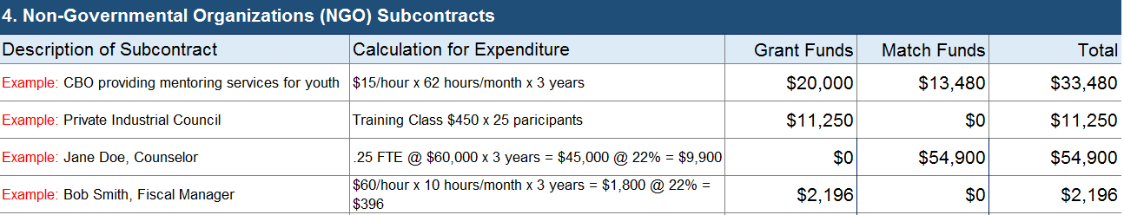
Line Item Examples – NGO Subcontracts
Local Government Agency Applicants
Due to the pass-through requirement, 90% of funding should be identified under this line item
If a community partner has not been selected, identify the amount of grant funds that will be allocated and describe services to be provided
Nonprofit Organization Applicants
The applicant shall identify grant funds associated with NGO subcontracts
The applicant shall identify the amount of funds allocated to each NGO and itemize the services that will be provided

Slide 11
Line Item Examples – Equipment/Fixed Assets
Applicants shall identify the grant funds associated with equipment and fixed assets purchased by the applicant
Equipment and fixed assets are nonexpendable property having a useful life of more than one year and acquisition costs of $5,000 or more per unit
Equipment and fixed assets included in the proposed budget does not guarantee approval; separate and prior approval from the BSCC will be required

Slide 12
Line Item Examples - Other
The applicant shall identify training, travel, or other costs, set aside for such purposes, for use by the applicant
Similar expenditures allocated by partner agencies or subcontractors should be included in the applicable budget line item
Out-of-state travel is restricted and only allowed in exceptional situations; prior approval will be required, even if out-of-state travel is outlined in proposed budget

Slide 13
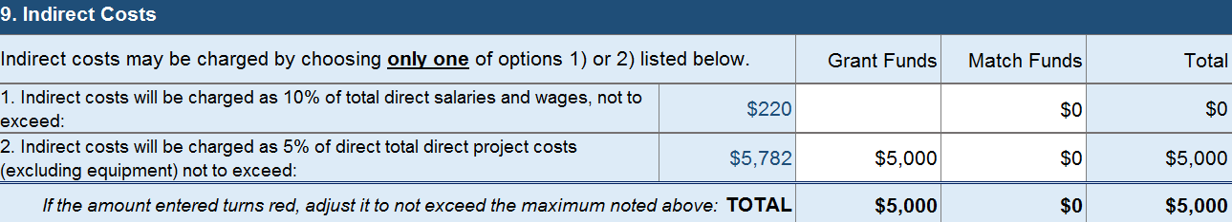
Line Item Examples – Indirect Costs
Applicants can charge indirect costs by choosing one of the following options: 10% of direct salaries and wages, including or excluding benefits or 5% of total direct project costs, excluding equipment
The applicant shall identify the expenses that will be supported by the indirect costs rate

Slide 14
Questions?

Slide 15
Contact Information
Isabel M. Diaz, Associate Governmental Program Analyst
Email: Isabel.diaz@bscc.ca.gov
Phone: (916) 621-2878
or
Youth Reinvestment Grant Inbox
Email: youthreinvestment@bscc.ca.gov

