Slide 1
Bidders’ Conference
Law Enforcement Assisted Diversion (LEAD) Grant Project
LEAD is a registered trademark of the Seattle/King County LEAD Policy Coordinating Group.

Slide 2
Overview of the day
Agenda
Introductions
Housekeeping
FAQs

Slide 3
BSCC Grant Process
Board Authorization
Executive Steering Committee
RFP Development
Fair and Equitable Process
Transparency

Slide 4
Introduction Assembly Bill 843
$15 million
$550,000 for contracts with Evaluators and Technical Assistance
$14,450,000 million for up to three jurisdictions
Purpose:
Improve public safety and reduce recidivism by increasing availability and use of social services while reducing cost of repeated incarceration
Identifies the requirements for
referral of people who may be arrested for, or who have a history of, low-level drug offenses or prostitution, to social services in lieu of prosecution.

Slide 5
Introduction Assembly Bill 1837
Principles :
Provide intensive case management services and an individually tailored intervention plan that acts as a blueprint for assisting LEAD participants.
Prioritize temporary and permanent housing without preconditions of drug or alcohol treatment or abstinence from drugs or alcohol.
Employ human and social service resources in coordination with law enforcement .
Participation shall be voluntary throughout the duration of the program and shall not require abstinence from drug or alcohol use as a condition of continued participation.

Slide 6
Introduction Assembly Bill 843
Gateways to Services
Prebooking Referral
Any of the offenses in subdivision (b)
Immediate referral to case manager for crisis services and to schedule a complete assessment intake interview
Participation in LEAD diversion shall be voluntary - person may decline to participate in the program at any time
Criminal charges based on the conduct for which a person is diverted to LEAD shall not be filed, if the person finishes the complete assessment intake interview within a period set by the local partners, but not to exceed 30 days after the referral.

Slide 7
Introduction Assembly Bill 843
Offenses Eligible for Referral to LEAD:
1. Possession for sale or transfer of a controlled substance or other prohibited substance where the circumstances indicate that the sale or transfer is intended to provide a subsistence living or to allow the person to obtain or afford drugs for his or her own consumption
2. Sale or transfer of a controlled substance or other prohibited substance where the circumstances indicate that the sale or transfer is intended to provide a subsistence living or to allow the person to obtain or afford drugs for his or her own consumption
3. Possession of a controlled substance or other prohibited substance
4. Being under the influence of a controlled substance or other prohibited substance
5. Being under the influence of alcohol and a controlled substance or other prohibited substance
6. Prostitution pursuant to subdivision (b) of Section 647 of the California Penal Code.

Slide 8
Introduction Assembly Bill 843
Social Contact Referral
High risk of arrest in the future for any of the crimes specified in subdivision (b), provided that:
Wants to voluntarily participate.
Verification of prior involvement through:
Criminal history records
Observation
Reliable info provided by another first responder, professional, or a credible community member
Occurred within the LEAD pilot program area
Occurred within 24 months of the date of referral
No pending case in drug court or mental health court
No existing NCO, TRO, or antiharassment order from making contact with a current LEAD participant.
LEAD may accept Social Contact referrals only if there is
capacity after responding to Prebooking referrals

Slide 9
Assembly Bill 843
Services may include
Intensive case management
Temporary and permanent housing that includes individualized supportive services
Individually tailored intervention plans
Medical care
Mental health care
Treatment for alcohol or substance use disorders
Nutritional counseling and treatment
Psychological counseling
Employment
Employment training and education
Civil legal services
System navigation

Slide 10
Assembly Bill 843
Grant funding may be used to support any of the following:
Project management and community engagement.
Temporary services and treatment necessary to stabilize a participant’s condition, including necessary housing.
Outreach and direct service costs for services
Civil legal services for LEAD participants.
Dedicated prosecutorial resources, including for coordinating any nondiverted criminal cases of LEAD participants.
Dedicated law enforcement resources, including overtime required for participation in operational meetings and training.
Training and technical assistance from experts in the implementation of LEAD in other jurisdictions.
Collecting and maintaining the data necessary for program evaluation.

Slide 11
Evaluators
California State University Long Beach (CSULB)
Expert Consultants
LEAD National Support Bureau, Seattle Washington

Slide 12
Seattle/King County LEAD Policy Coordinating Group.
Lisa Daugaard
Director, Public Defender Association
LEAD National Support Bureau
Seattle, Washington
Jim Pugel
Chief Deputy Sheriff, King County
Seattle, Washington
Kris Nyrop
Public Defender Association
LEAD National Support Bureau
Seattle, Washington

Slide 13
Project Description
In addition to the guiding principles established through SB 843, the ESC identified the following foundational approaches are also to be included in the LEAD project design:
The LEAD Grant is to be guided by harm reduction principles.
The LEAD Grant is systems change-oriented – a new role for law enforcement reflecting an integrated approach with collaborative partners and service providers.
The LEAD Grant reflects a shift from the punitive approach for community safety to a psycho-social, public health approach.
The LEAD Grant is to be founded upon the Seattle LEAD model

Slide 14
Project Description
Eligibility
Funding Amounts/ Match
Grant Period
Independent Evaluation
Technical Assistance
Leveraging funds

Slide 15
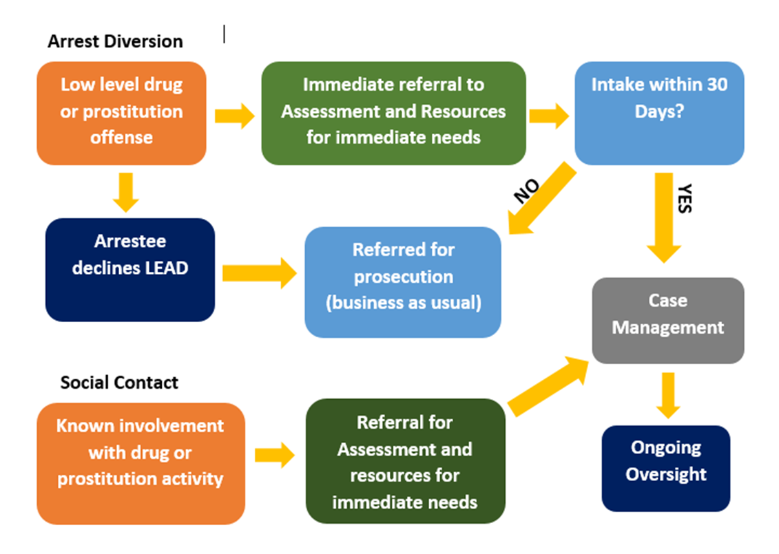
Project Design

Slide 16
Project Design
Key Stakeholder Partners
Key Stakeholder Policy Committee
Community Engagement
MOUs With Individualized Statement of Intent

Slide 17
Project Design
Eligible Participants
Referral Process
Service Area/Catchment

Slide 18
Project Design
Offenses Eligible for Referral To LEAD Program For Prebooking Diversion And Social Contact Referrals
Possession for sale or transfer of a controlled substance or other prohibited substance where the circumstances indicate that the sale or transfer is intended to provide a subsistence living or to allow the person to obtain or afford drugs for his or her own consumption.
2) Sale or transfer of a controlled substance or other prohibited substance where the circumstances indicate that the sale or transfer is intended to provide a subsistence living or to allow the person to obtain or afford drugs for his or her own consumption.
3) Possession of a controlled substance or other prohibited substance.
4) Being under the influence of a controlled substance or other prohibited substance.
5) Being under the influence of alcohol and a controlled substance or other prohibited substance.
6) Prostitution pursuant to subdivision (b) of Section 647 of the California Penal Code.

Slide 19
Project Design
Eligibility Criteria To Be Met For Social Contact Referral To The LEAD Project
1. Verification by law enforcement that the individual has had prior involvement with low-level drug activity or prostitution. Verification shall consist of any of the following: Criminal history records, including, but not limited to, prior police reports, arrests, jail bookings, criminal charges, or convictions indicating that he or she was engaged in low-level drug or prostitution activity. Law enforcement has directly observed the individual’s low-level drug or prostitution activity on prior occasions. Law enforcement has a reliable basis of information to believe that the individual is engaged in low-level drug or prostitution activity, including, but not limited to, information provided by another first responder, a professional, or a credible community member.
2. The individual’s prior involvement with low-level drug or prostitution activity occurred within the LEAD pilot program area.
3. The individual’s prior involvement with low-level drug or prostitution activity occurred within 24 months of the date of referral.
4. The individual does not have a pending case in drug court or mental health court.
5. The individual is not prohibited, by means of an existing no-contact order, temporary restraining order, or anti-harassment order, from making contact with a current LEAD participant.

Slide 20
Project Design
Delivery of Services
Types of services
Harm reduction model
Integrated system
Non- displacement principle
Project manager
Operational work group
Work Plan
Ramp-up Period
Consensus building and training
Evidence-Based Practices
R.E.D.

Slide 21
What Do We Mean By Evidence-based? There are different forms of evidence:
● The lowest form is anecdotal evidence; stories, opinions, testimonials, case studies, etc. – No concrete data but it often makes us feel good
● The highest form is empirical evidence – research, data, results from controlled studies, etc. - but sometimes it doesn‘t make us feel good

Slide 22
Evidence-based Means…
Doing “what works”.
This means evidence exists that the program or intervention is effective in reducing recidivism.
Effectiveness is demonstrated through empirical research – not stories, anecdotes, common sense, or personal beliefs about effectiveness.

Slide 23
Research says that services and interventions can be effective in reducing recidivism, however, not all programs are equally effective…
The most effective programs are based on principles of effective intervention:
Risk (Who)
Need (What)
Responsivity (How)
Fidelity (How Well)

Slide 24
EBP and the LEAD Grant Project
The use of EBP is woven into the rating criteria.
Applicants should be able to adequately describe the evidence that demonstrates the proposed intervention will work.
Describe why it is suited to the need and objectives described in the application for funding.
How the principles of effective intervention are addressed in the project

Slide 25
What is the R.E.D. Initiative?
The Racial and Ethnic Disparity (R.E.D.) Initiative refers to reducing the overrepresentation of individuals of color who come into contact (at all decision points along the continuum) with the justice system relative to their numbers in the general population.

Slide 26
Attorney General Announces OpenJustice, 9/2/15
“There are large racial/ethnic disparities in arrest rates that hold across men and women. African Americans are the most likely to be arrested at any age, most notably between 18 and 40. Asians have the lowest arrest rates.”
https://openjustice.doj.ca.gov

Slide 27
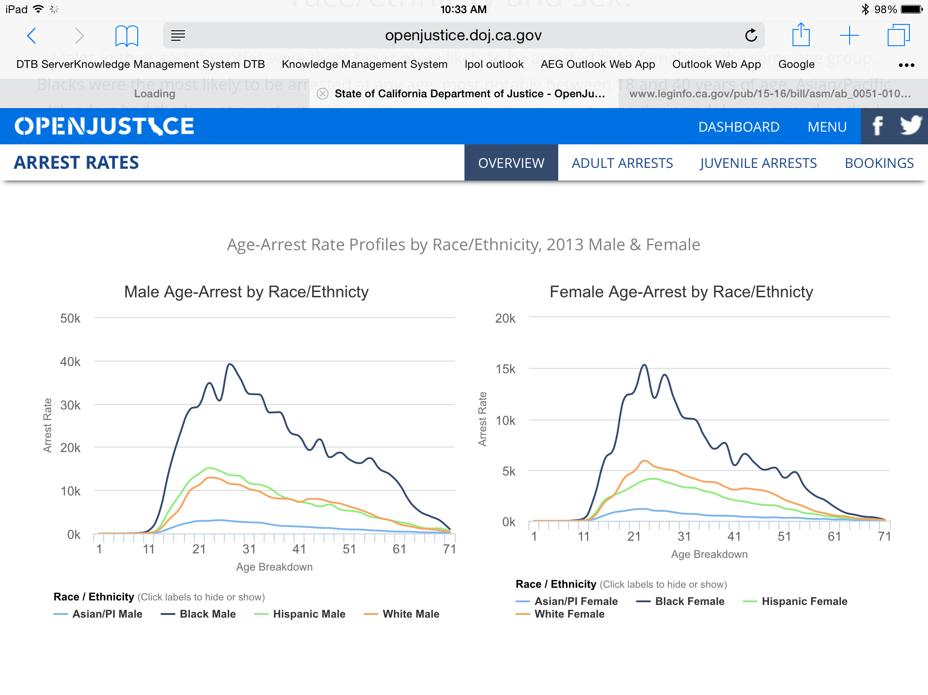

Slide 28
R.E.D. and the LEAD Grant Project
Although R.E.D. is not specifically factored into the rating criteria for the LEAD Grant project, it is a good practice to ask questions during proposal development and throughout program:
How do local departments measure effectiveness with underserved communities?
How does the agency deal with issues of linguistic diversity?
Do you explore relationships with the community relative to the LEAD project?
Does your project reflect specific needs of diverse communities?

Slide 29
Key Tools/Strategies to Reduce R.E.D.
Development of structured decision-making instruments (e.g., booking protocols, risk assessment tools, etc.).
“Competency” scan of policies and practices to reduce individual and structural bias against communities of color (e.g., bed assignments, race neutral policies that produce differential outcomes by race/ethnicity, etc.).
Evaluation of “systems” to prevent structural bias in communities of color (e.g. handling processes, reconciling differential paradigms of justice, etc.).
Procedural Justice: transparency, consistency, community buy-in.

Slide 30
For more information about R.E.D.:
Contact: Nicole Woodman, Field Representative and R.E.D. Lead
916/322-1427
nicole.woodman@bscc.ca.gov

Slide 31
Grant Requirements
Grant Agreement
Match
Governing Board Resolution
Audit
Orientation - TBD
Invoicing-Quarterly
Progress Reports-Quarterly

Slide 32
Grant Requirements Cont.
Monitoring
Periodic monitoring by BSCC for program and fiscal and to provide technical assistance and training
Technical Assistance with National LEAD Bureau
Grantee meetings and training
Fidelity to the model

Slide 33
Grant Requirements Cont.
Independent Evaluation
CSULB
Grantees must be able to cooperate fully and work closely with evaluators, provide required data and meet timelines.
Identify performance objectives that demonstrate recidivism reduction and other outcomes are due to project’s methodologies
Identify process for determining whether performance targets have been met
Conduct a control group study research design

Slide 34
The RFP Process After Your Proposal Is Submitted...
Technical Compliance Review
Proposal Evaluation Process
Point value weights given to each section of the application
Minimum scoring threshold
ESC recommendations made
Board Approval

Slide 35
Review of Key Dates
TENTATIVE TIMELINE | ACTIVITY
February 1, 2017 | Proposals due to BSCC
February 2 - 8, 2017 | BSCC Technical compliance review
February 15, 2017 due | Non-substantive changes due by noon
February 22, 2016 | Rater training
February 19 – March 8, 2016 | Proposal reading and rating process
March 22, 2017 | Funding recommendation based on reading/rating process and review/approval by ESC
April 20, 2017 | Present funding recommendations to the Board
April 21, 2017 | Contract start date
TBD May 2017 | Grantee orientation

Slide 36
Proposal Instructions
Section I, I(a), VII(b), VIII, IX and X are tables and do not count toward 25 pg limit
Sections II - VII (a) are narrative
25 page limit for narrative (12pt Arial font 1.5 spacing, one inch margins)
Point value assigned to each section

Slide 37
Proposal Instructions
Proposal Checklist
Project Abstract
Project Work Plan
MOU with Statements of Intent
Governing Resolution (if available prior
to proposal submission)
Optional Docs:
Geographical Map of Service Area
Endnote Page

Slide 38
Roadmap
To-Dos:
Read the RFP
Read and be familiar with SB 843 Legislation
Engage Stakeholder Partners
Determine Need
Commit 10% Cash Match
Select Service/Catchment Area
Determine Outcomes
Identify/Select Services, Resources & Providers
Develop Work Plan

Slide 39
Review
&
Wrap-up

Slide 40
Submit additional questions about the LEAD Grant or RFP to:
Daryle McDaniel
daryle.mcdaniel@bscc.ca.gov
Colleen Stoner
colleen.stoner@bscc.ca.gov

